Slide 1



Uniqueness and Entrepreneurship
Ethan S. Altshuler
Savannah College of Art and Design
GDVX-565 MA Candidacy Review
Friday, May 3rd, 2024
Notes:
Hello everyone, good morning/afternoon.
Thank you all so much for being here and being a part of my candidacy review.
I’m excited to present to you Uniqueness and Entrepreneurship.
As you will learn, the combined aspects of both uniqueness and entrepreneurship tie into both my personal growth and my chosen company for my candidacy review.

Slide 2
Executive Overview
Statement of Purpose
Personal Journey
Project Narratives
  Mind Video & Nature’s Mind Exhibit
  I and Love and You Typographic Video
Balaguer Guitars
Final Deliverable — Customized Instrument Design on T-Shirts
Notes:
Read slide

Slide 3
Statement of Purpose
An evolutionary journey
Artist, creator and designer
Peak moments from childhood until now
Combined passions of art and music
And so the journey begins!
Notes:
Read slide

Slide 4
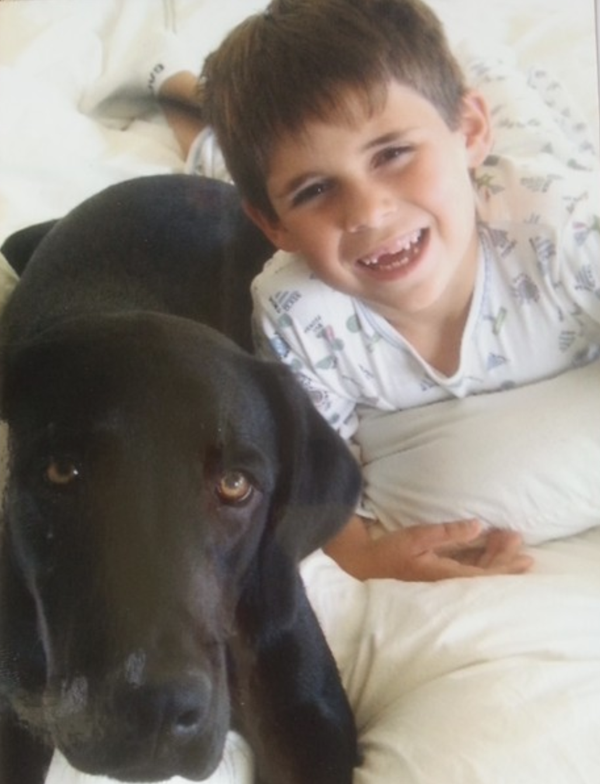
Personal Journey
I have been creating art since age 3
Notes:
I have been creating art since age 3.
As a graphic designer, illustrator, and artist, I think visually and create content using an eye for perspective, along with having a precise attention to detail and the ability to see movement.
Given my Asperger’s diagnosis at 2 ½, my unique creativity is very reflective of who I am as a person, and I am empowered to share my creative abilities with the world and make a difference!
I have had the opportunity and privilege to create freelance work for various clients outside of SCAD.
Additionally, I have offered to sell my art to raise money for Neuro Talent Works, which is an organization that advances neurodiversity inclusion in the workplace by connecting employers to neurodivergent talent.

Slide 5
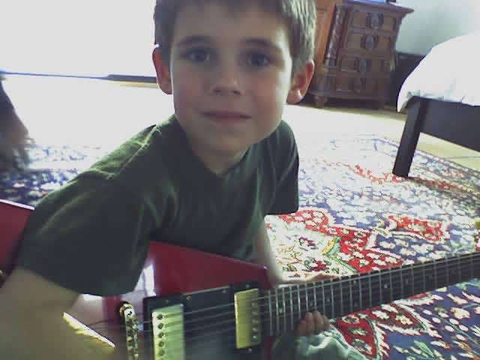
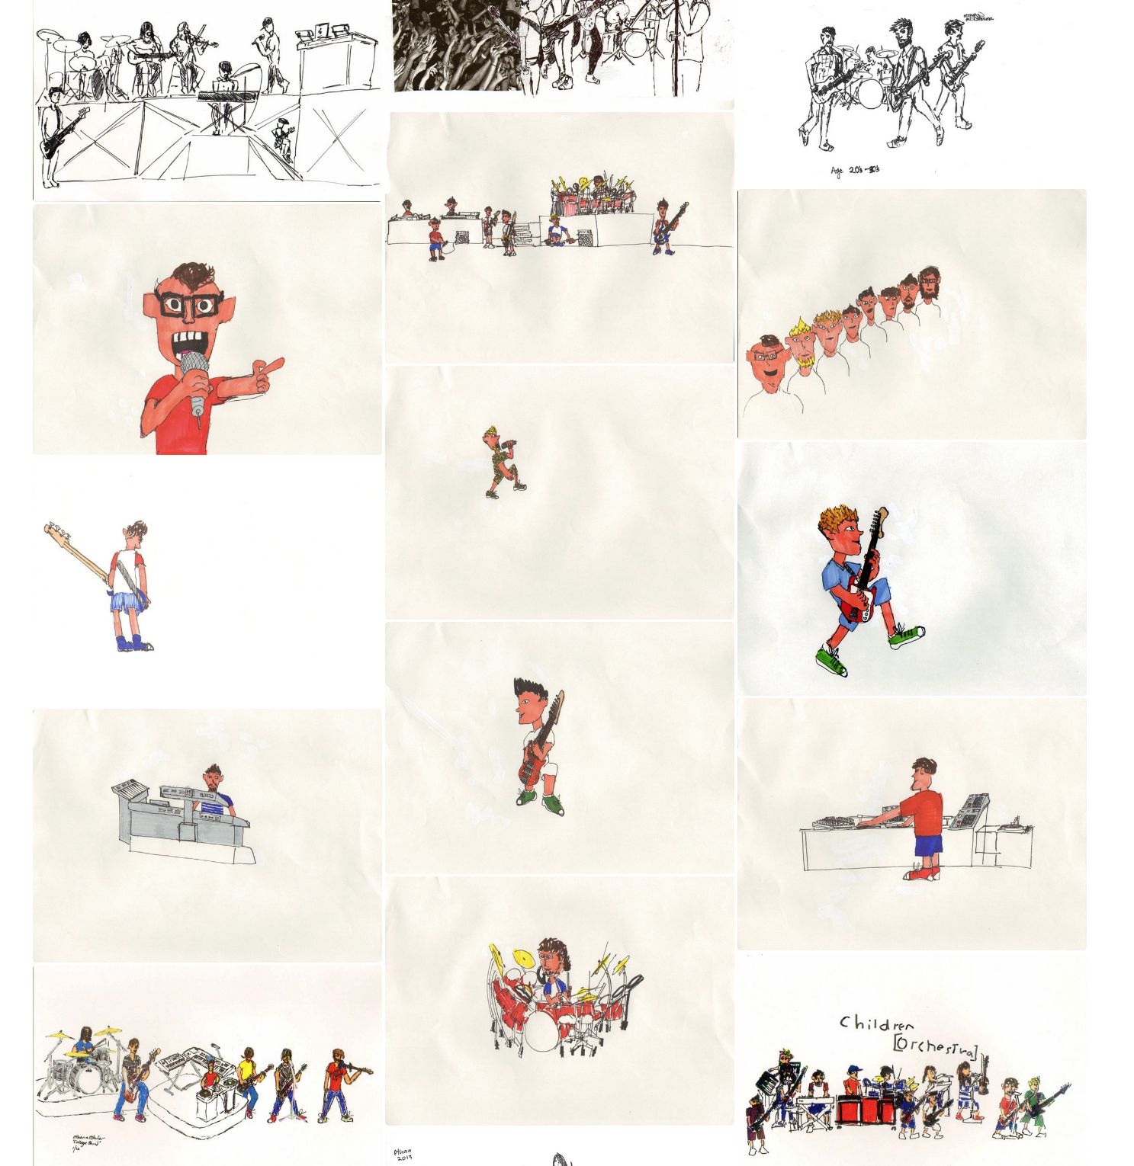
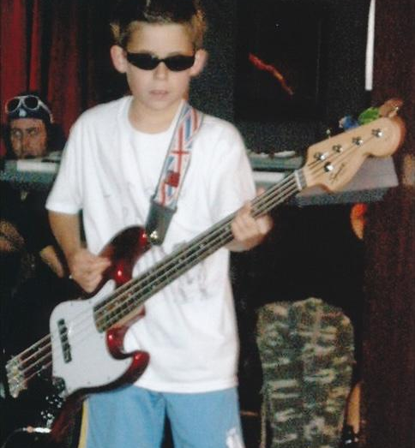
Rock n’ Roll caught my attention early
Personal Journey
Notes:
As you can see in the top picture, I am seen playing my oldest brother’s old Gibson Flying V at age 5 in 2004
Below in 2009, I am seen performing with a music program at age 10
On the right, you can see a series of some of my rock n’ roll/band art using sharpies on paper

Slide 6
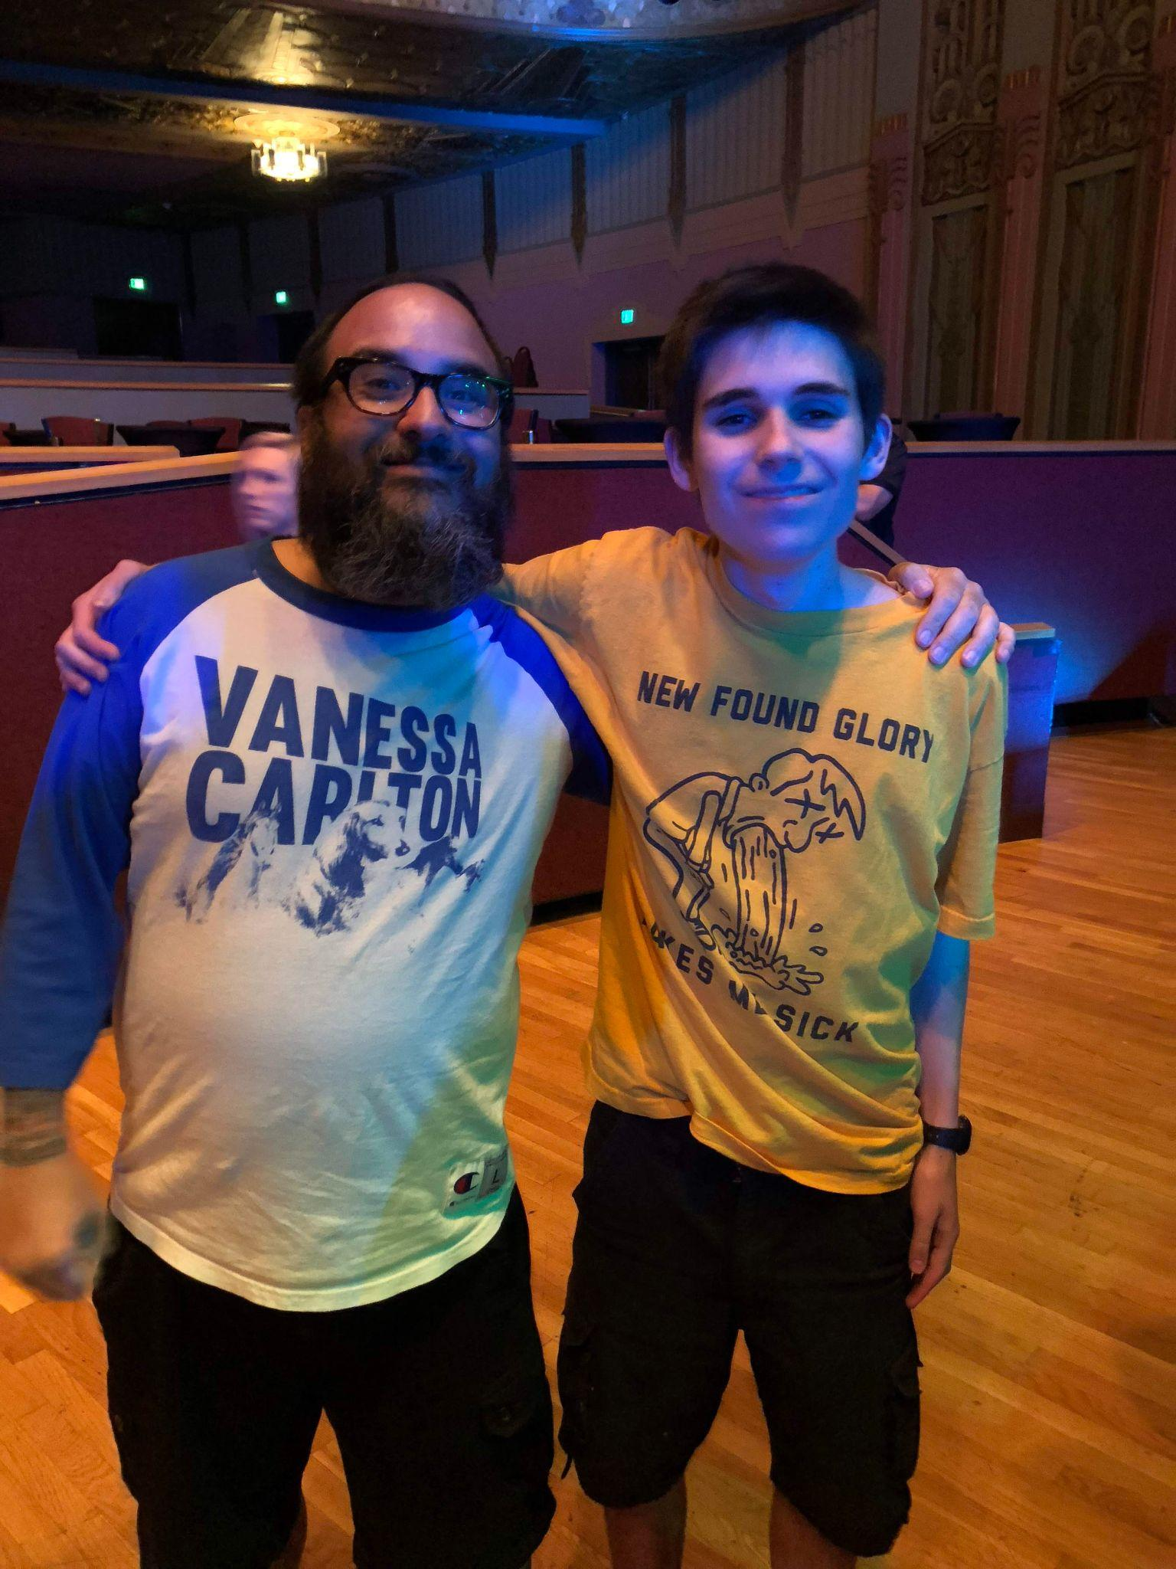
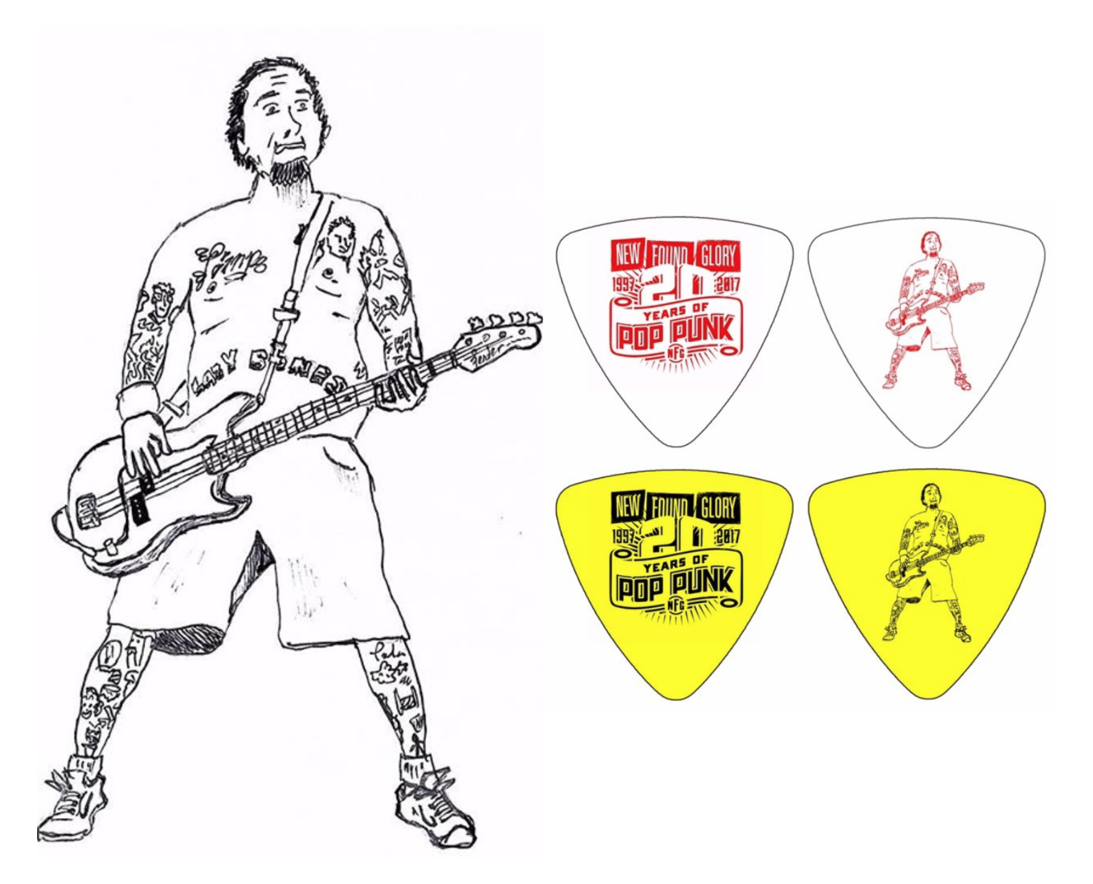
New Found Glory
featured my artwork
Personal Journey
Myself and New Found Glory bassist Ian Grushka
Notes:
I freehand drew this picture of Ian as a reference image while looking at my phone during class one day in high school.
I gave it to him at an album release party of theirs in 2017 and to my surprise a couple weeks later, he direct messaged me on Instagram with a picture of my drawing of him on bass picks that he would throw out to the audience at each of their shows, and even mailed me some myself!!

Slide 7
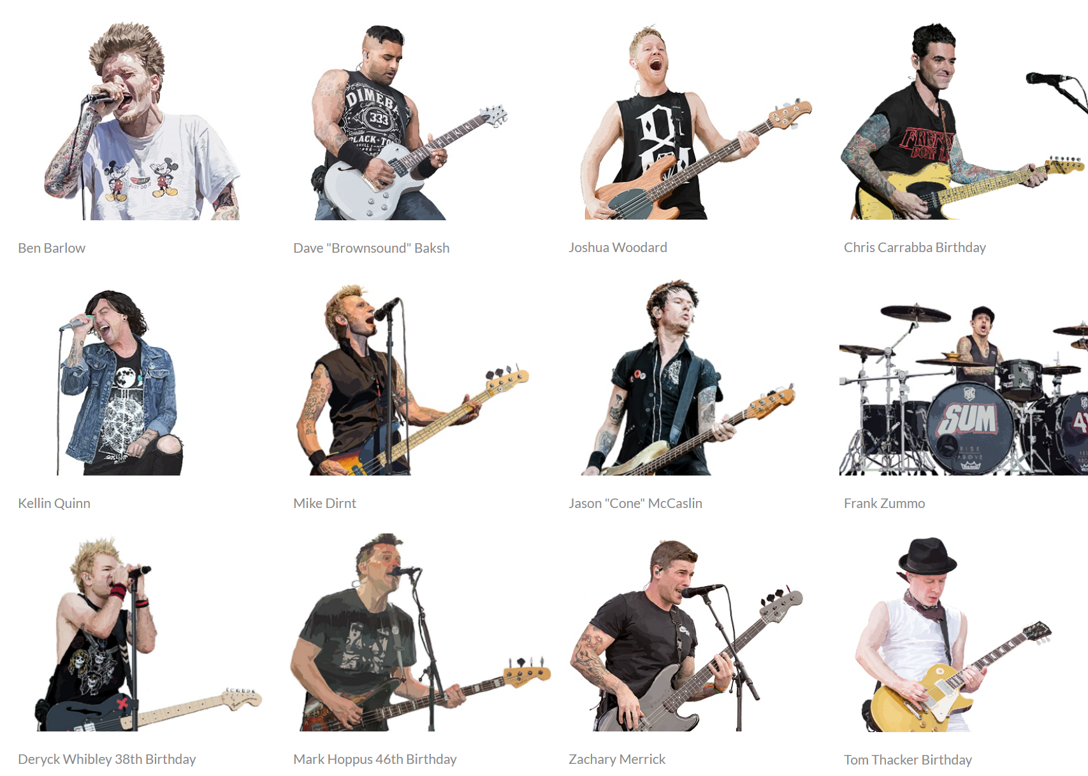
Connecting with bands and artists within my genres
Personal Journey
“Explorimented” — Explored + Experimented
Notes:
Semantics
Speaking of semantics, I accidentally came up with a word after getting tongue tied between two words “Explored” and “Experimented” which resulted in “Explorimented”, which is literally what I do, as I explore and experiment throughout my creative outlets of music and art
Upon entering my first year of college, I explored creating art digitally using a wacom tablet and a stylus and working with software programs such as Adobe Photoshop and Illustrator

Slide 8
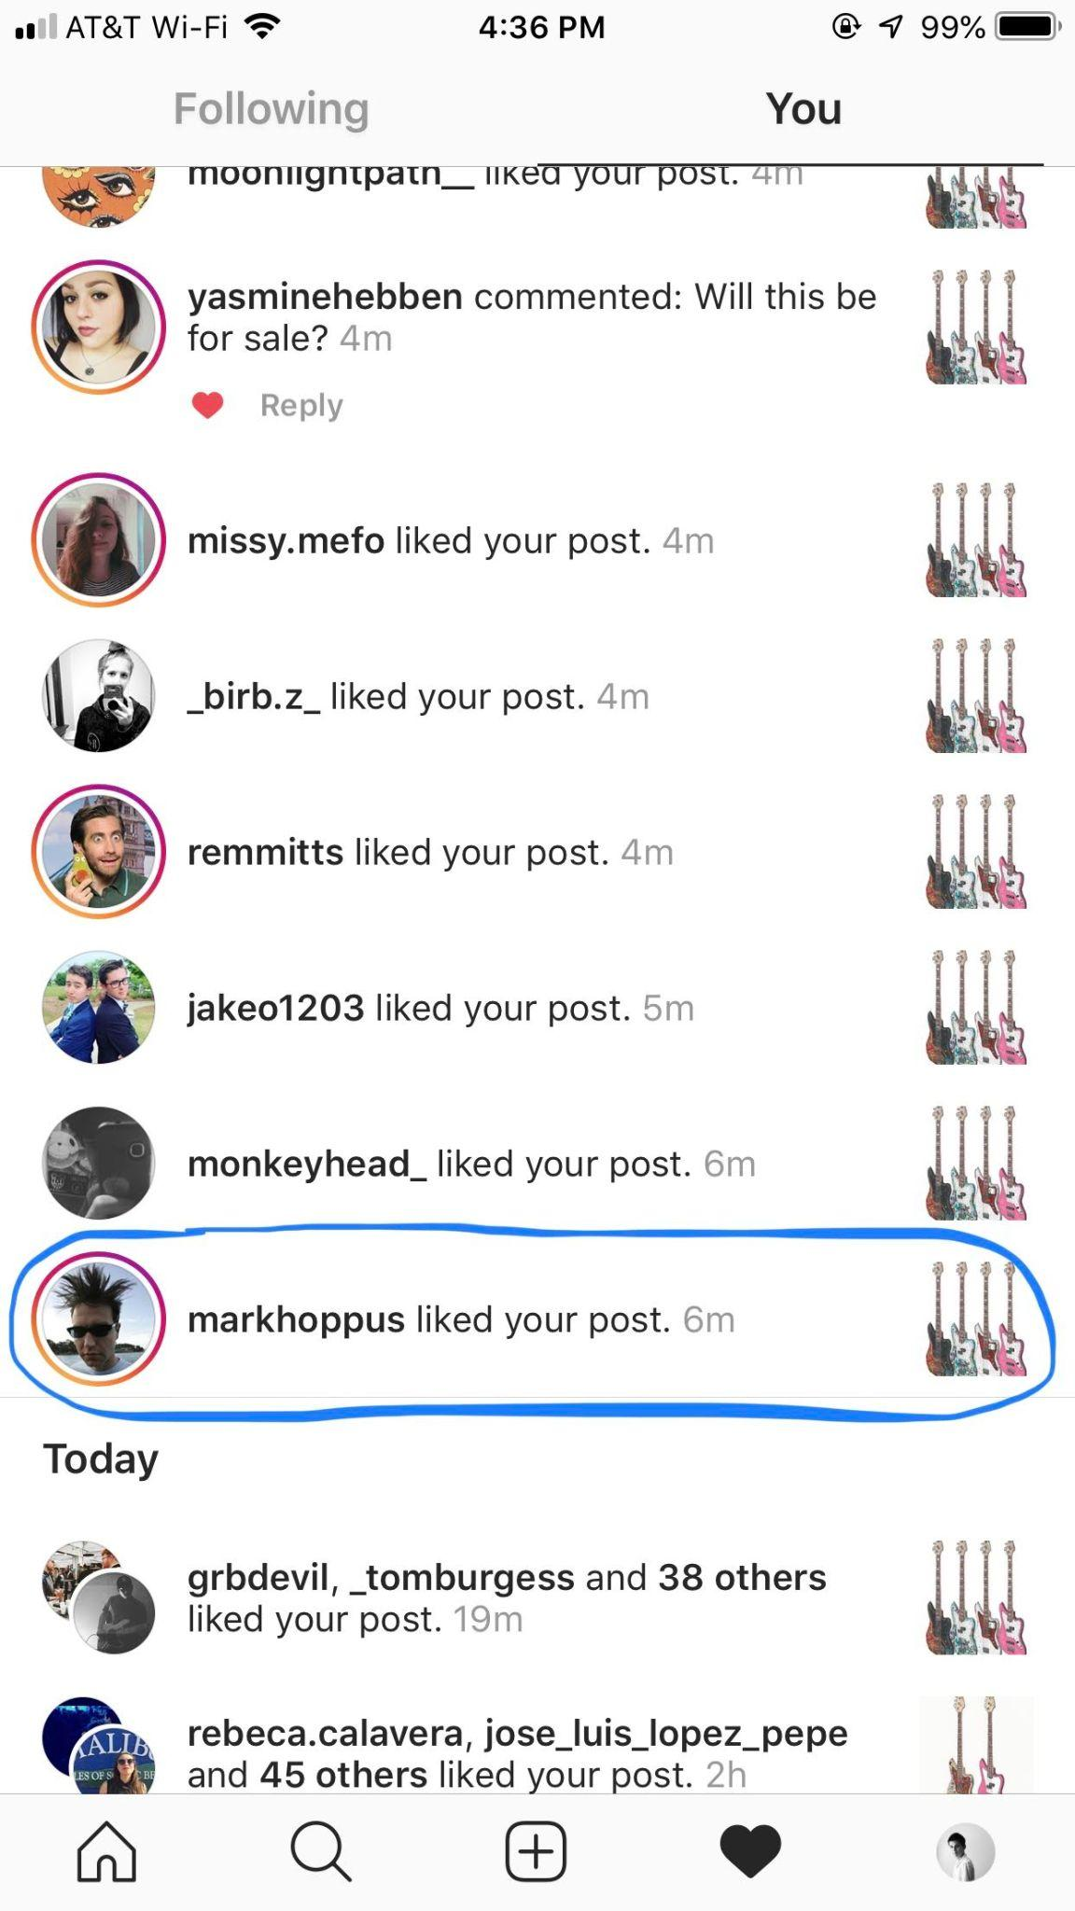
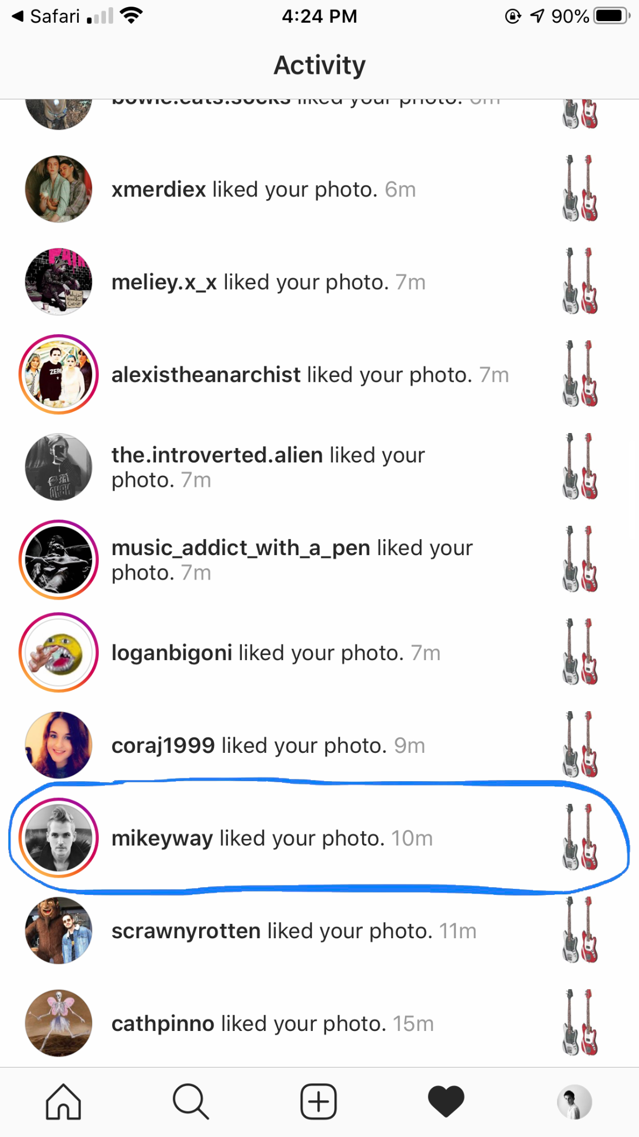
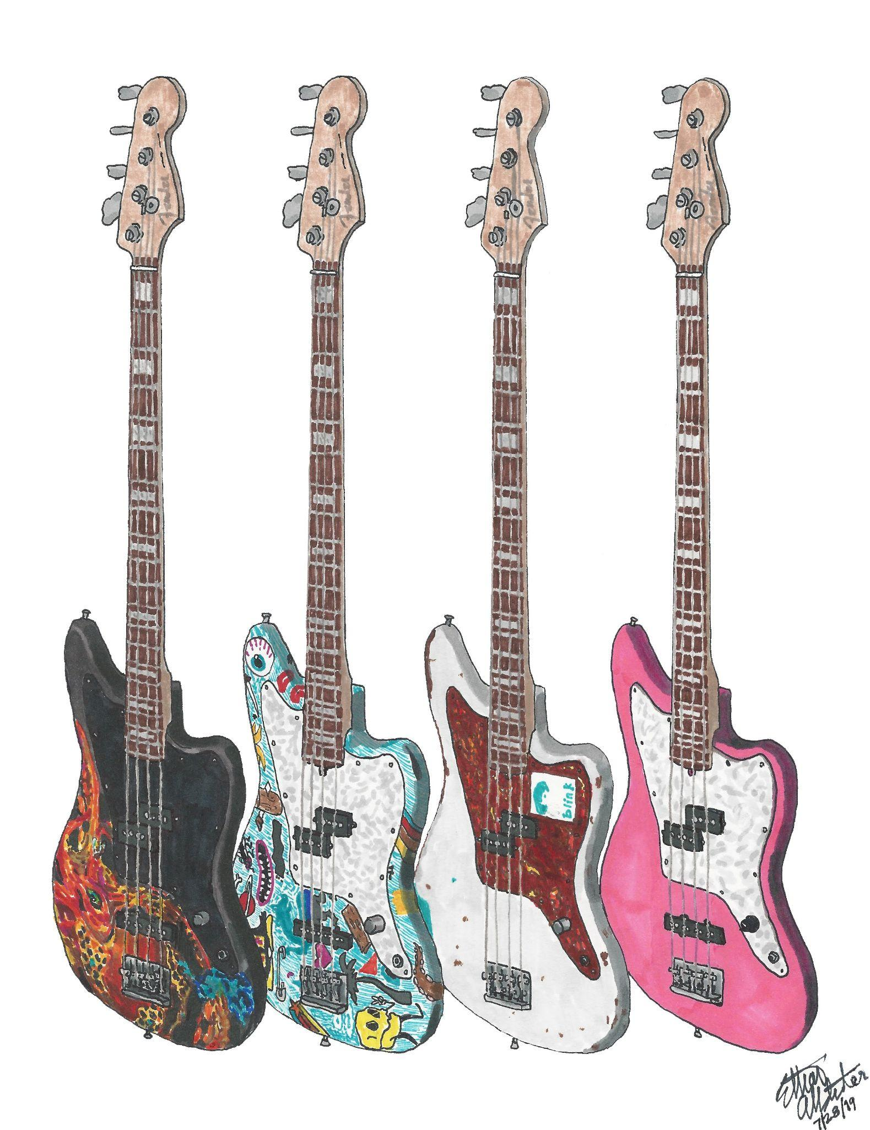
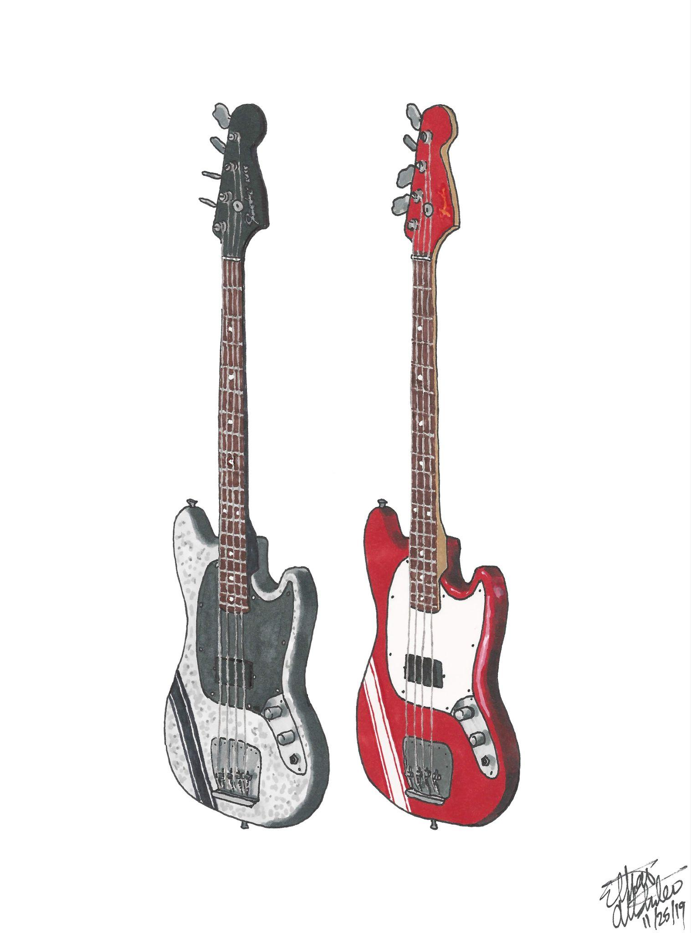
Mark Hoppus & Mikey Way liking and reposting my art
on their Instagram stories
Personal Journey
blink-182
My Chemical Romance
July 2019
November 2019
Notes:
My hand drawn art caught the attention of the actual pop punk & emo legends themselves!!

Slide 9
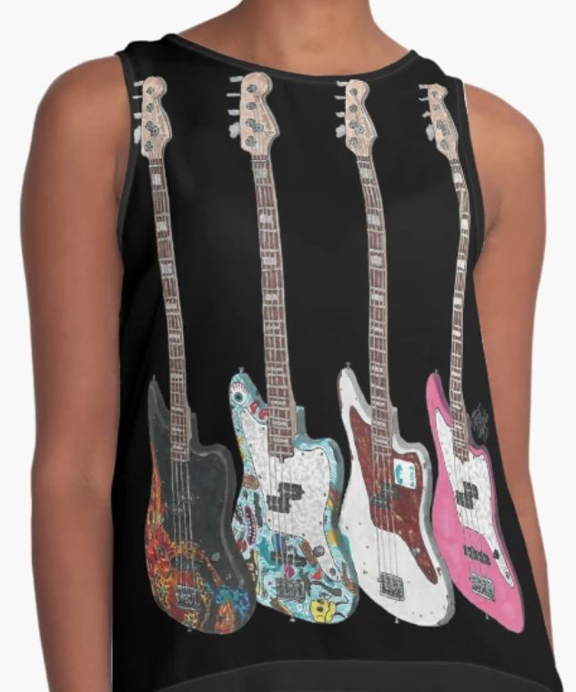
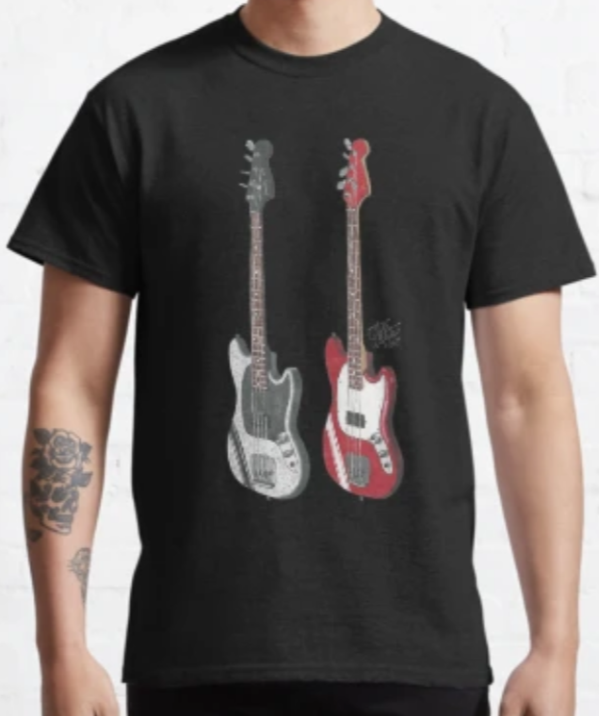

Personal Journey
I’m an entrepreneur
My line of merchandise was designed to reach as many demographics as possible as well as to gain recognition and build my brand
Notes:
Being an entrepreneur myself, I can only imagine how difficult it must be to start something from the ground up.
That is exactly why I applaud Joe Balaguer, founder and CEO of Balaguer Guitars, which is my company of choice for my candidacy review project, which we will review momentarily.
I deeply admire his courage and determination, as well as the reasons for why he founded his own company, which was to “make his guitars feel more personalized and affordable to a wide variety of clients.”

Slide 10
Graduate Studies
Savannah College of Art & Design
  Mind Video & Nature’s Mind Exhibit
  I and Love and You Typographic Video
  Balaguer Guitars
Notes:
I have embarked on my journey to SCAD as a Graphic Design & Visual Experience Master’s student.
These three projects that I’m about to present, which were completed during my graduate studies, illustrate technical skills, emotional connection and my sense of purpose.

Slide 11
Mind Video & Nature’s Mind Exhibit
  Mind Video Precedes the Museum Exhibit
  Common Theme: Uniqueness
  Very Deep and Philosophical
Notes:
Professor Fano, Ideation Models & Process, GDVX-702, Fall 2023
[Give thanks to Prof. F if he’s one of the panelists]

Slide 12
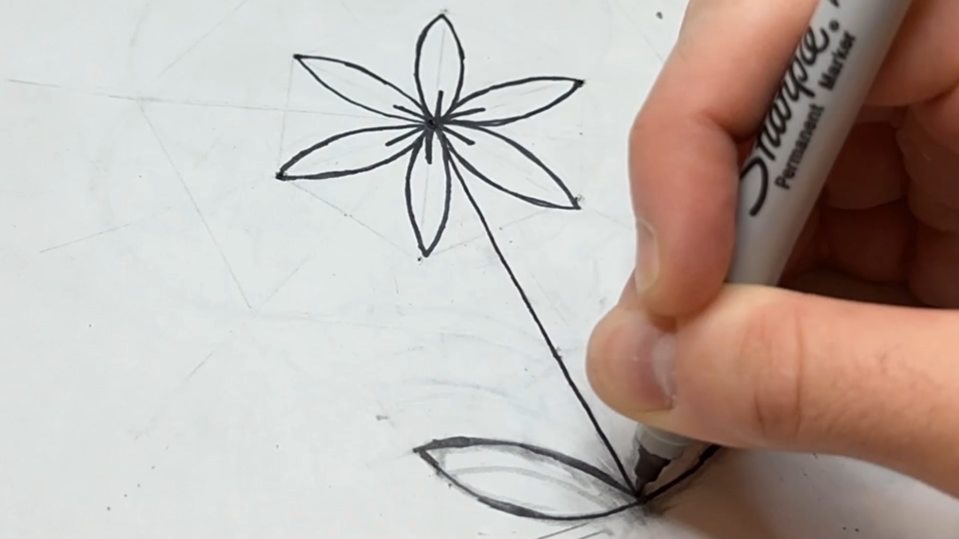
Mind Video
Notes:
Play video

Slide 13
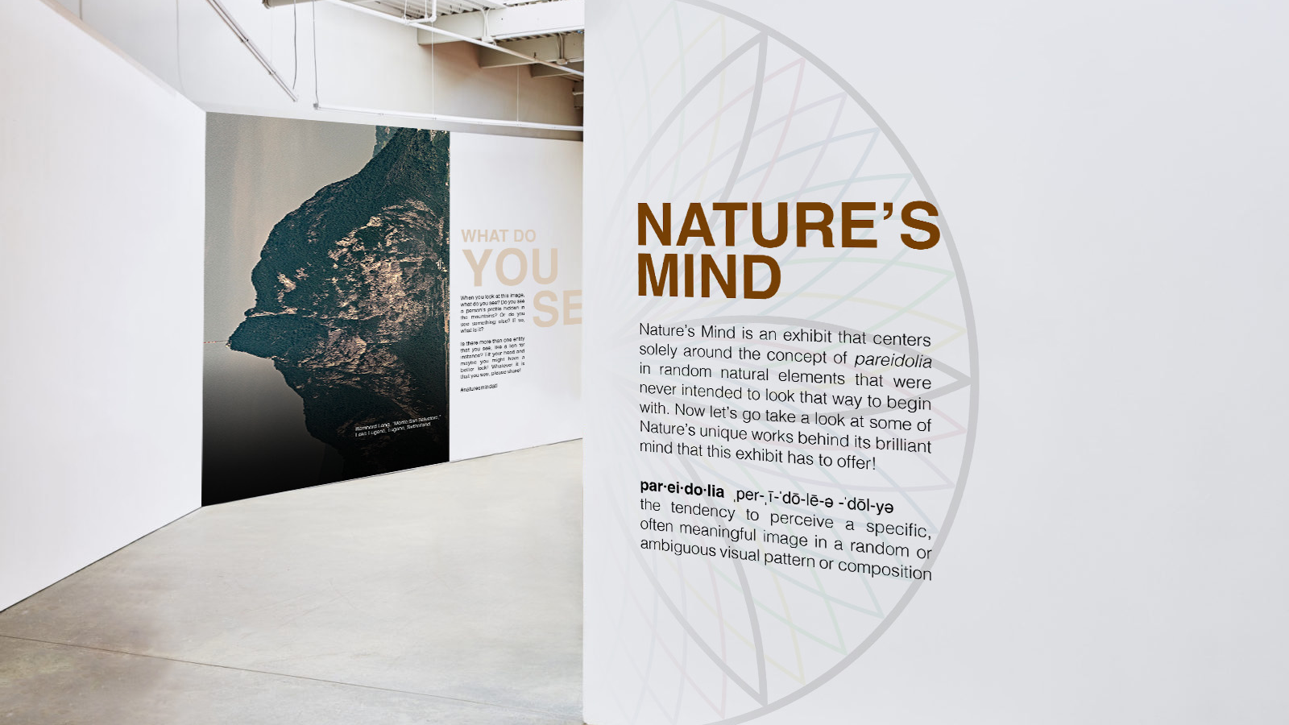
Nature’s Mind Exhibit
Notes:
With that in MIND, what started as a keyword with the word mind chosen ended up becoming the video you just saw and now this museum exhibit called Nature’s Mind which I would like to present to you now.
Take a breath.
[Explain the concept of pareidolia. Say what the exhibit is about.]
[Open the pdf. Take time on each slide and point out hidden resemblances on each visual.]

Slide 14
I and Love and You
  Typographic Video
  Lighthearted
Notes:
Professor Wong, Typographic Voice and Visual Narrative, GDVX-734, Winter 2024
First of all, I want to give a big shout out to Professor Wong who’s here with us today for being such an absolute wonderful professor during the Winter quarter

Slide 15

I and Love and You
Notes:
Play video
Everyone put your hands up!
I wanted to showcase Professor Wong’s typographic video here because it was an opportunity to sharpen my technical skills and experiment with the fundamentals of typographic hierarchy in Adobe AfterEffects

Slide 16

Balaguer Guitars Process Book
Notes:
Now. The time has finally come to dig into my candidacy review project and deliverable.

Slide 17

Balaguer Guitars
  Research Results
  Project Description
  Final Deliverable — Customized Instrument Design on T-Shirts
Notes:
Methodology —
I chose the music industry because I’m a passionate musician who wants to enter this industry
I started looking at larger well-known brands like Fender and Gibson but was advised by Assoc. Chair Eckersley to look for a smaller, lesser well-known company that would not only be less bureaucratic but more accessible, and boy was he right!
Why I chose Balaguer — I chose Balaguer because of the uniqueness of their value proposition which I’m gonna explain momentarily, as well as their entrepreneurial spirit, which were two astounding attributes that resonated with me and my journey at SCAD

Slide 18
Joe Balaguer
Interview Response
Notes:
One of the delightful results of this candidacy review was my direct communication with the founder and CEO of Balaguer Guitars himself, Joe Balaguer, who was also kind enough to review my survey in addition to allowing me to share it on his private Facebook Group timeline.
I even presented him with a series of questions to help me better understand his company from the inside out, and having this form of direct communication with him was nothing short of profoundly impactful.

Slide 19
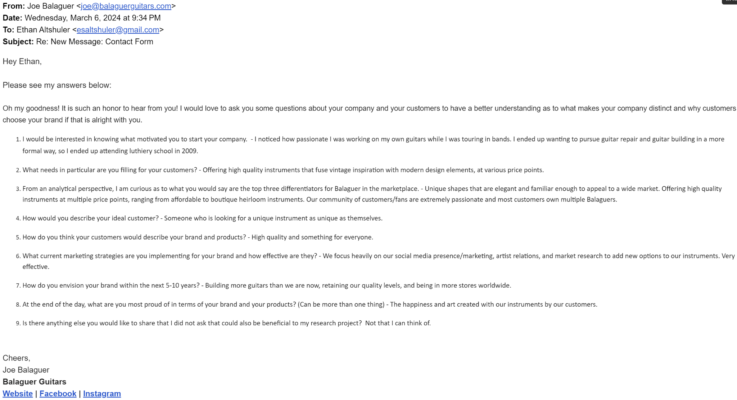
Notes:
Evidence slide
[Only show for like a second and then move onto the next slide]

Slide 20
Balaguer Guitars’ Main Objective
Put customers center stage with an instrument of their own that is unique and affordable
The uniqueness that comes with these custom builds is reflective of the artists as both a person and a player
Notes:
What I took away from my interview with Joe is that:
Balaguer Guitars’ main objective is to put customers center stage with an instrument of their own that is unique and affordable.
The uniqueness that comes with these custom builds is reflective of the artists as both a person and a player.
This plays a pivotal role in solidifying the company’s relationship with existing and prospective customers.

Slide 21
Demographic Analysis
Balaguer appeals to:
Notes:
What you are about to see are the results collected from a Google Forms survey I conducted which Joe personally reviewed and encouraged his followers to fill out through his private Facebook group chat.

Slide 22
Demographic Analysis
Balaguer appeals to:
Mostly between 25-50 yr. olds

Slide 23
Demographic Analysis
Balaguer appeals to:
Mostly between 25-50 yr. olds
Wide income range

Slide 24
Demographic Analysis
Balaguer appeals to:
Mostly between 25-50 yr. olds
Wide income range
Predominantly male gender demographics

Slide 25
Demographic Analysis
Balaguer appeals to:
Mostly between 25-50 yr. olds
Wide income range
Predominantly male gender demographics
Serious guitar players interested in honing their craft

Slide 26
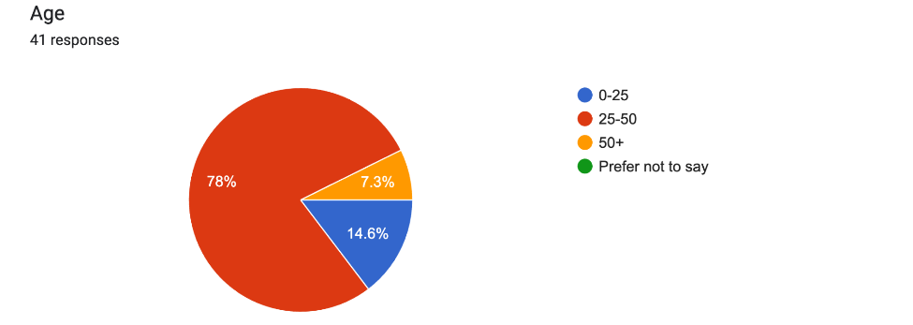
Age Demographics
Notes:
Mostly 25-50 yr. Olds
Vast majority is for younger and middle-aged demographics, few Gen-X
The brand itself is not even a decade old and is not that well-known to wider demographics
Balaguer doesn’t make guitars for kids like Fender and Squier
Balaguer is more niche and targets audiences within certain music scenes like the Vans Warped Tour scene

Slide 27
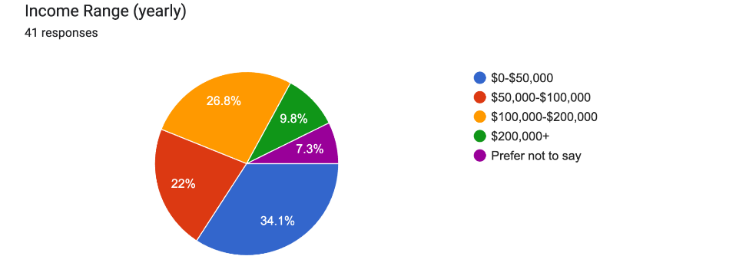
Income Range Demographics
Notes:
Balaguer spans a wide income range of demographics.
1/3 of the pie chart in blue has an average yearly income of $0-$50,000
The 27% in orange is $100,000–$200,000
The 22% in red is $50,000–$100,000
The 10% in green is $200,000+
The percentages of red, orange and green combined is 59%

Slide 28
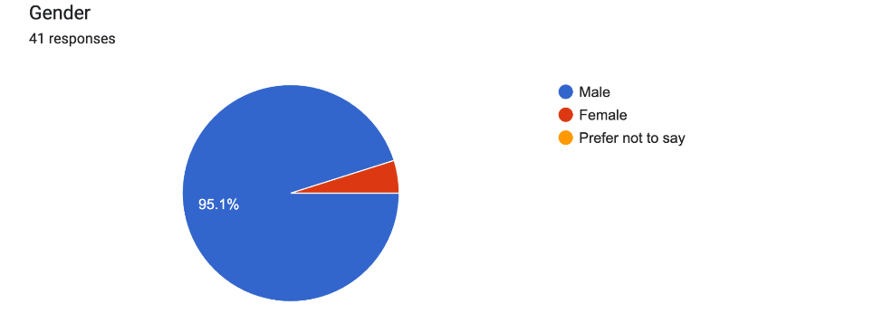
Gender Demographics
Notes:
Balaguer does not span many female demographics in terms of players, which is typical for most guitar and instrument manufacturing companies.

Slide 29
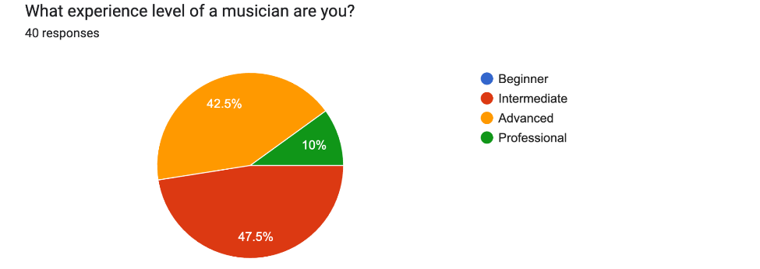
Skill Level Demographics
Notes:
Balaguer is not for beginners, but rather for people who are knowledgeable about guitars and are committed to playing. It would be ludicrous to give a beginner guitarist a customized guitar when they don’t know anything about guitars in terms of the overall specs.

Slide 30
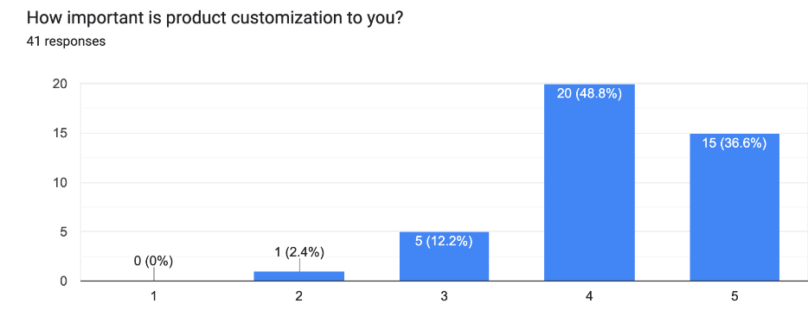
Product Customization
Not important
Very important
Notes:
In addition to learning about demographics, I learned about client needs and desires and discovered that the vast majority of Balaguer’s clients from my survey value product customization.

Slide 31
Product Customization
Not important
Very important
Notes:
In fact, 86% of respondents value product customization to satisfy their unique desires
To quote my interview with Joe, “How would you describe your ideal customer?” his answer was… [transition to next slide]

Slide 32
Product Customization
Not important
Very important
“Someone who is looking for a unique instrument as unique as themselves.” — Joe Balaguer
Notes:
“Someone who is looking for a unique instrument as unique as themselves.”

Slide 33
Why One Chooses
Balaguer
Materials & Aesthetics
Wood choice + body type and neck profile
Electronics, hardware and string gauges
Color and finish
Playability and overall feel
Notes:
Materials & aesthetics are key. You want to have a guitar that is both comfortable and super easy to play.

Slide 34
Why One Chooses
Balaguer
Company Culture/Community
“The brand identity and family seemed to appeal to me most alongside the instruments themselves.” — Survey Respondent
U.S. based company
Great online community
Astounding customer service
Notes:
astounding customer service

Slide 35
Why One Chooses
Balaguer
Value
“The overall commitment to top quality at an affordable price, the offset look that’s become kind of the ‘Balaguer Look,’ and the vast amount of options available to really customize and spec out the perfect instruments for me.” — Survey Respondent
Best value for a custom built guitar
Selectable body types
Great online Build Your Own® tool
Notes:
Read slide
Very few companies have this virtual feature incorporated into their business model

Slide 36
Why One Chooses
Balaguer
Quality
“I love Balaguer’s fusion of vintage and modern features, they make very high quality instruments.” — Survey Respondent
Superior build quality
Instrument quality reasonably priced
Creativity in each model
Notes:
Read slide

Slide 37
Why One Chooses
Balaguer Summary
What makes Balaguer unique:
Materials & Aesthetics
Company Culture/Community
Value
Quality
Notes:
Read slide

Slide 38
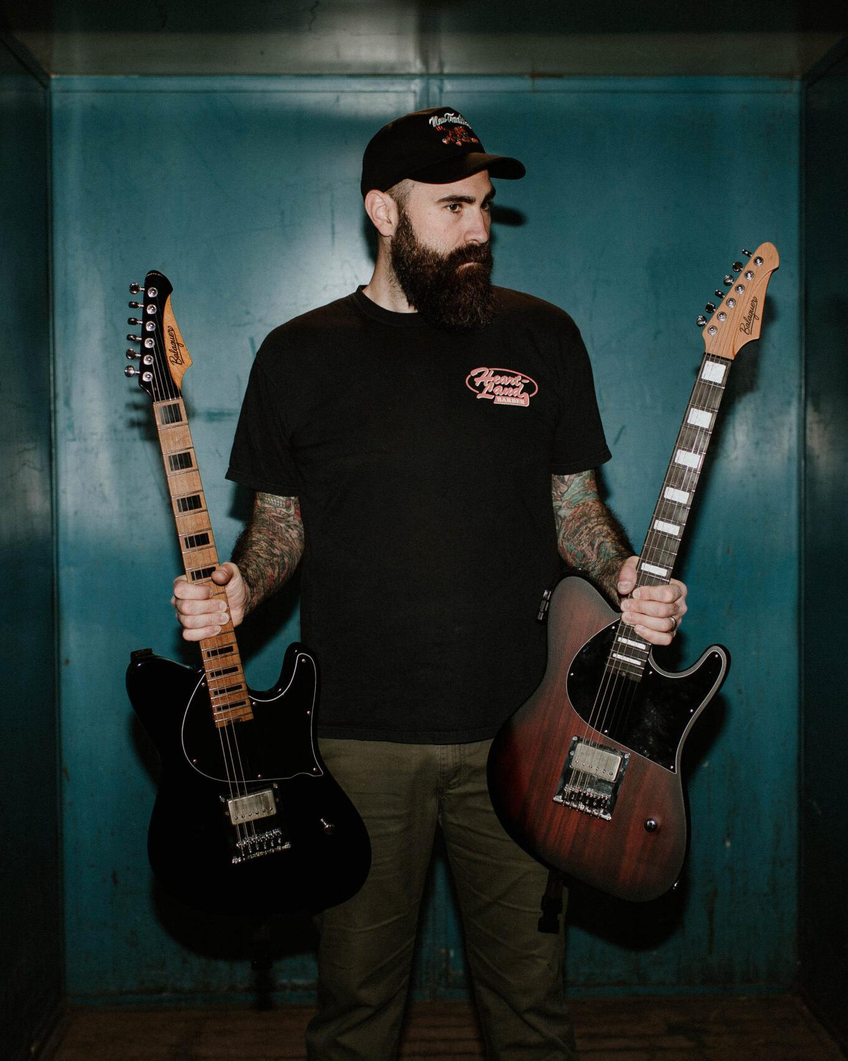
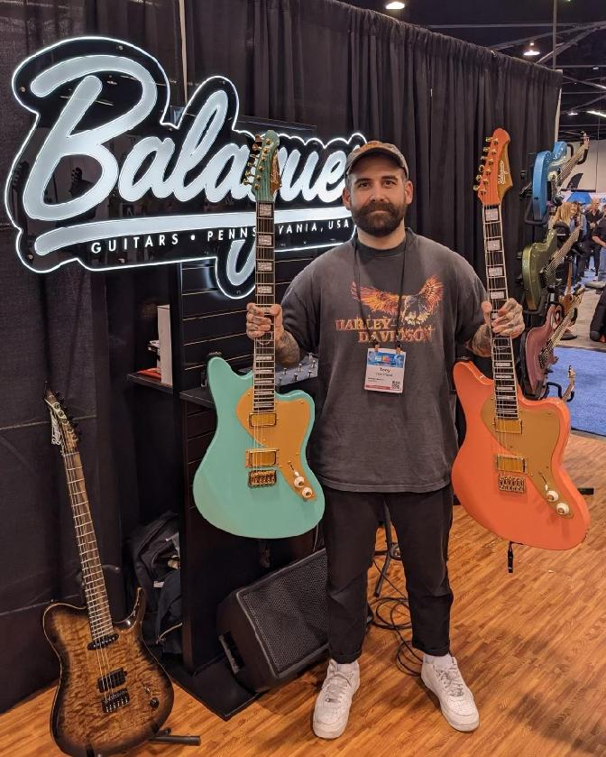
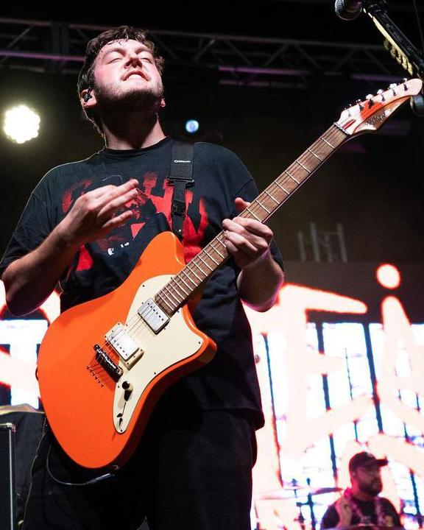
Balaguer Artists
Dan O’Connor,
Four Year Strong
Tony Pizzuti,
Sleeping With Sirens, ex-The Word Alive
Tyler Szalkowski,
State Champs
Notes:
Here are examples of artists who chose Balaguer Guitars as their go-to brand of guitar who utilize their customized products

Slide 39
Balaguer Guitars’ Main Objective
Put customers center stage with an instrument of their own that is unique and affordable
The uniqueness that comes with these custom builds is reflective of the artists as both a person and a player
Notes:
To reiterate, Balaguer ensures its commitment to solidify its relationship with current customers as well as attract new customers. [DON’T READ THE BULLETS]

Slide 40
Research to Reaction
The Path From Survey Results to Custom T-Shirts
Notes:
Methodology (cont’d) !
Let me explain how I went from research to deliverable:

Slide 41
Research to Reaction
The Path From Survey Results to Custom T-Shirts
Research Synthesis: Balaguer wants to solidify its relationship with current customers and attract new customers
Notes:
Methodology (cont’d) !
Read slide
I had a deep understanding of the demographics and their desire for uniqueness and customization which led me on a path

Slide 42
Research to Reaction
The Path From Survey Results to Custom T-Shirts
Research Synthesis: Balaguer wants to solidify its relationship with current customers and attract new customers
Affordable Customization: Differentiates them from their competitors
Notes:
Methodology (cont’d) !
Read slide
I looked around to see what other competitors had for their own products and virtual Build Your Own® instrument design and building tools as well as their price points

Slide 43
Research to Reaction
The Path From Survey Results to Custom T-Shirts
Research Synthesis: Balaguer wants to solidify its relationship with current customers and attract new customers
Affordable Customization: Differentiates them from their competitors
Demographics:
78% are between the ages of 25 and 50, and 87% highly value customization
Notes:
Methodology (cont’d) !
Read slide
Drilling down on Balaguer and thinking about their existing customers and how to help Joe attract new customers while looking at market research, I concluded that customized merchandise with the same design would complement the instrument purchase through their virtual Build Your Own® tool.

Slide 44
Research to Reaction
The Path From Survey Results to Custom T-Shirts
Research Synthesis: Balaguer wants to solidify its relationship with current customers and attract new customers
Affordable Customization: Differentiates them from their competitors
Demographics:
78% are between the ages of 25 and 50, and 87% highly value customization
Custom T-Shirts:
Age 35 and above, value customization, and market for customized t-shirts is increasing rapidly
Notes:
Methodology (cont’d) !
No other company offers customized merchandise, specifically taking a customized instrument design and placing it on a t-shirt.
I thought about having an entire store with mousepads, sweatshirts, posters and water bottles, but decided not to so that I could shift my focus to one deliverable
Upon examining Balaguer’s demographics, it was obvious that t-shirts were the most appropriate, specifically men aged 25-50.

Slide 45
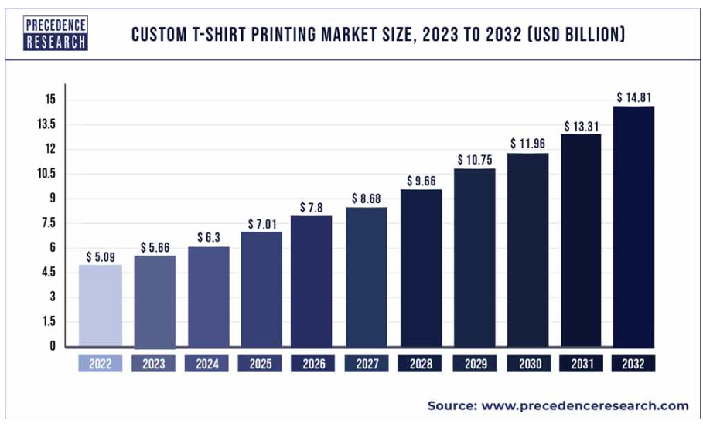
Custom T-Shirt Design
Solidifying Customer Relationships
Growing Market for Custom T-Shirts
According to Precedence Research (2023) the global custom t-shirt printing market is poised to grow at a Compounded Annual Growth Rate of 11.27% from 2023 to 2032.
Fits Balaguer Customer Demographic
Adults over 35 tend to buy t-shirts that reflect their interests. They are tech-savvy and interested in expressing themselves through fashion, and they have the disposable income to afford custom tees (Gemini AI, 2024).
Notes:
Read slide

Slide 46
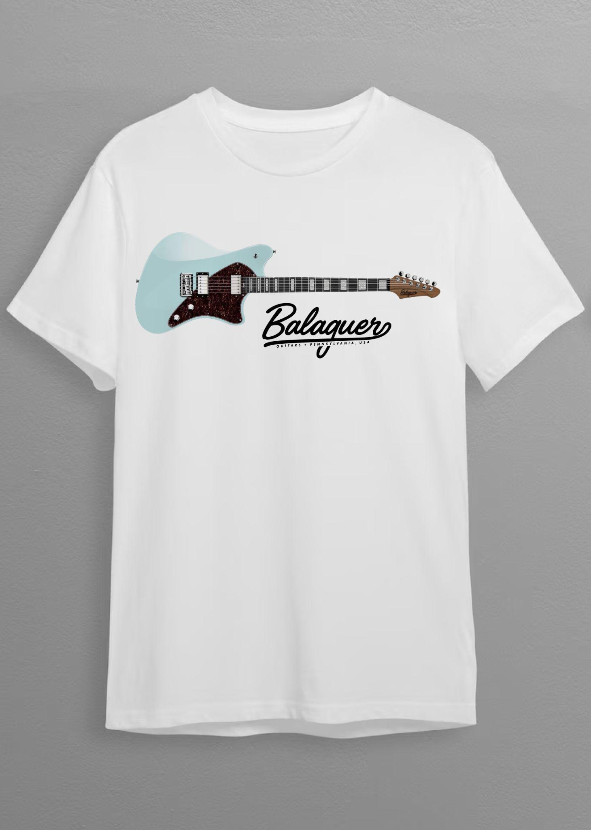
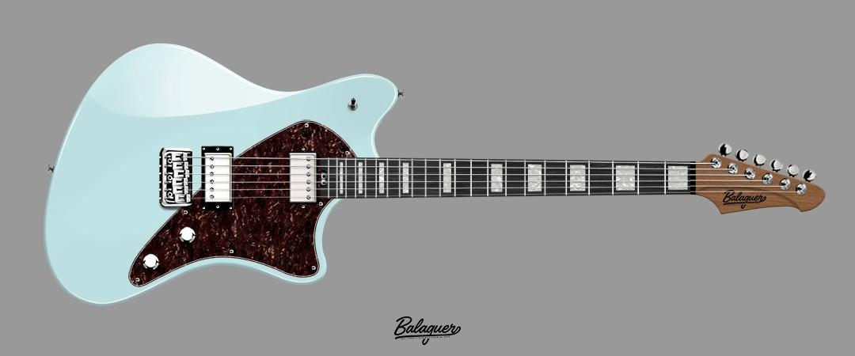
Custom T-Shirt Design
Solidifying Customer Relationships
Notes:
Click on guitar — video showcasing a walkthrough of their virtual Build Your Own® tool when customizing an instrument online to one’s personal specs
This is their differentiator in the marketplace
As we discussed, customization is the main takeaway from my research and Joe’s mission, which is supported by this tool and receives great reviews

Slide 47
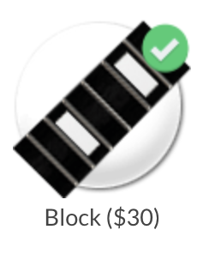
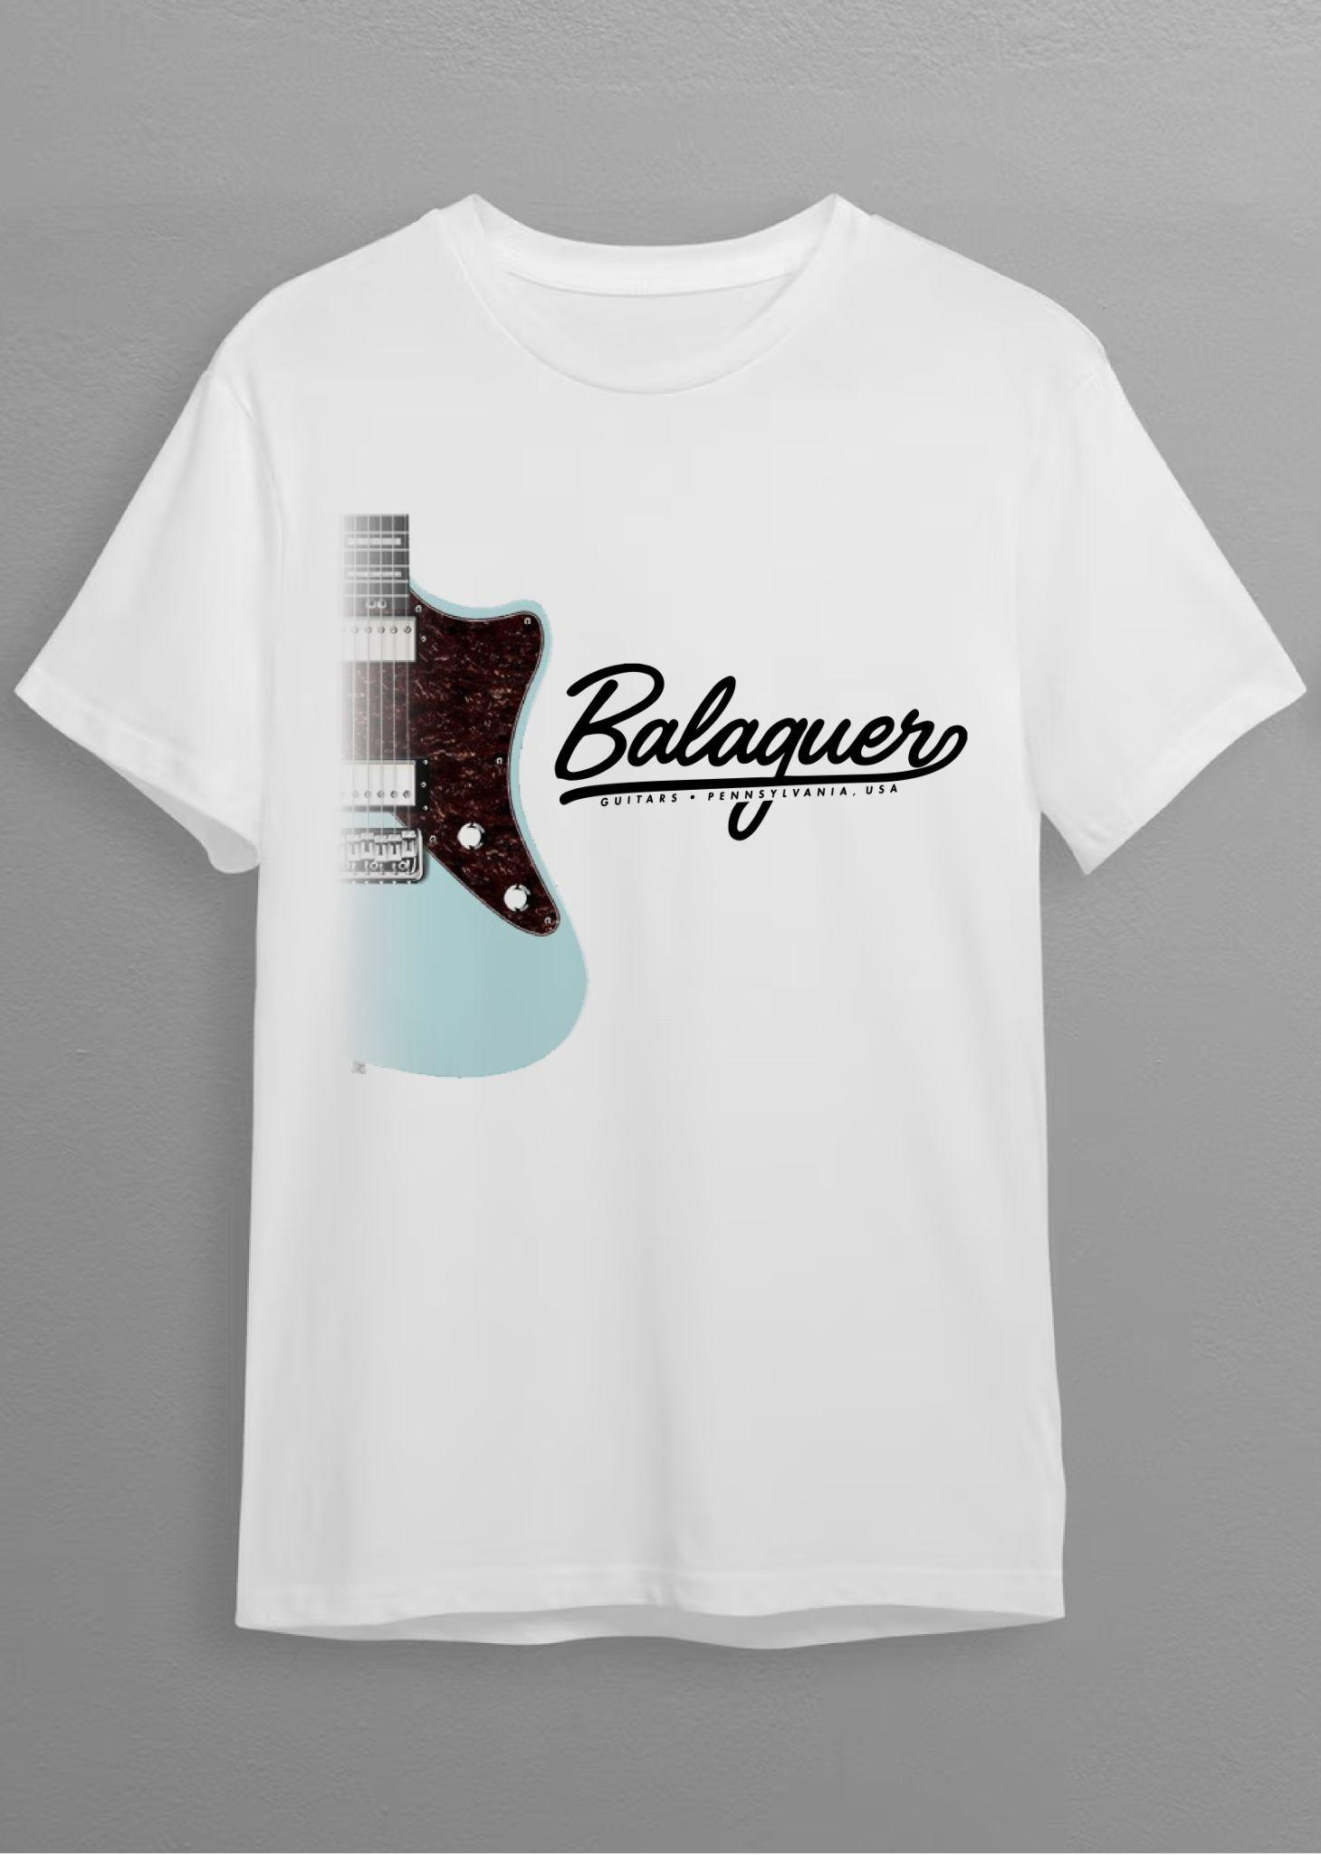
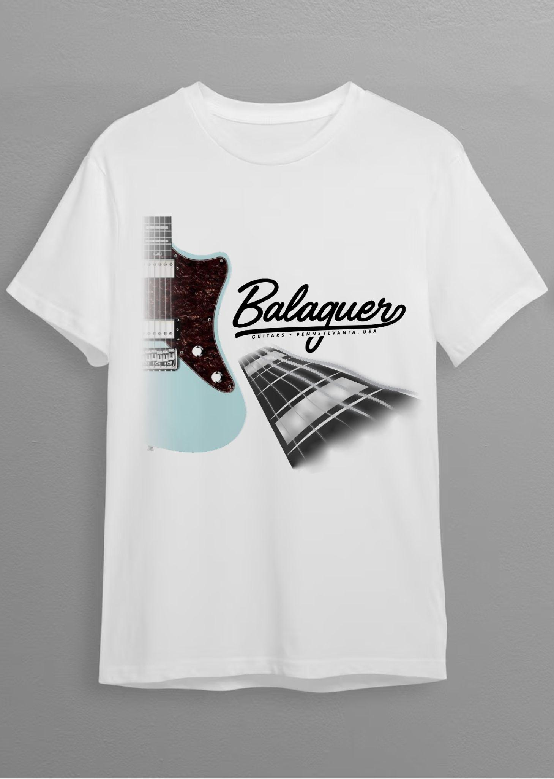
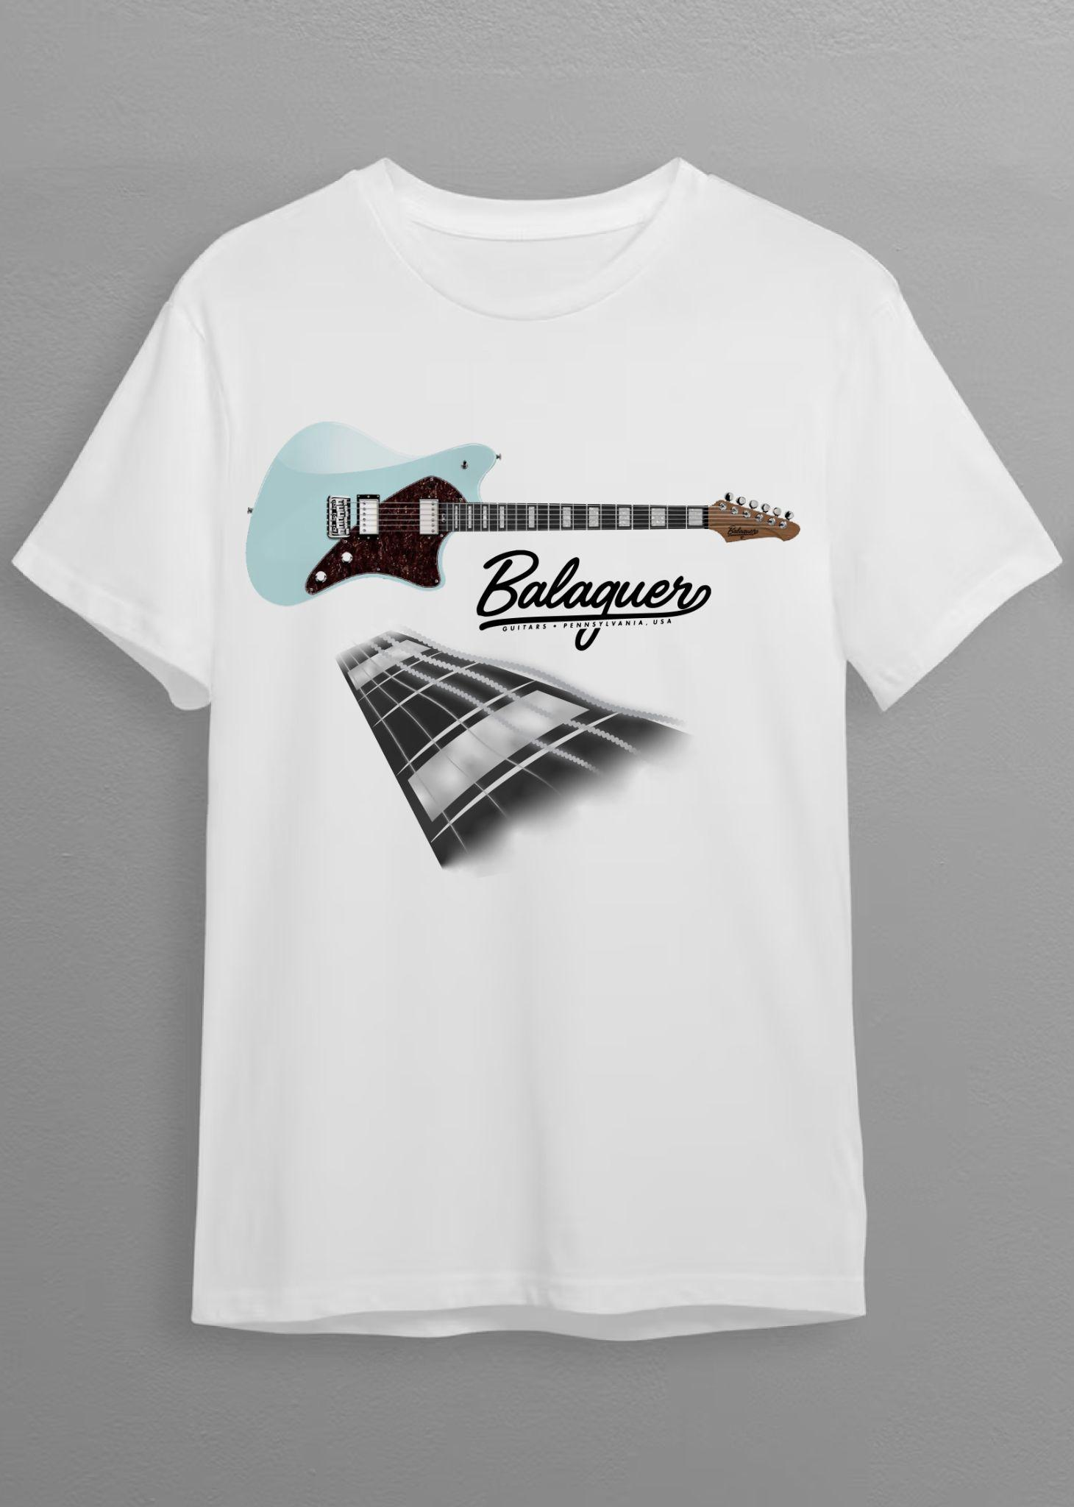
Inlay
Final Deliverable — Customized Instrument Design on T-Shirts
Notes:
Pragmatics
Here are four designs, two of which are the same with the addition of a two-point perspective graphic fingerboard that replicates the same aesthetic as the given instrument design template

Slide 48
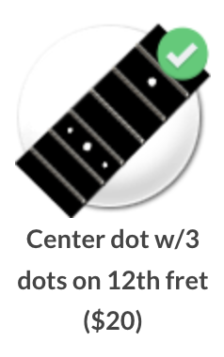
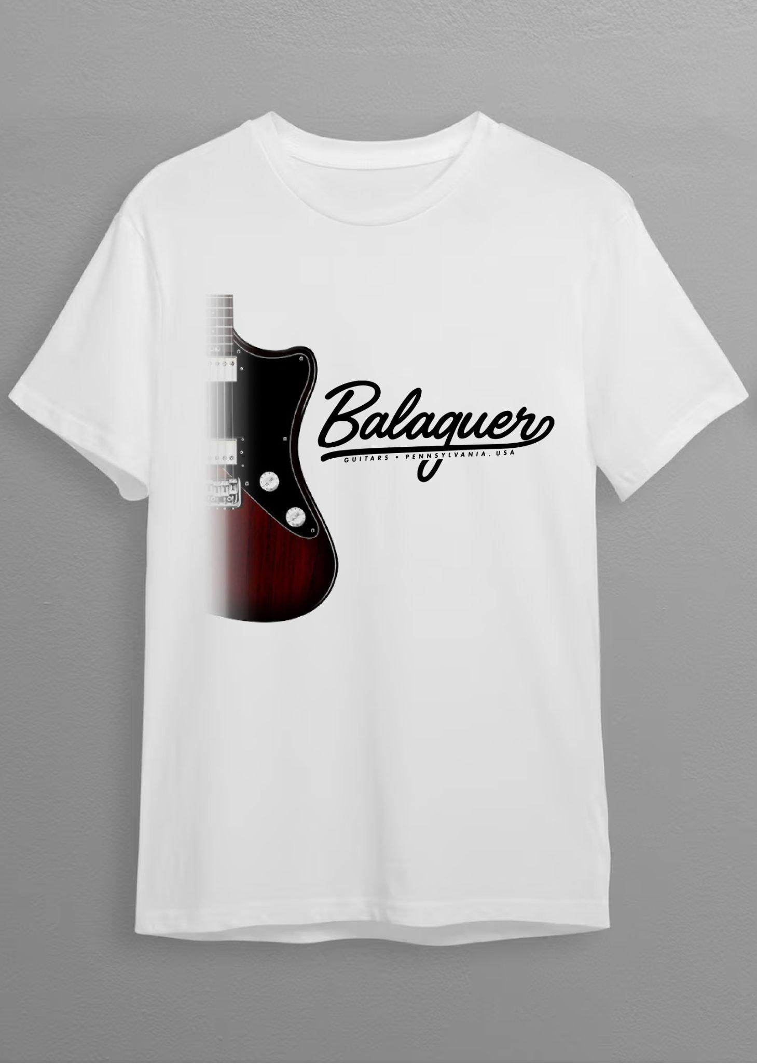
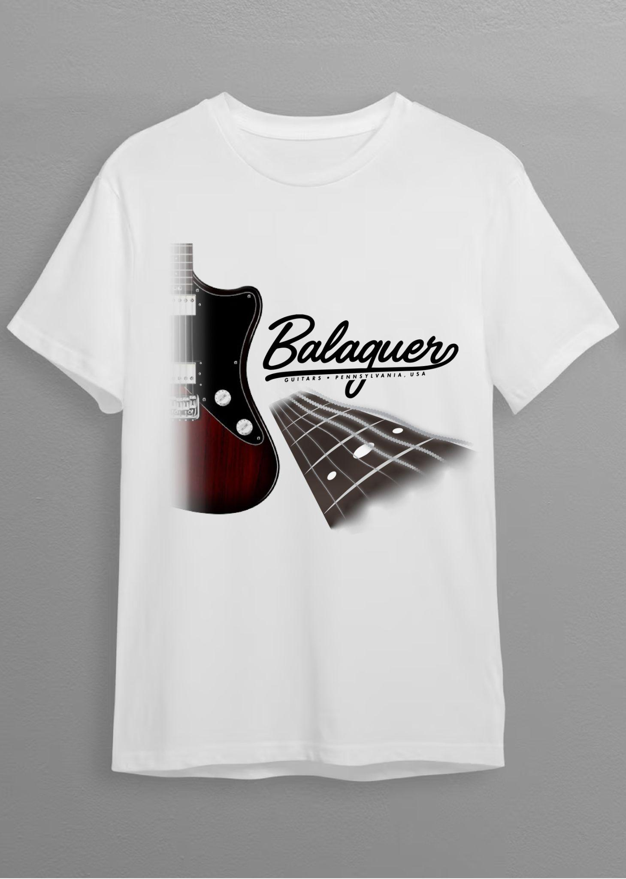
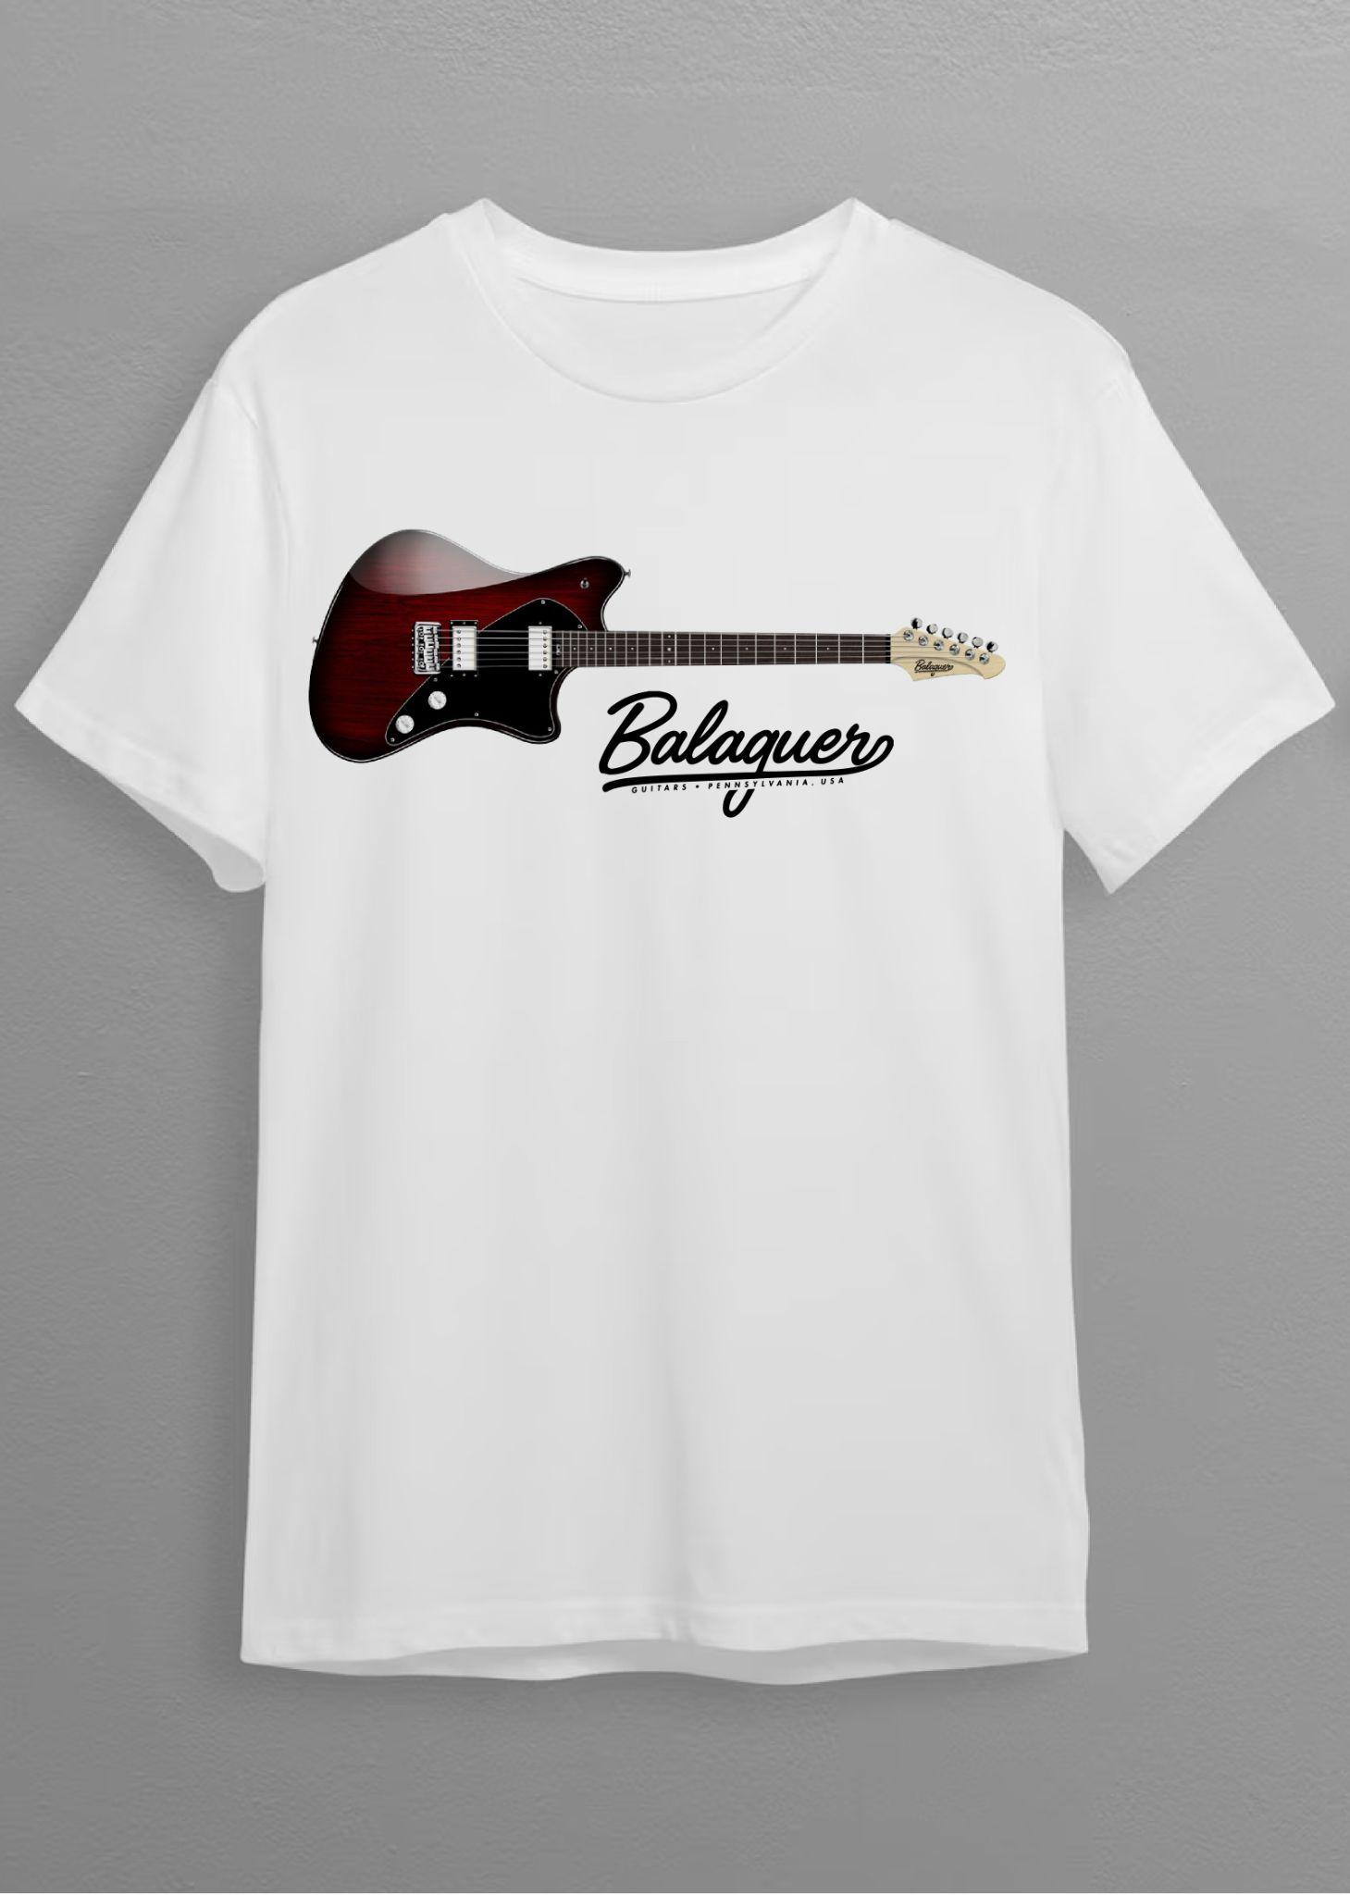
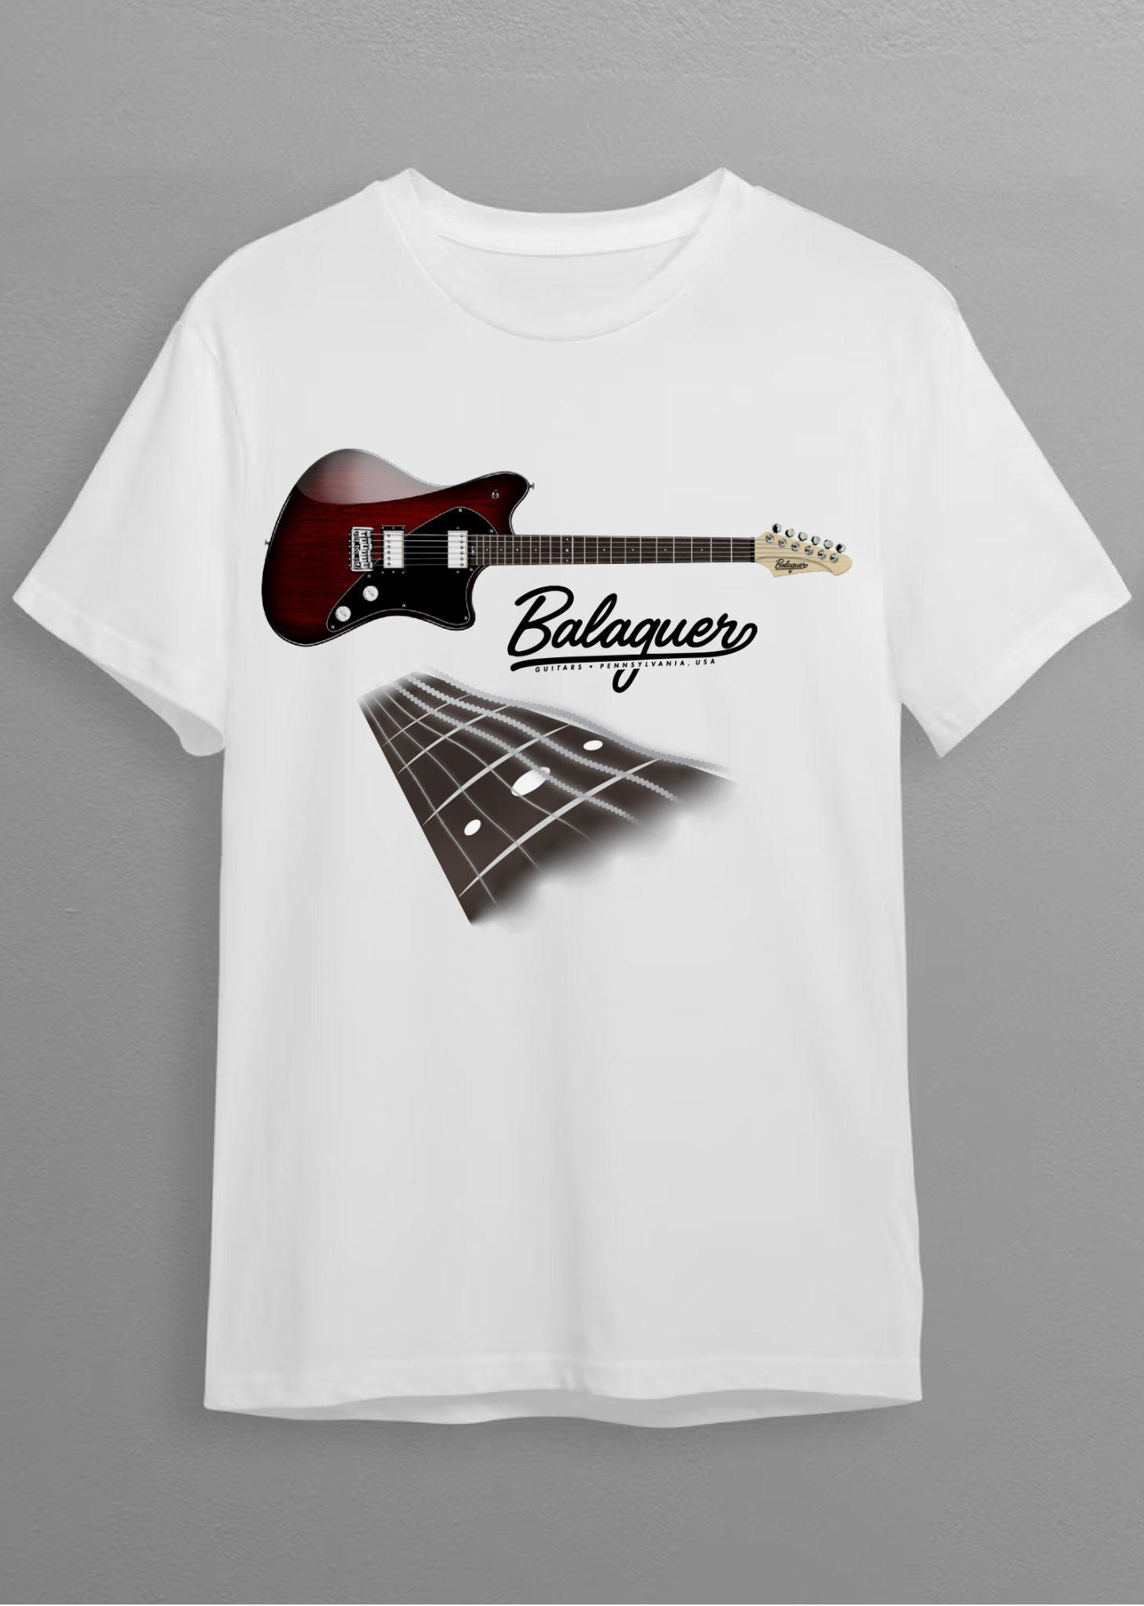
Inlay
Final Deliverable — Customized Instrument Design on T-Shirts
Notes:
Pragmatics (cont’d)
Here are more examples that showcase how the aesthetic from the guitar design templates is translated onto the two-point perspective fingerboard designs
Balaguer has a monochromatic color screen

Slide 49
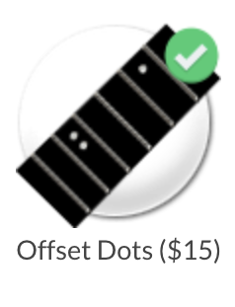
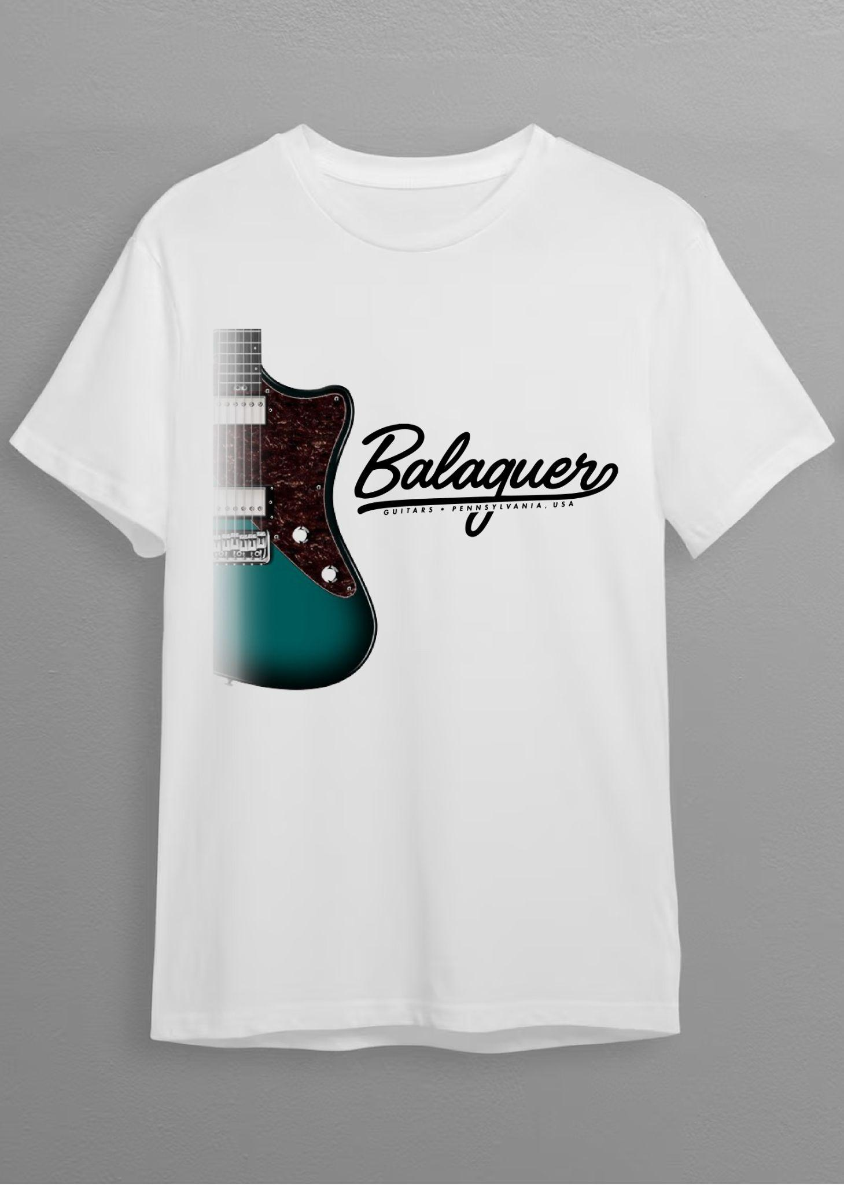
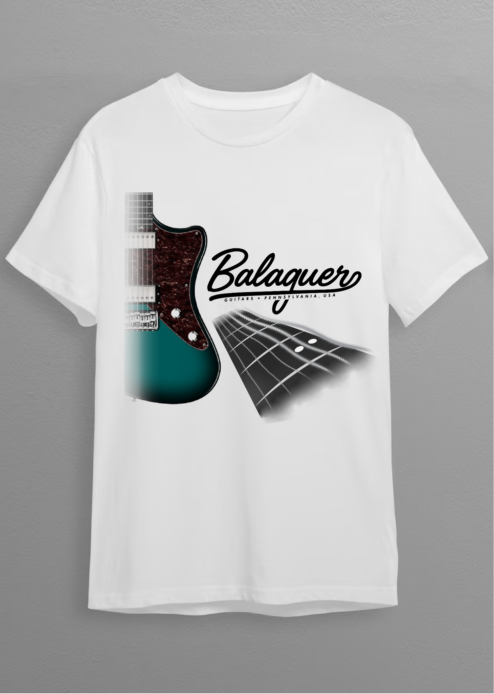
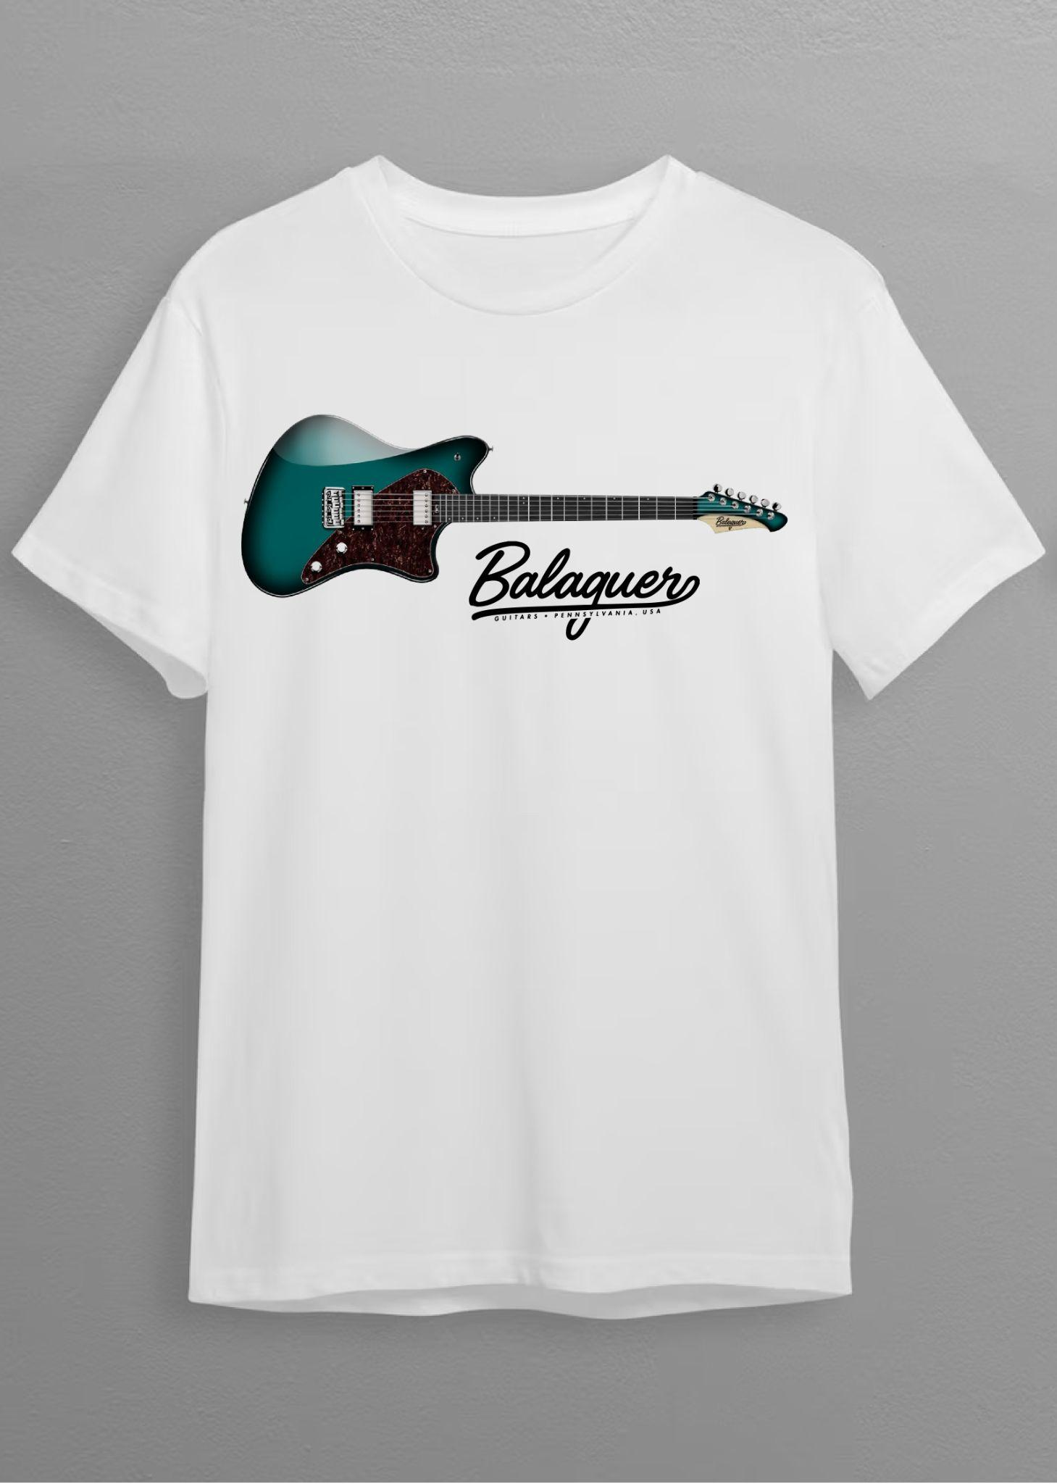
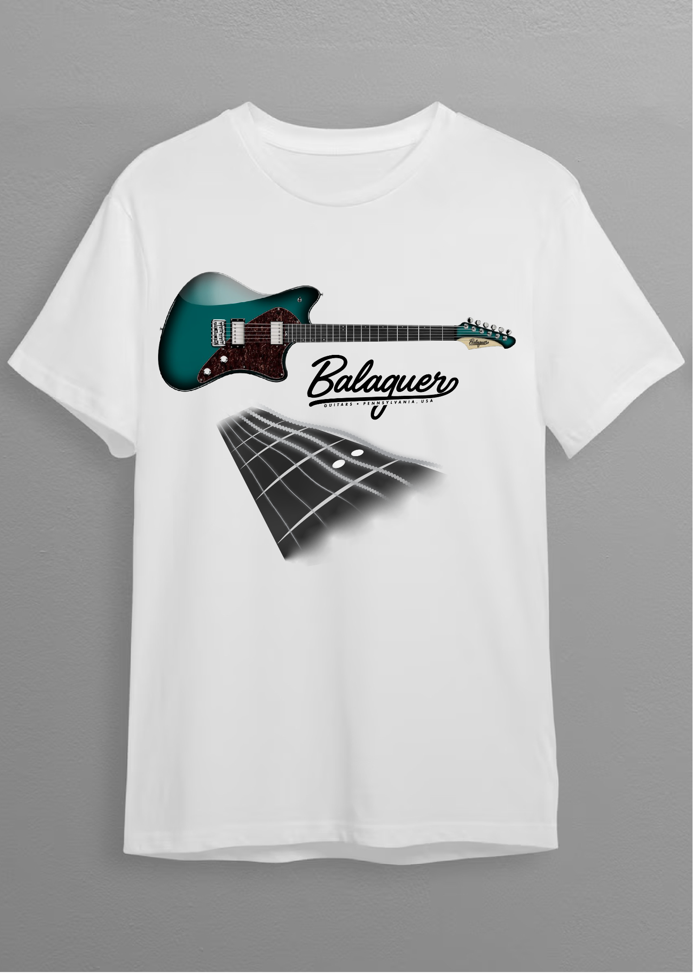
Inlay
Final Deliverable — Customized Instrument Design on T-Shirts
Notes:
Pragmatics (cont’d)
Here are examples with the two offset dots on the 12th fret.
To be clear, anyone can purchase a t-shirt after designing their dream instrument using the Build Your Own® tool. However, only those who fulfill their orders for the instrument will receive the following on the back…

Slide 50
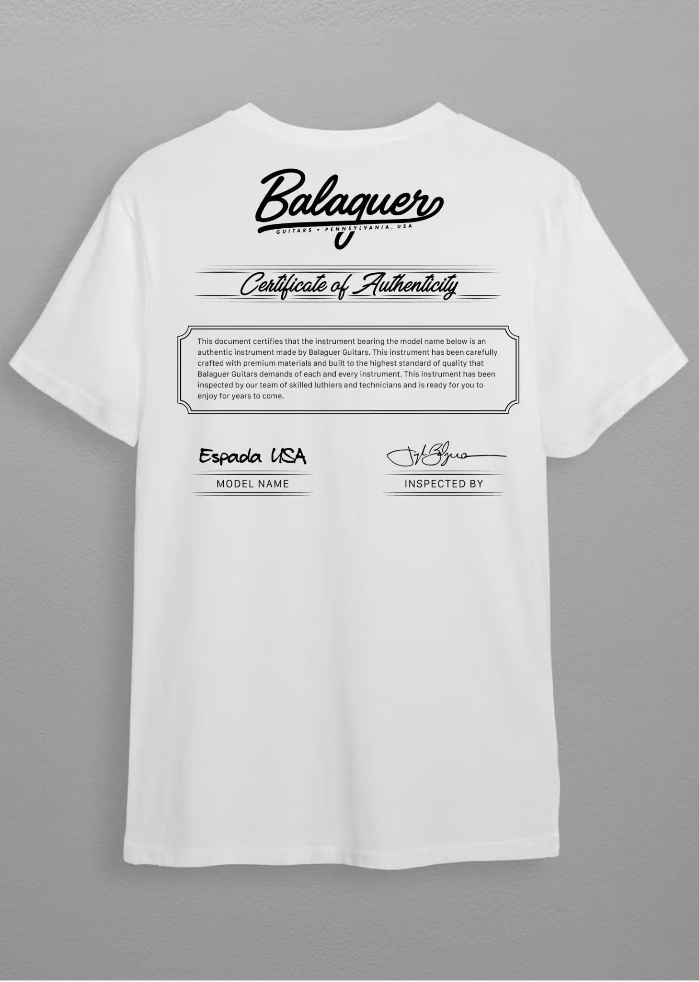
Final Deliverable — Customized Instrument Design on T-Shirts
Certificate of Authenticity on the back is only for people who order a customized instrument through Balaguer’s website, which comes as an accessory along with the actual instrument itself.
Notes:
Read slide
The serial number is not included on shirts for privacy & security concerns. This only comes for those who designed a customized instrument using the Build Your Own® tool and fulfilled their order, for no extra charge, as it is complementary.

Slide 51

Certificate of Authenticity
Notes:
Here is a closeup of Certificate of Authenticity printed on the back of t-shirts for those who fulfill their orders of actual instruments after customizing them online using the Build Your Own® tool.
This is free advertising for Balaguer Guitars as their uniqueness and customization qualities are emphasized through people walking around town
I found a script typeface for the header that closely matched the same aesthetic when typing out the Certificate of Authenticity header text after examining the color scheme and typeface selection of Balauger’s brand identity

Slide 52
Closing Thoughts
Notes:
Today I present to you my creation as a result of my understanding of the marketplace, research and creative development, which are customized Balaguer guitars on t-shirts! [show everyone the t-shirts on clothesline and offer one a design]
Transition to closing thoughts — “As I reflect on my first day of graduate school where I took IDUS-711 and learned about customer research and fast-forwarding to the creation of this project where I created a survey and connected with customers and synthesized their information, I was able to reach a point to where I could create a completely unique deliverable in the marketplace!”
Although my time here at SCAD will be coming to a close very soon, what I’ve learned from my experiences attending all my classes, as well as the creative input I’ve received from some of the most astounding and thought-provoking professors who have encouraged me to take things to the next level, is something that will always be a part of me throughout the rest of my life.

Slide 53



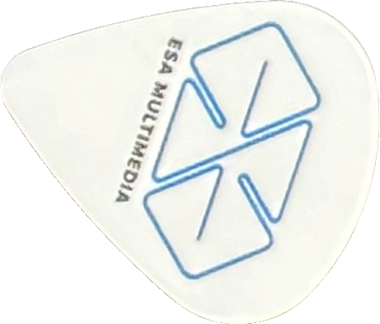

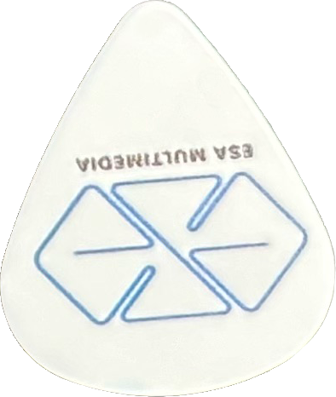
Thank you!
Notes:
Hand out customized t-shirts & guitar picks

Slide 54
Bibliography
Balaguer Guitars. (n.d.). Retrieved March 21, 2024, from https://www.balaguerguitars.com/
ethanAart. (n.d.). Retrieved March 21, 2024, from https://ethanaart.com/
Gemini AI. (2024, March 28). Custom T-Shirt Buyers. https://g.co/gemini/share/f4970cecea4b
Precedence Research. (2023, March). Custom T-Shirt Printing Market. https://www.precedenceresearch.com/custom-tshirt-printing-market
Sherman Altshuler Family Website. (n.d.). Retrieved March 21, 2024, from https://shermanaltshuler.com/
Facebook Group Survey results. (2024, March 7). Ethan Candidacy Review Project — Balaguer Guitars. Private post.
Balaguer, J., (2024, March 6). Interview email response. https://drive.google.com/file/d/1GRPGOzeqmvz9SYS9eppHk40F3Jqd9lZC/view?usp=sharing
Notes:
Here are my sources.

