Slide 1



A Hero’s Journey
Ethan S. Altshuler
Savannah College of Art and Design
GDVX-565 MA Candidacy Review
Friday, May 24th, 2024
Notes:
Hello everyone, good morning
Thank you so much for being here and being a part of my candidacy review, and allowing me to take it a second time around this quarter, which I really appreciate.
I’m really excited to present to you… my Hero’s Journey.

Slide 2
Executive Overview
Personal Journey
Project Narratives
Nature’s Mind Exhibit
Everything, Everyday
Balaguer Guitars Insights
Final Deliverable — Interactive Exhibit of the Balaguer Hero’s Journey
Notes:
Read slide

Slide 3
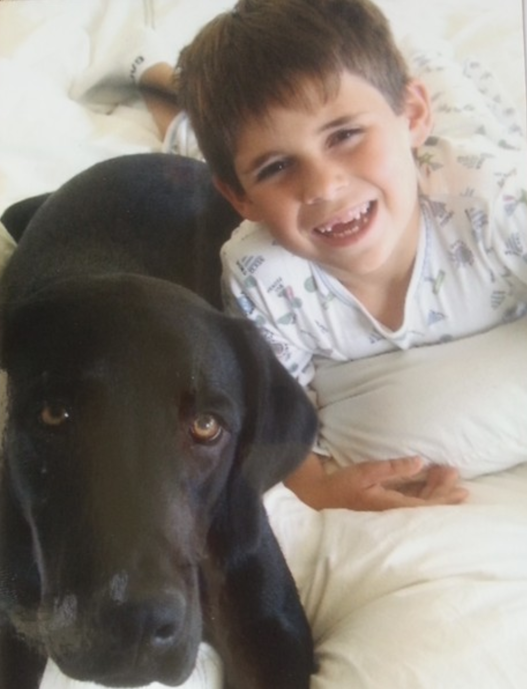
Personal Journey
I have been creating art since age 3
Notes:
I have been creating art since age 3.
As a graphic designer, illustrator, and artist, I think visually and create content using an eye for perspective, along with having a precise attention to detail and the ability to see movement.
Given my Asperger’s diagnosis at 2 ½, my unique creativity is very reflective of who I am as a person, and I am empowered to share my creative abilities with the world and make a difference!

Slide 4
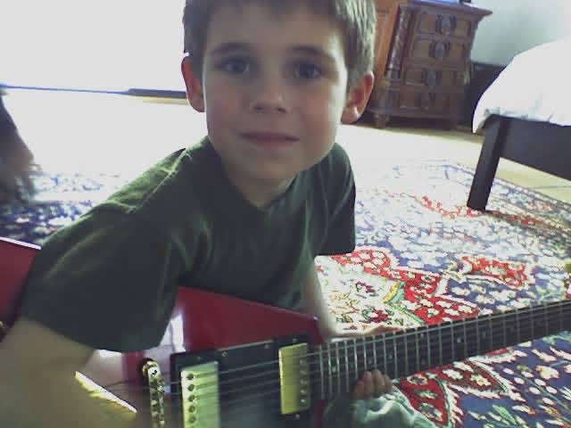
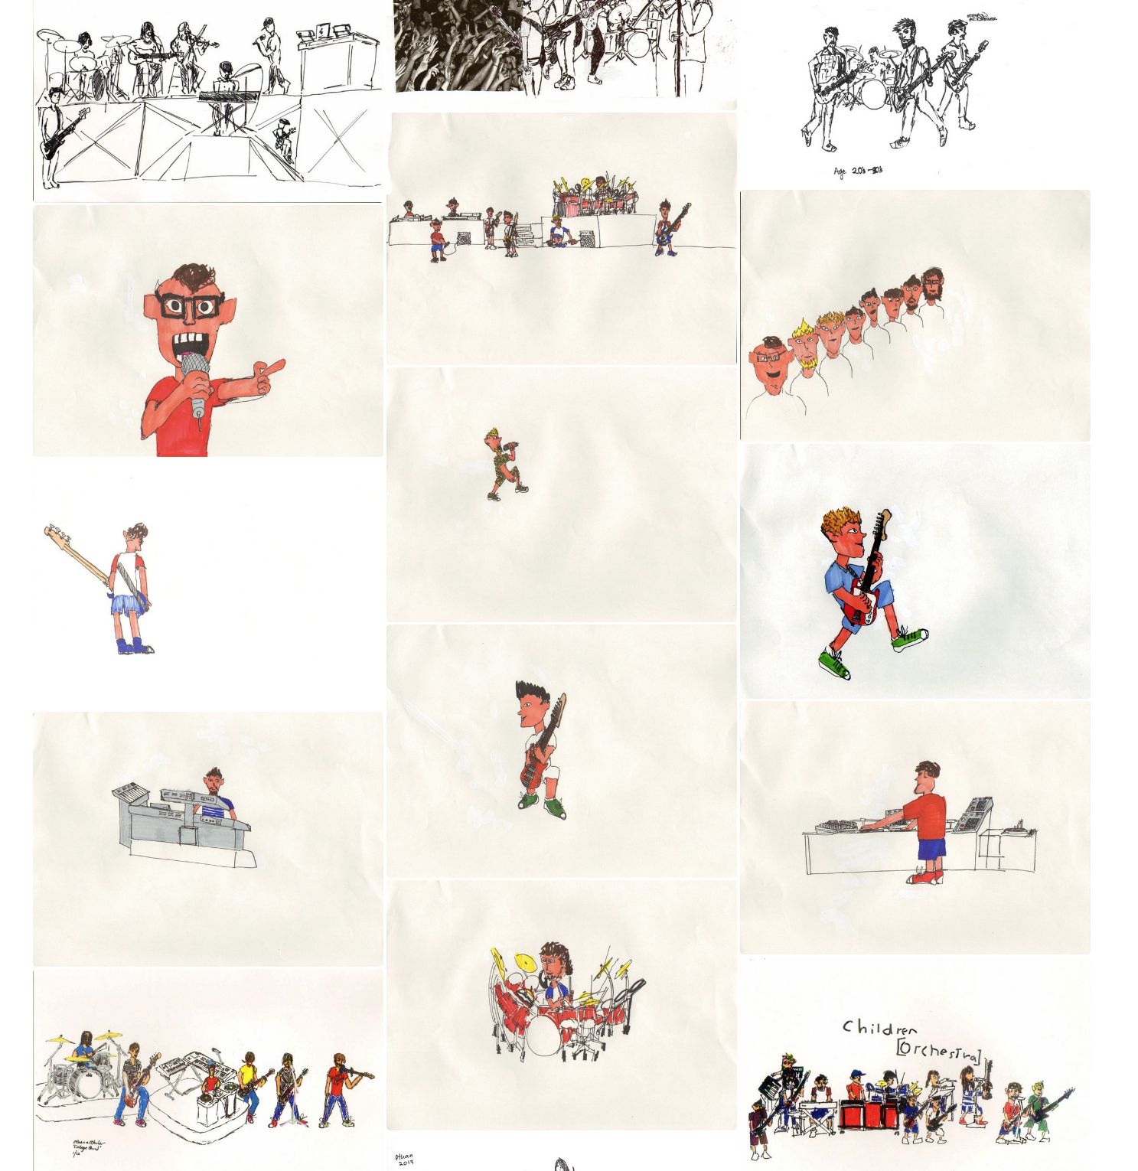
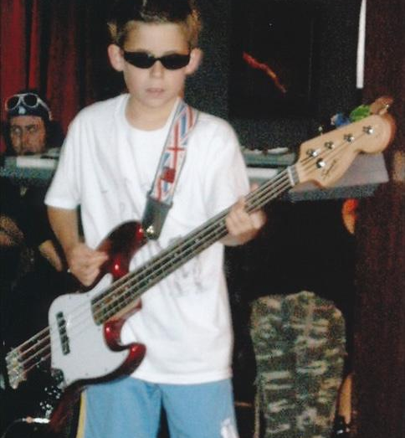
Rock n’ Roll caught my attention early
Personal Journey
Notes:
As you can see in the top picture, I am seen playing my oldest brother’s old Gibson Flying V at age 5 in 2004
Below in 2009, I am seen performing with a music program at age 10
On the right, you can see a series of some of my rock n’ roll/band art using sharpies on paper

Slide 5
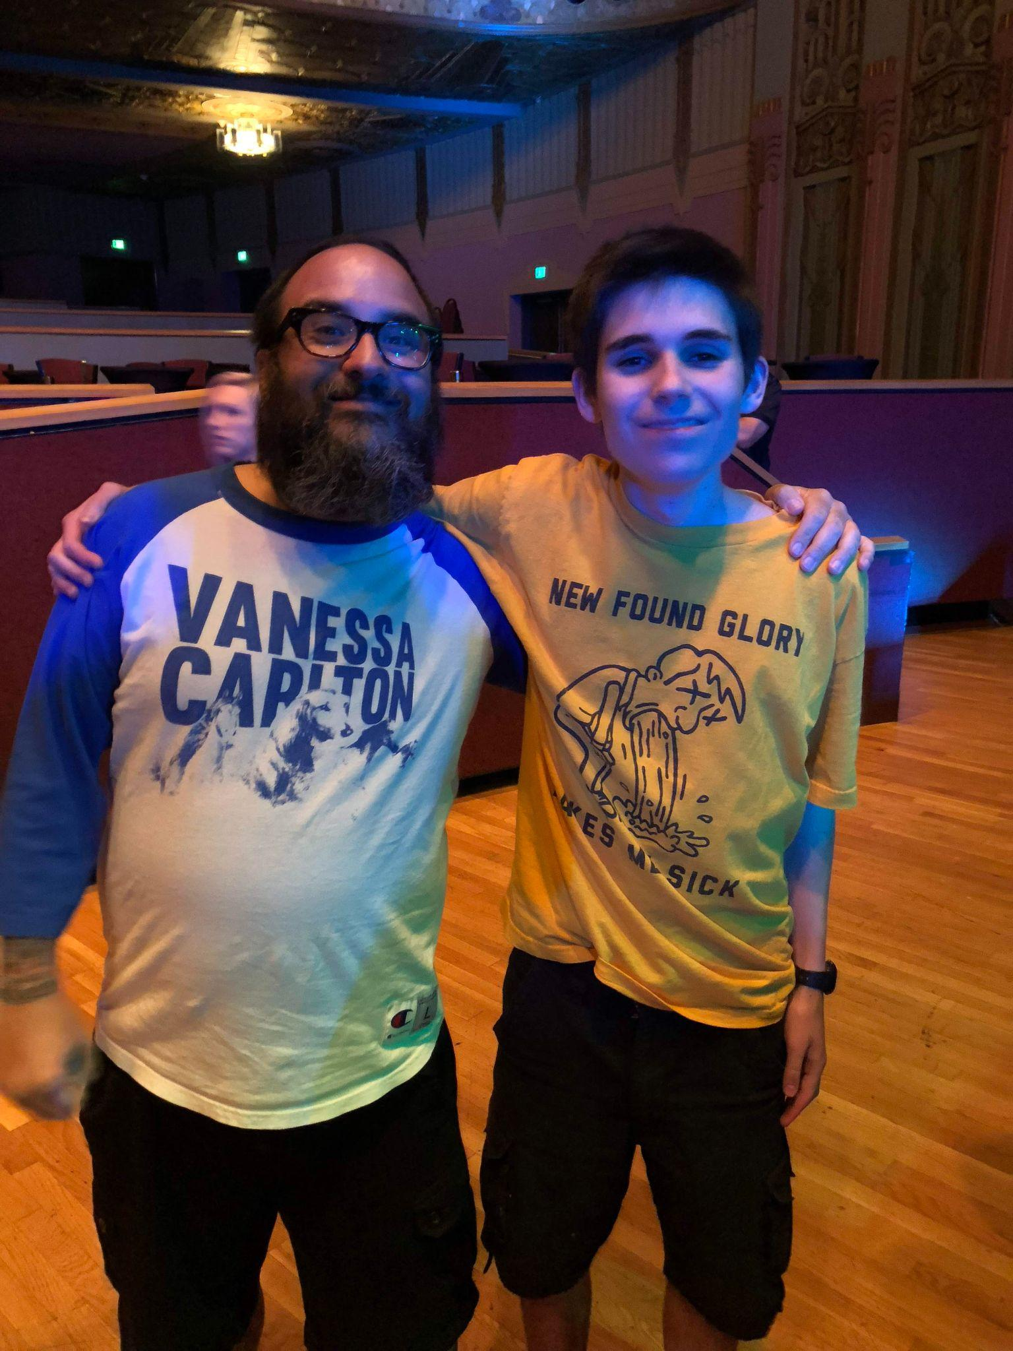
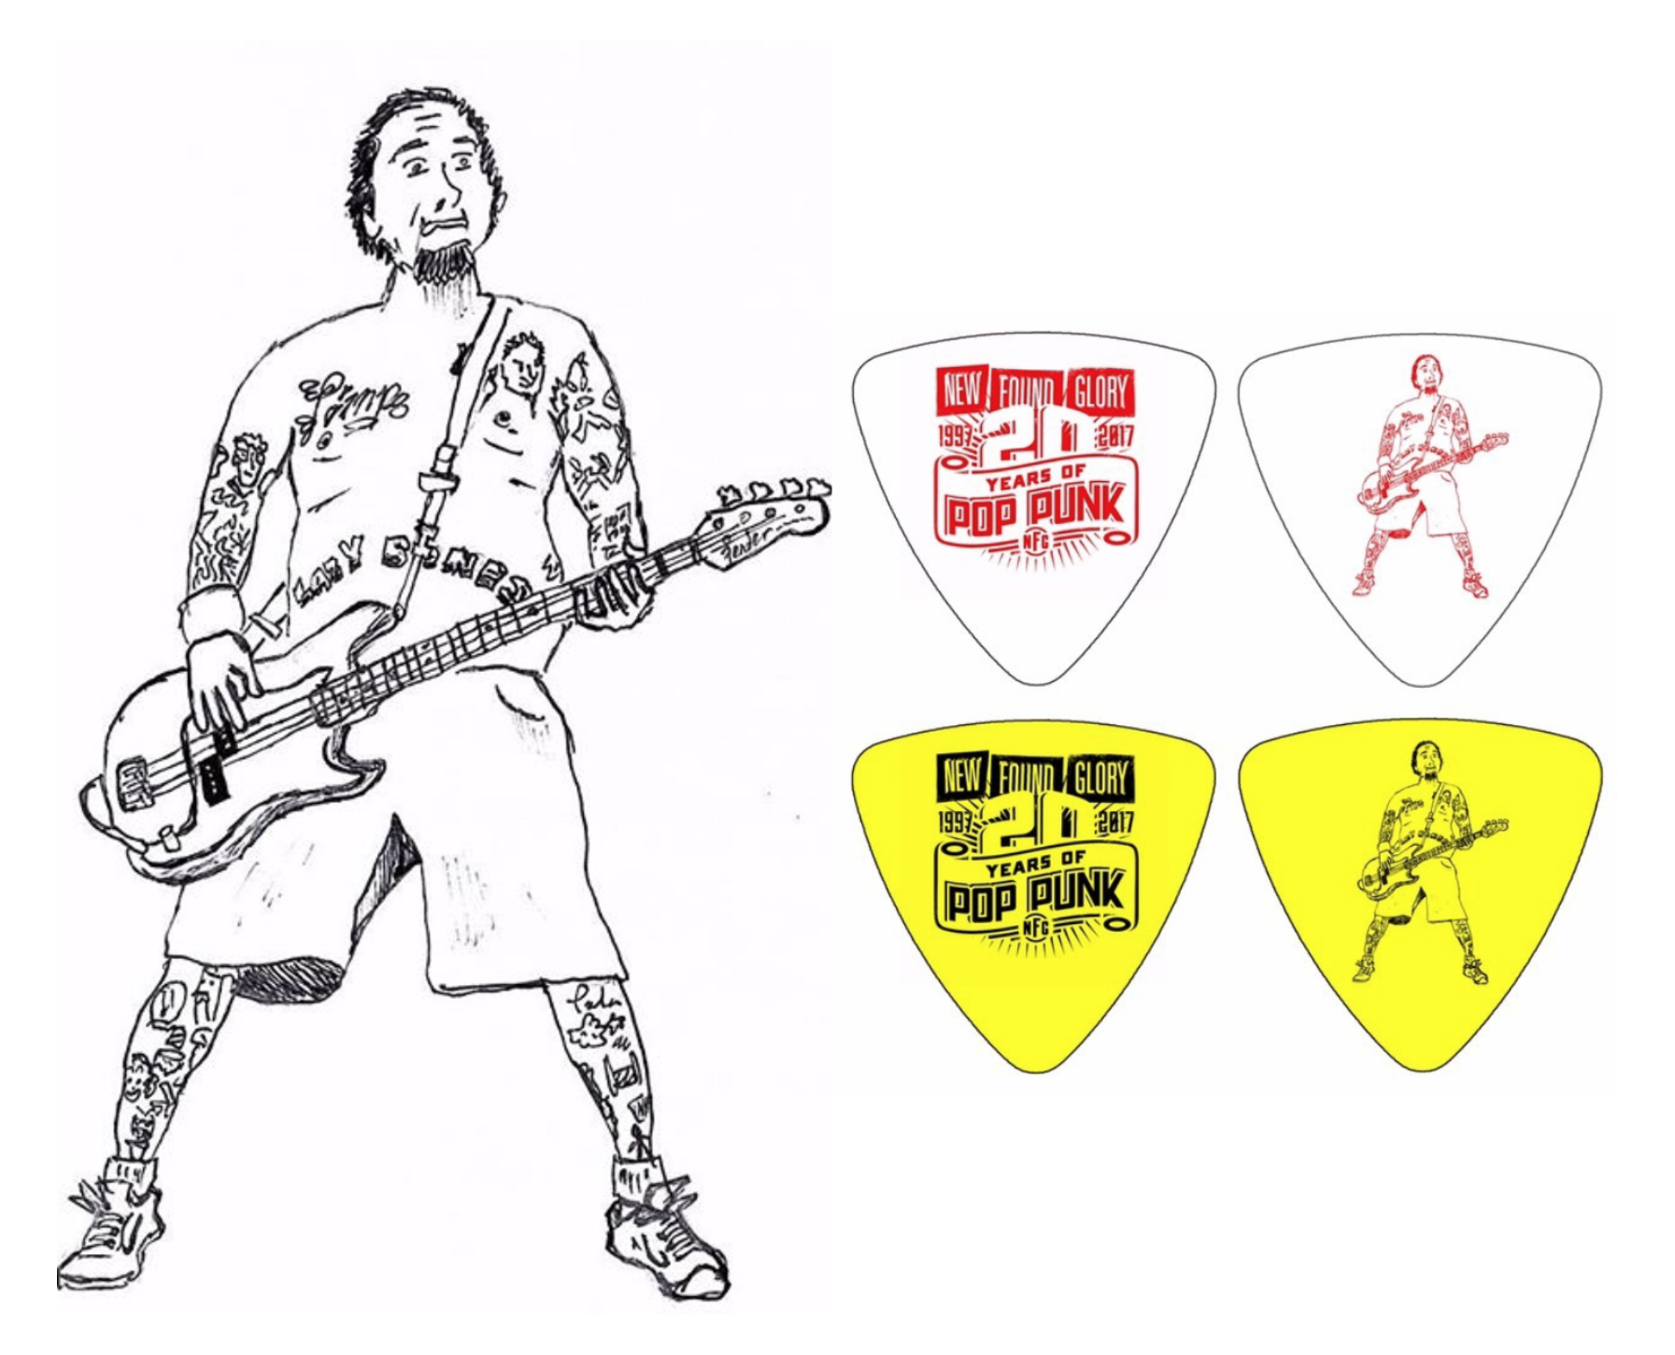
New Found Glory featured my artwork
Personal Journey
Myself and New Found Glory bassist Ian Grushka
Notes:
I freehand drew this picture of Ian as a reference image while looking at my phone during class one day in high school.
I gave it to him at an album release party of theirs in 2017
To my surprise a couple weeks later, he direct messaged me on Instagram with a picture of my drawing of him on bass picks that he would throw out to the audience at each of their shows, and even mailed me some myself!!

Slide 6
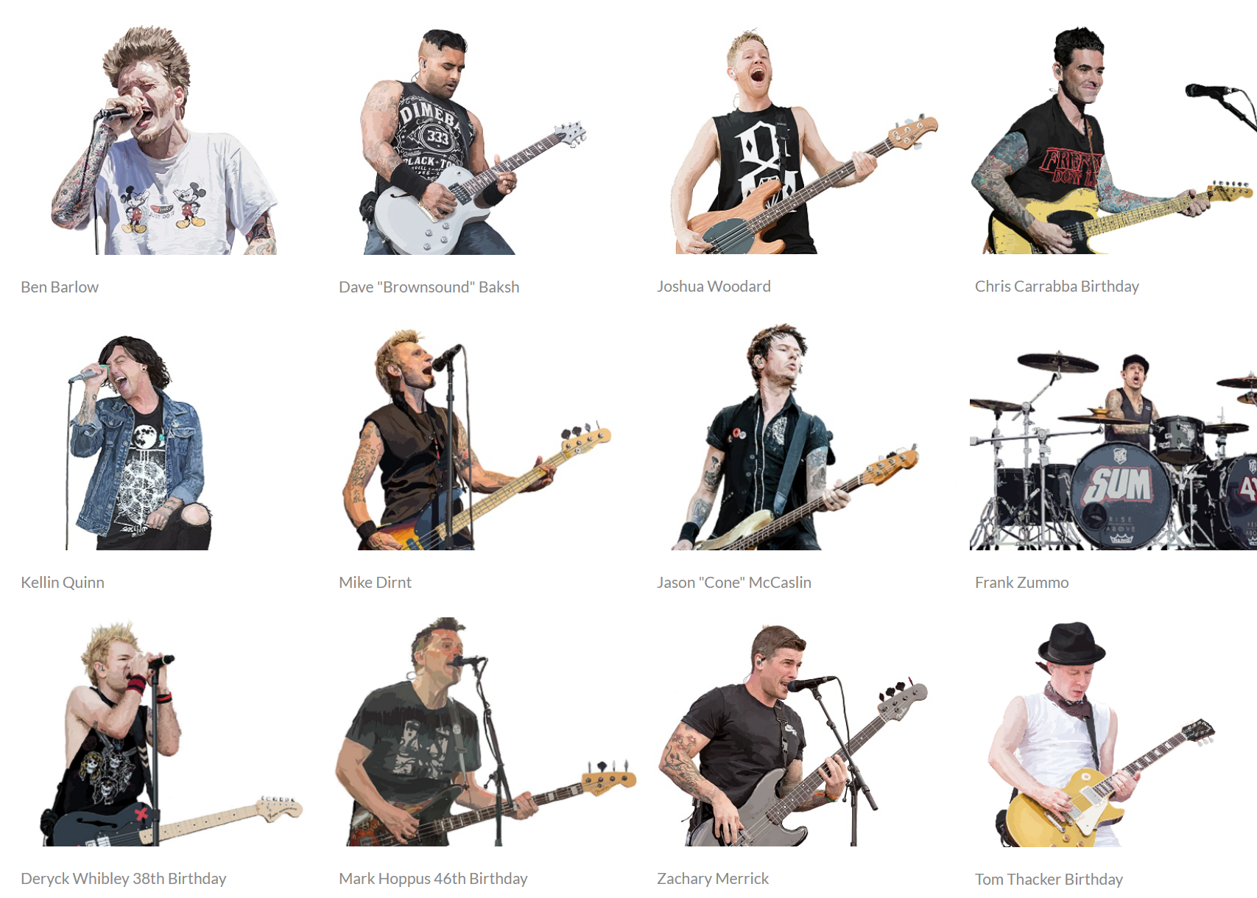
Connecting with bands and artists within my genres
Personal Journey
“Explorimented” — Explored + Experimented
Notes:
Semantics
Speaking of semantics, I accidentally came up with a word after getting tongue tied between two words “Explored” and “Experimented” which resulted in “Explorimented”, which is literally what I do, as I explore and experiment throughout my creative outlets of music and art
Upon entering my first year of college, I explored creating art digitally using a wacom tablet and a stylus and working with software programs such as Adobe Photoshop and Illustrator

Slide 7
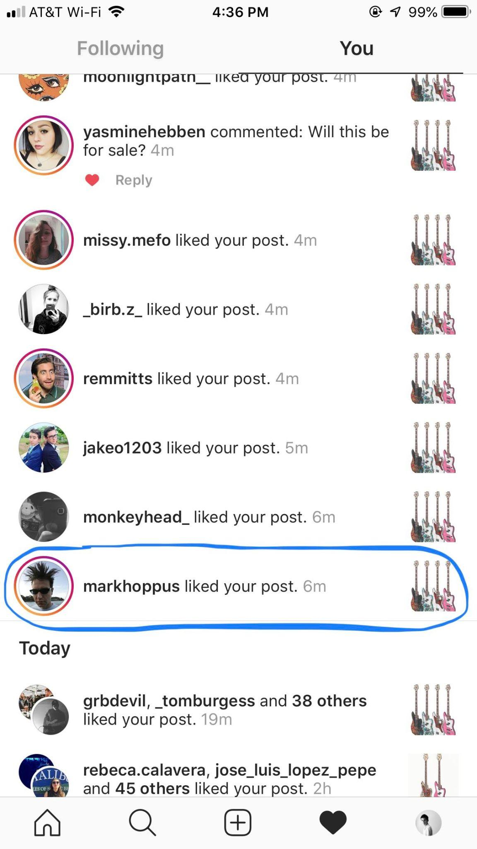
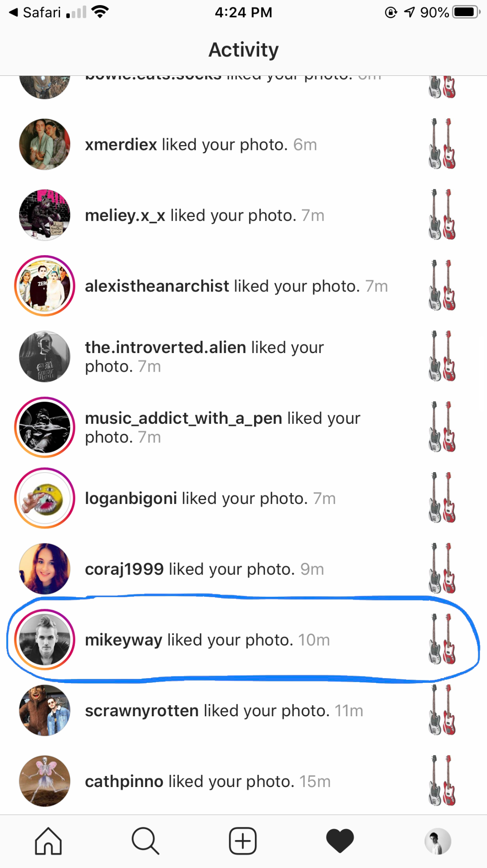
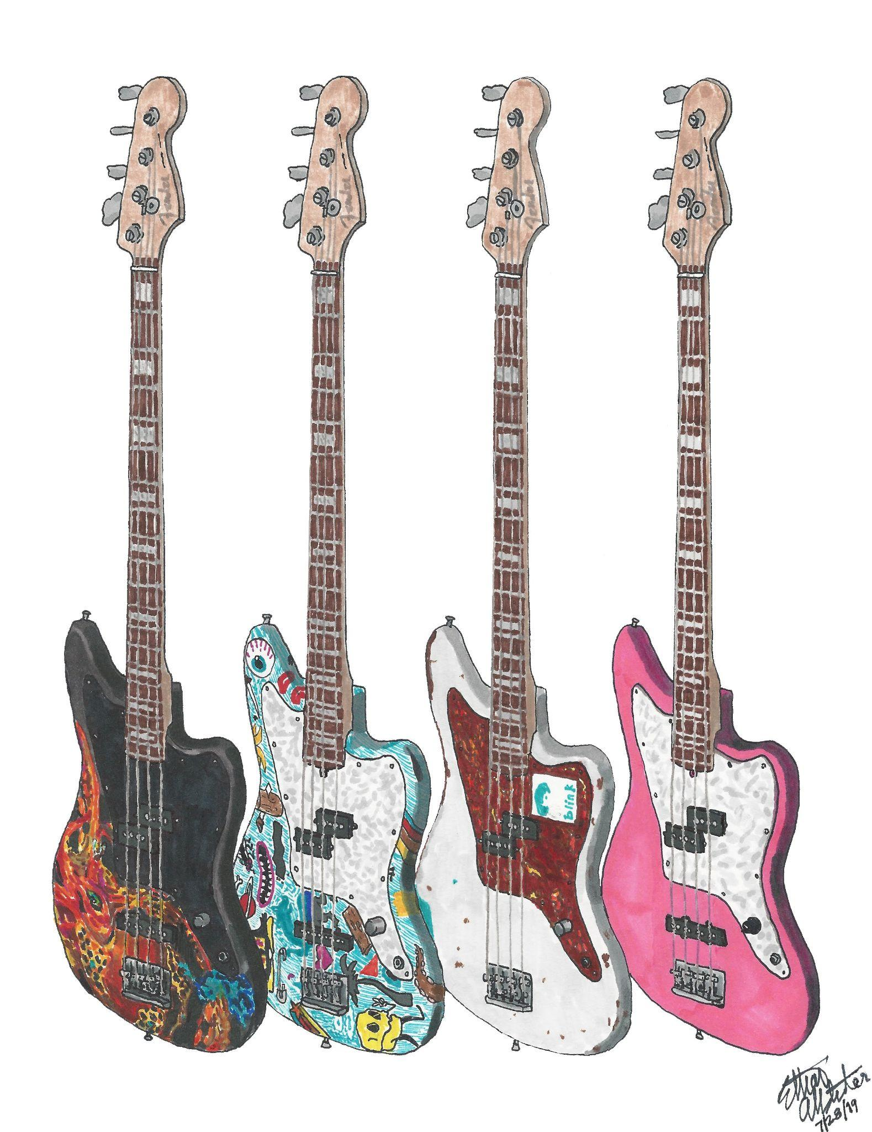
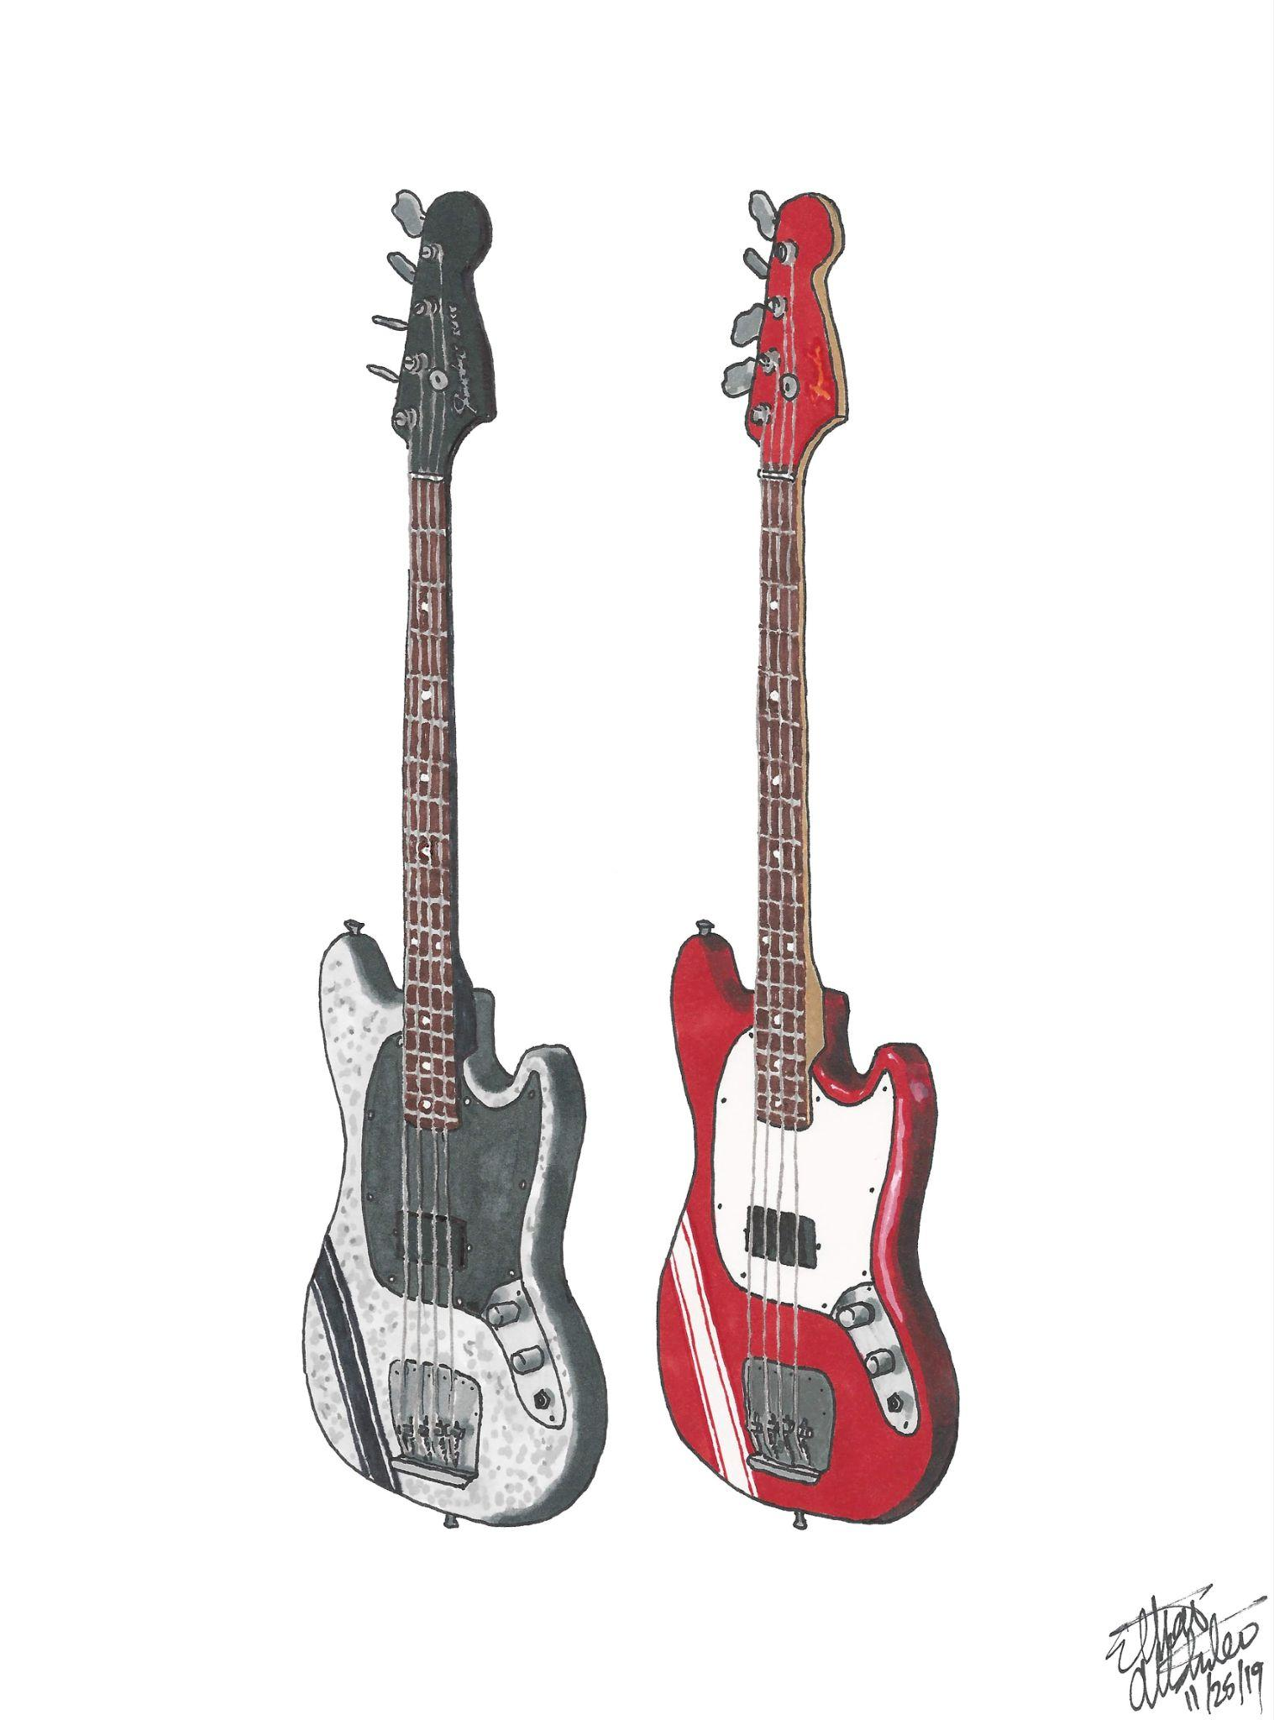
Mark Hoppus & Mikey Way liking and reposting my art on their Instagram stories
Personal Journey
blink-182
My Chemical Romance
July 2019
November 2019
Notes:
My hand drawn art caught the attention of the actual pop punk & emo legends themselves!!

Slide 8
Graduate Studies Savannah College of Art & Design
Nature’s Mind Exhibit
Everything, Everyday
Notes:
Now shifting gears as I embarked on my journey to SCAD as a Graphic Design & Visual Experience Master’s student.
These 2 projects that I’m about to present, which were completed during my graduate studies, illustrate technical skills, emotional connection, and my sense of purpose.

Slide 9

Nature’s Mind Exhibit
Notes:
Let’s dive into my first project I’d like to share from Professor Fano’s Ideation Models & Process class, GDVX-702, in Fall 2023.
The assignment was to work with individual words, ultimately turning into a concept leading to a deliverable.
I chose the word mind and created a museum exhibit that I will share with you today.

Slide 10
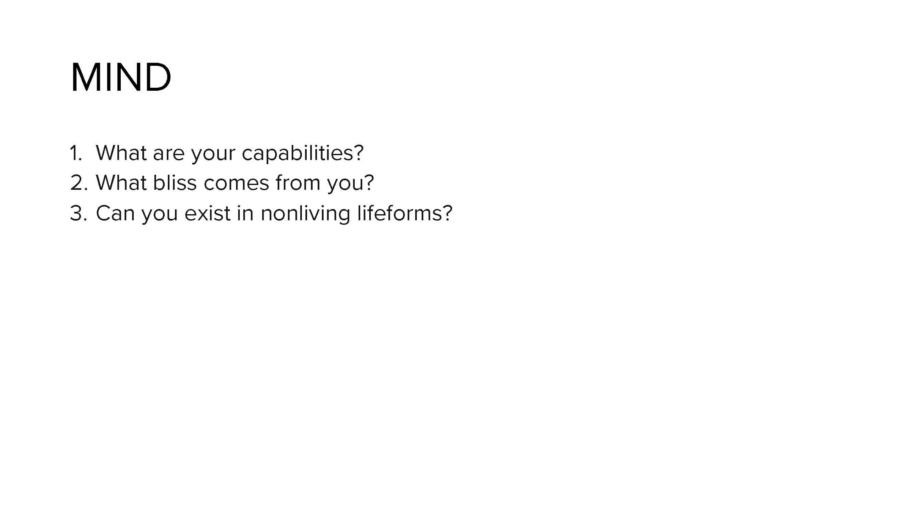
Notes:
So I started with the word mind, and dug into some open-ended questions that I asked.
I really challenged myself with choosing the word mind as it’s an abstract concept.
I was intrigued by the third question in particular, which was can mind exist in non-living lifeforms, and that was when I made my giant leap of faith to the concept of pareidolia

Slide 11
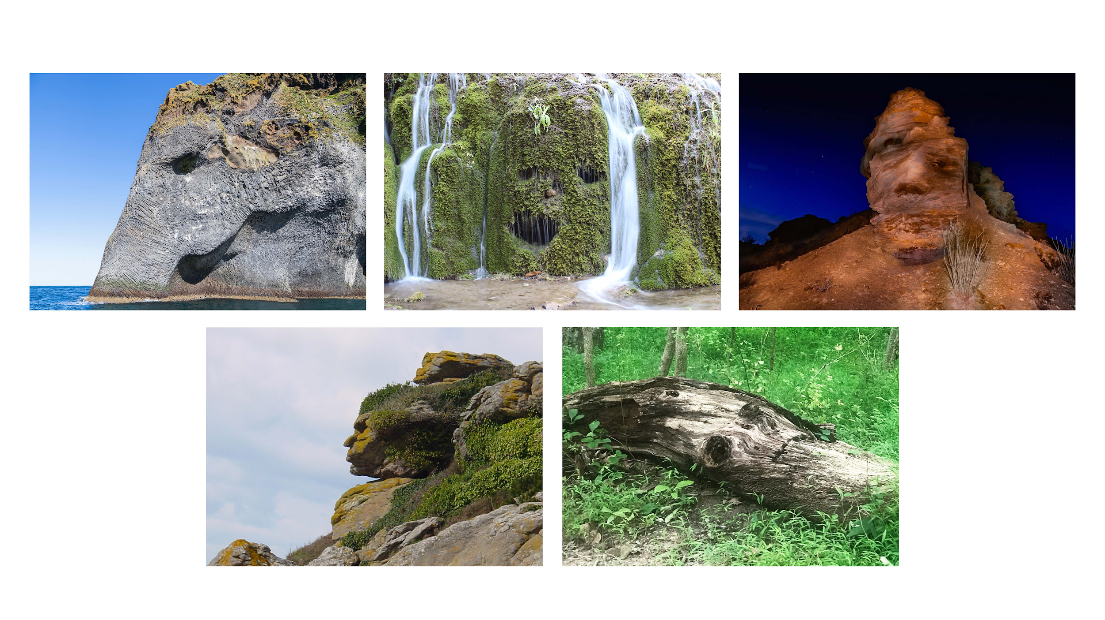
Notes:
Pareidolia is the tendency to perceive a specific, yet often meaningful image in a random or ambiguous visual pattern or composition.
Some people might just see nature’s objects, whereas others might see hidden resemblances within these given compositions.
These pictures depict pareidolia as one might see a face in these shapes and others might see an animal, or something else. What do you see?

Slide 12
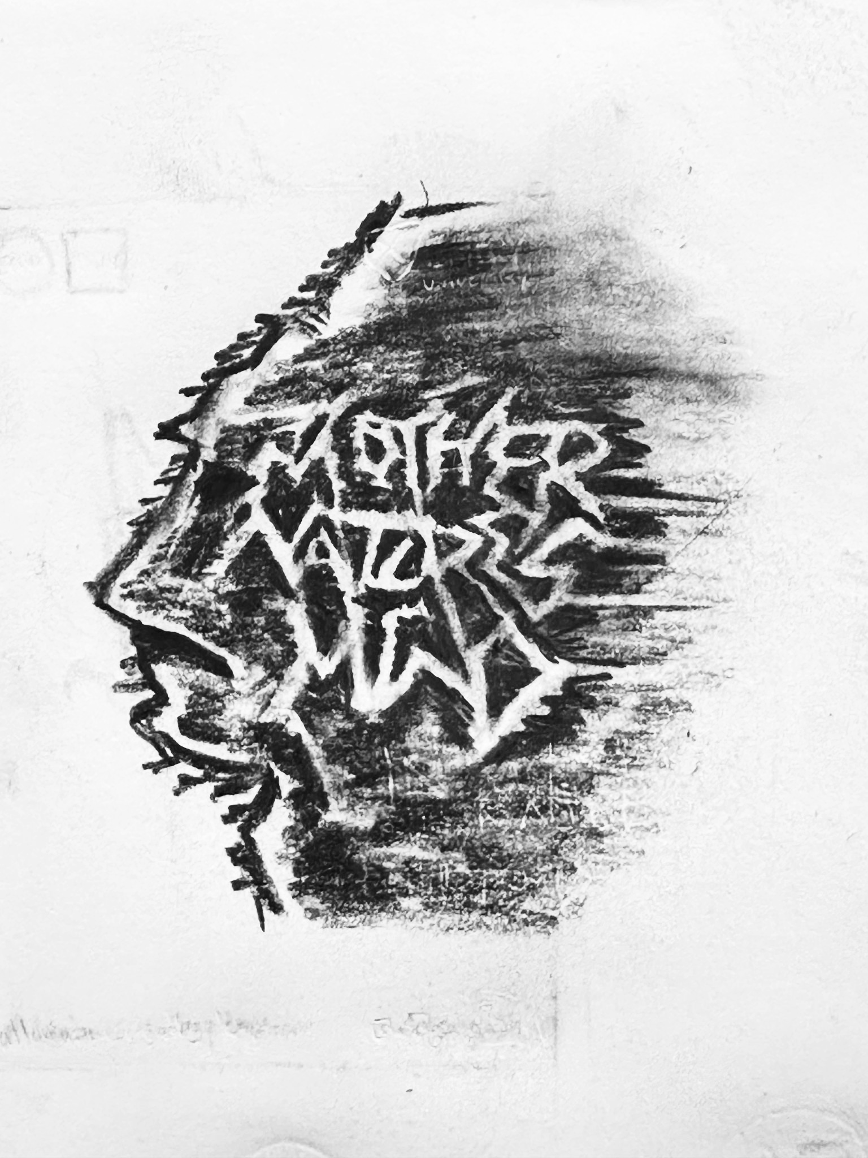
Notes:
I explored many different ways to design my museum logo, including a detailed sketch of a mountain range taken from a sideways angle that is designed to look like a face profile, as well as designing the typography in a way that would spell out given words while looking like ski routes.

Slide 13
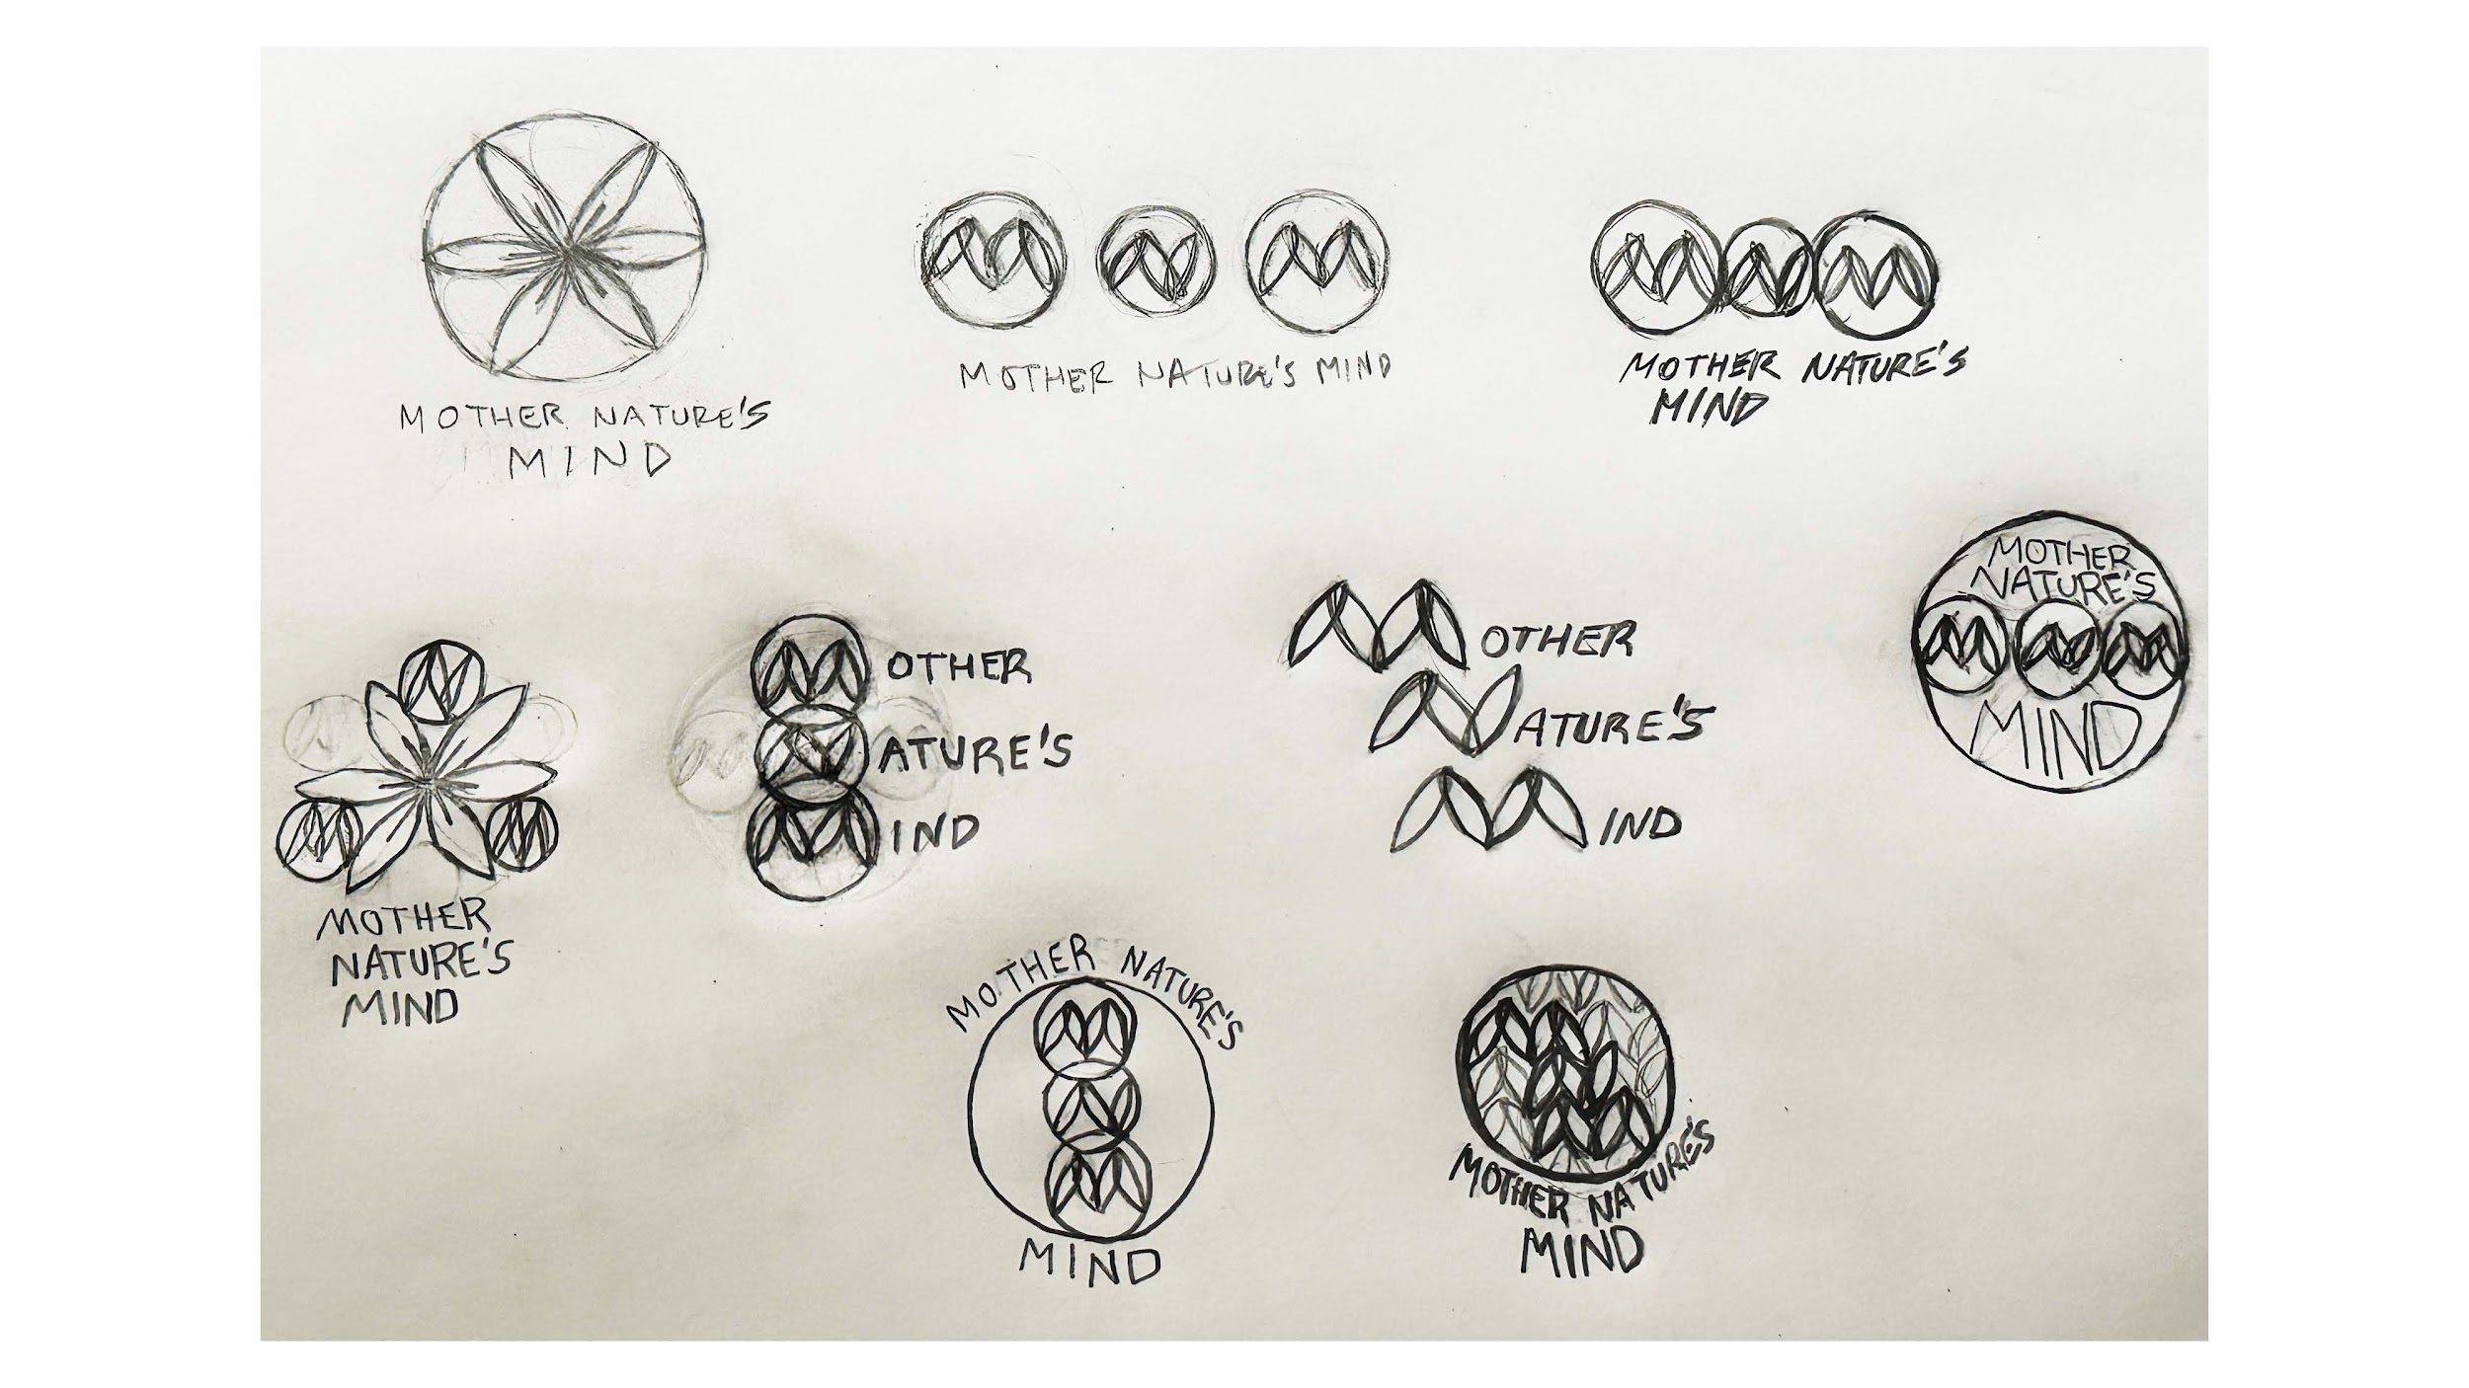
Notes:
I definitely wanted to incorporate an element of sacred geometry into my museum logo, as sacred geometry in general centers around the idea of nature having its own intelligence.

Slide 14
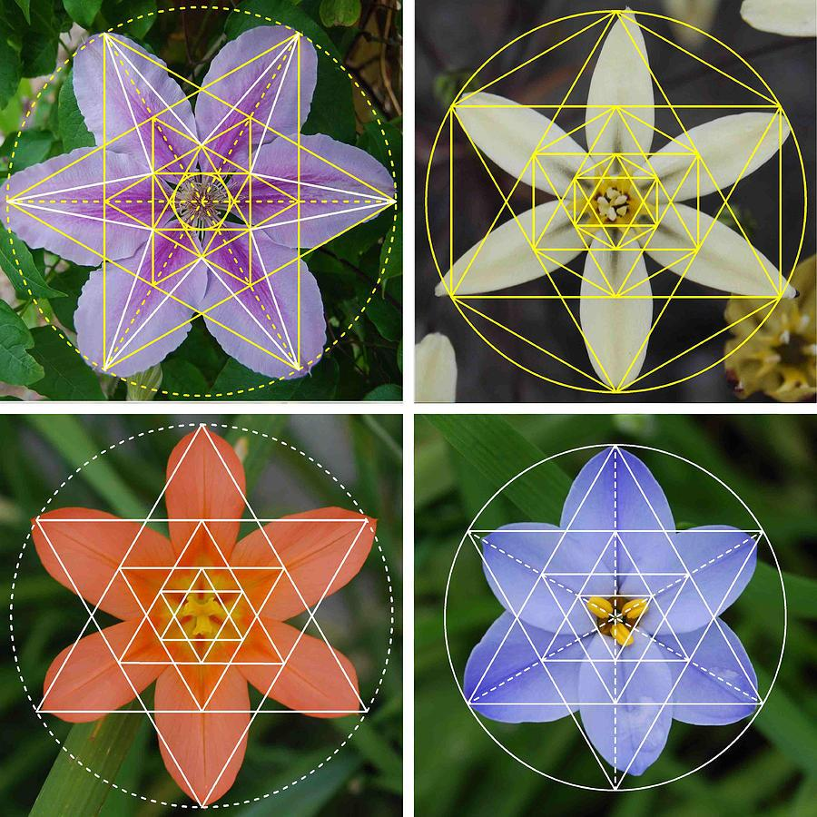
Notes:
Here are some examples of sacred geometry within nature and nature having a mind of its own.
If you look hard enough, you will see geometry in nature.

Slide 15
TYPE & COLOR STUDIES
#763f04
#d8c8b7
#a3907c
Helvetica Bold — Header
Helvetica Light — Body
Notes:
Style guide — type & color choices
I chose these colors mainly because I thought they would best represent nature, specifically landforms
I used a sans serif font because of its cleanliness and straightforwardness

Slide 16

FINAL LOGO
Notes:
Here is my final logo designed using Illustrator, which incorporates an element of sacred geometry.

Slide 17
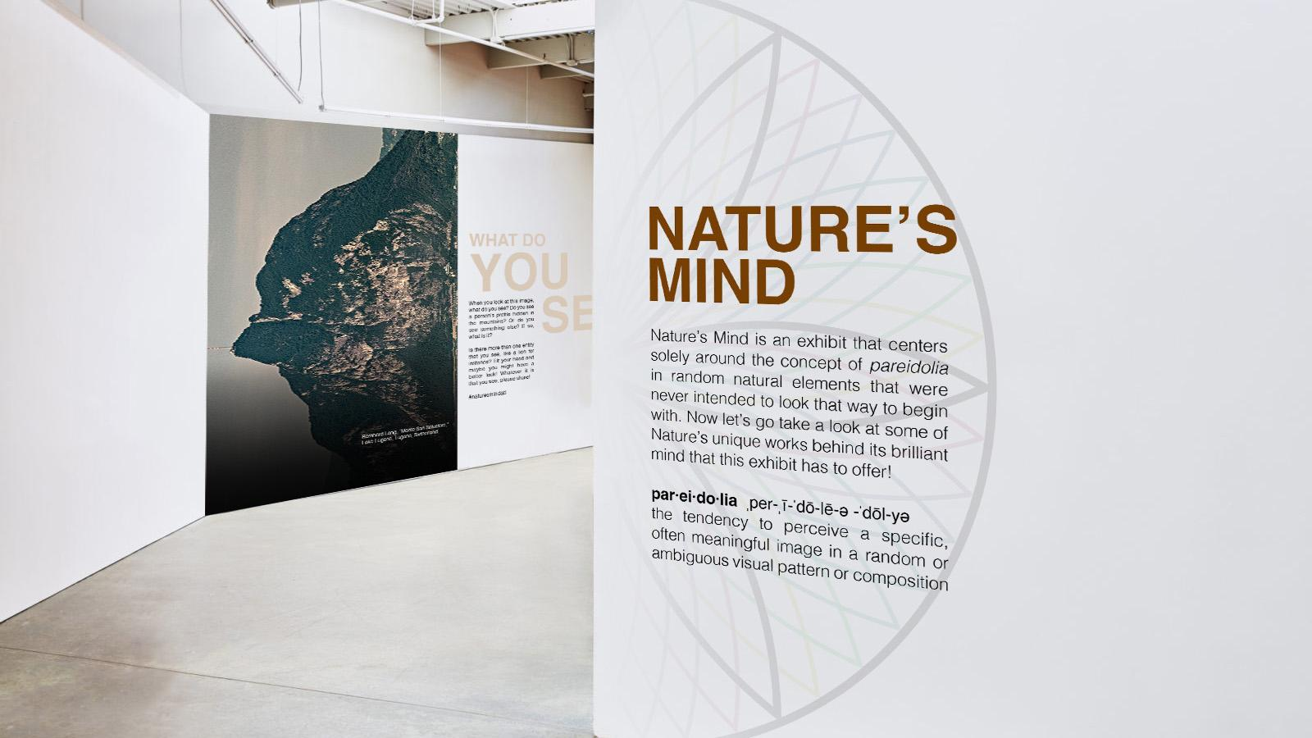
Notes:
Now, here is my museum exhibit Nature’s Mind, which takes place at Atlanta Contemporary.
What I knew was going to be a challenge upon creating this project was thinking about the overall concept of mind and disassociating it from a brain, along with sharing this idea in a way that would be interactive and engaging.

Slide 18
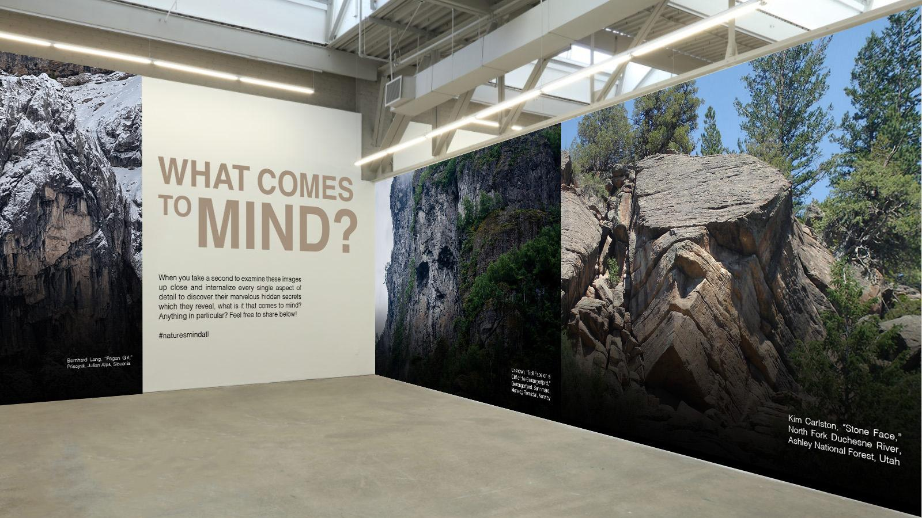
Notes:
What comes to mind when you see these images?

Slide 19
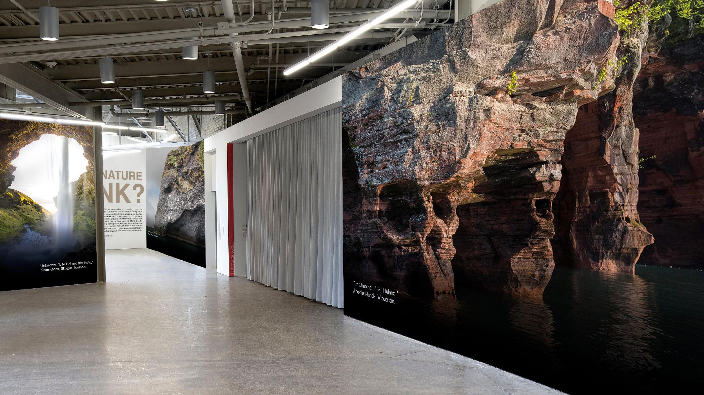
Notes:
I used Photoshop to mock up these compositions. I wanted the images to be scaled in a way that you were a part of the images as opposed to simply looking at them.
Now let me ask you this question. Does nature have a mind of its own or do we put our mind into nature?

Slide 20

Notes:
Here are some compositional typographic studies for developing my exhibit brochure that stress mainly on elements of typography.

Slide 21
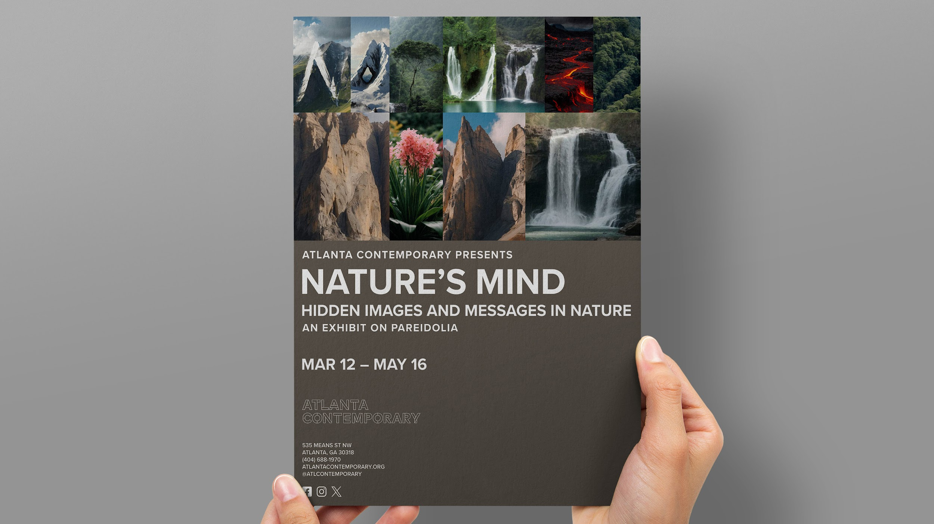
Notes:
Here is my final brochure for this exhibit created using Photoshop and InDesign.
As you can see, I used AI-generated images of nature to spell out nature’s mind.

Slide 22
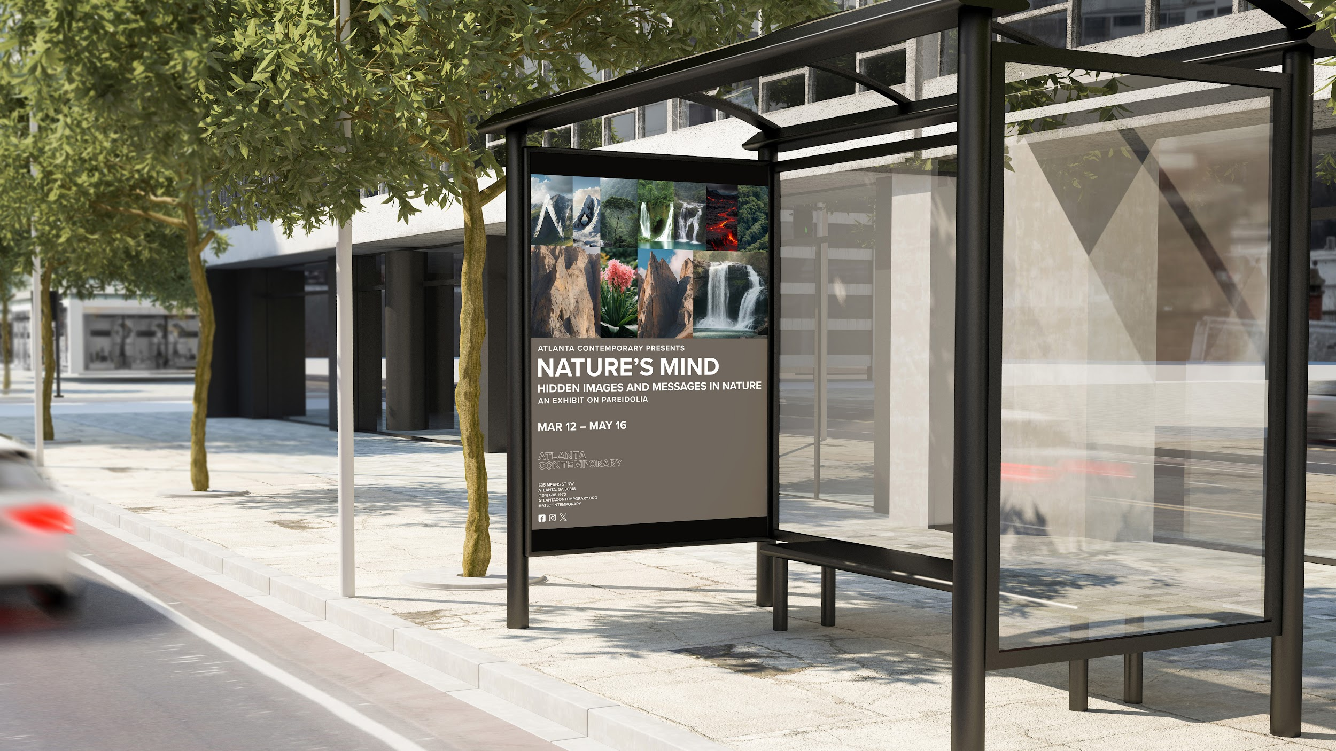
Notes:
Here is the same picture but scaled larger onto a bus stop billboard as an alternative medium to a brochure.
I really enjoyed this process and want to review my lessons learned…

Slide 23
Nature’s Mind Exhibit — What I Learned
What did I learn?
What went well?
What could I have done differently?
Notes:
*SLOW DOWN*
What did I learn? (as a graphic designer)
I definitely needed a process that was both physical and mental in terms of gathering inspiration from imagery as well as establishing connections between images and the viewer.
What went well?
A formal ideation process that was both physical and mental.
Creating a captivating experience that would allow people to not only see, but immerse themselves in a completely unique side of nature.
The educational component — not everyone knows about the concept of pareidolia and it’s rewarding to be in a position of sharing new knowledge with people.
What could I have done differently?
Show concrete examples of pareidolia next to the introductory wall of the exhibit with the exhibit name
For example, show an actual elephant then show the elephant shape in nature so there is a side by side comparison

Slide 24
Everything, Everyday
Notes:
Now, moving onto project 2, I present to you all a book titled Everything, Everyday…
Again, from Professor Fano’s Ideation Models & Process, GDVX-702, Fall 2023
The purpose of this project was to establish a new relationship between “usual” to “unusual” and to discover unseen resemblances in everything, everyday.

Slide 25
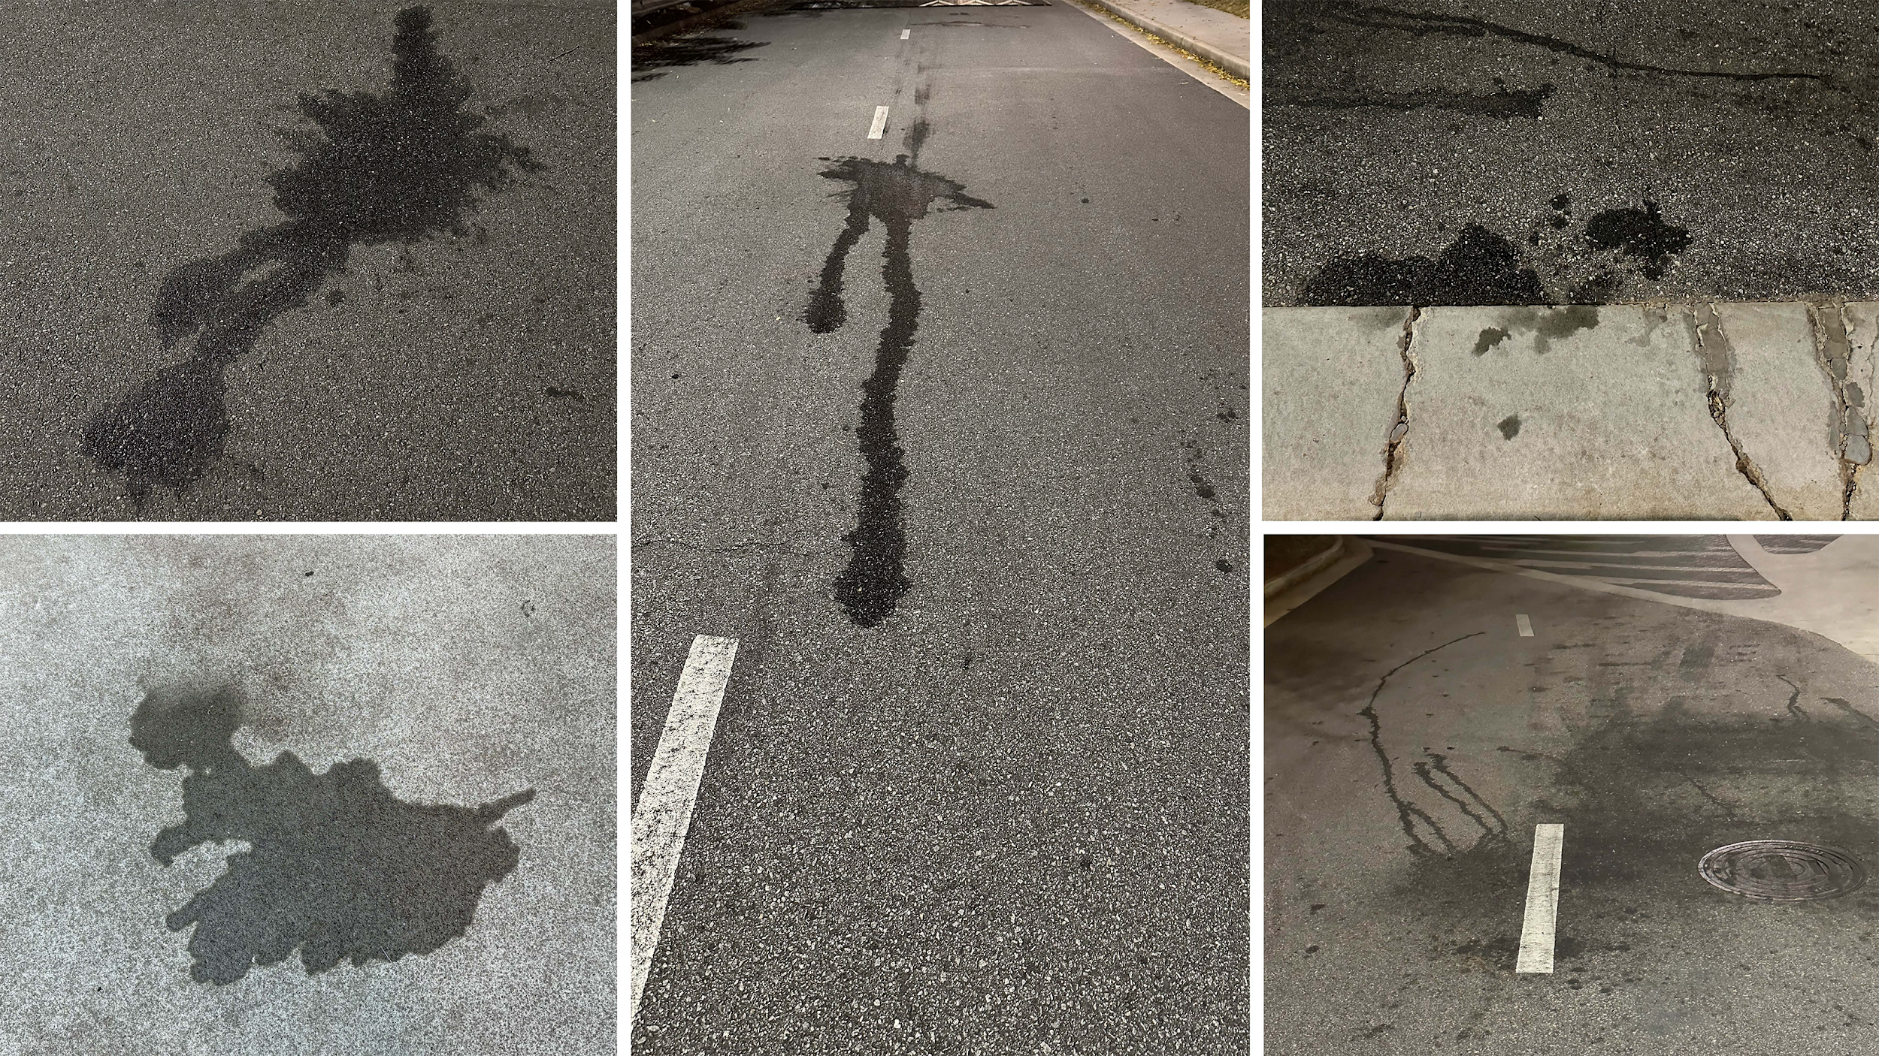
Notes:
I started walking around SCAD’s campus taking photos of my everyday life without having any bias just noticing my life. I was then instructed by Prof. Fano to look for specifics and to center my attention on those specifics.
The time that this project was presented to us in class literally happened to coincide with the war between Israel and Gaza.
That was when I started to closely analyze analogies in asphalt, like these oil drips in particular, which were really intriguing since I saw resemblances to blood drips, genocide and atrocity in general.
It’s amazing how perspective changes everything as something as innocuous as an oil drip in asphalt can be powerful enough to illicit strong feelings that might represent death and genocide.

Slide 26
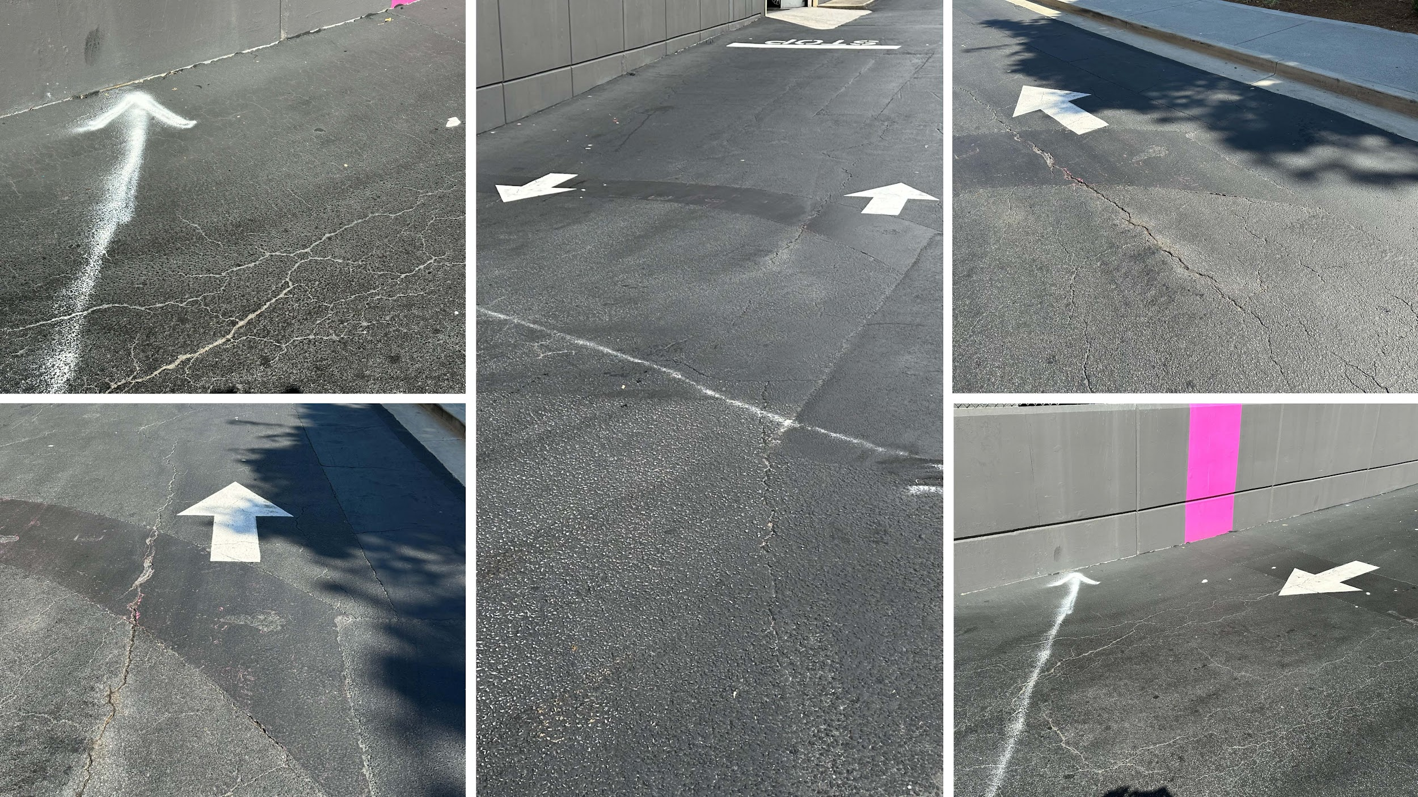
Notes:
More imagery from walking around
These arrows, specifically the one that’s spray painted aiming towards a wall, can serve as a metaphor towards a missile strike.
In a way, without realizing it, seeing these compositions in the asphalt as close to where I live serve as a reminder that we could’ve been the ones under attack, which definitely leaves an unsettling feeling.

Slide 27
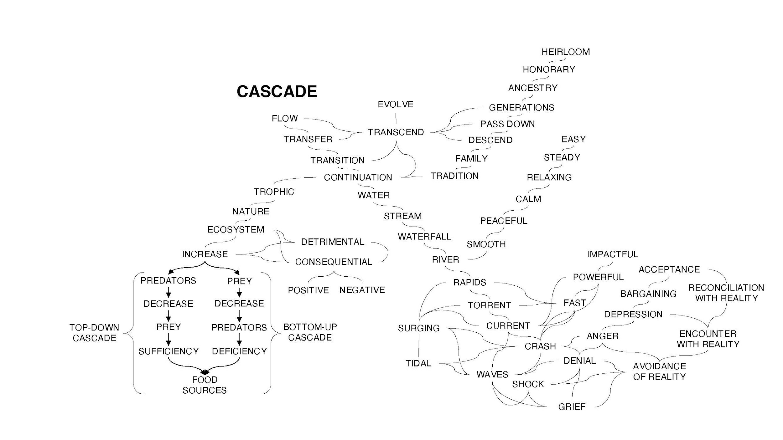
Notes:
I did a number of mind maps but this is the one that really helped guide me in the right direction towards designing my final deliverable as well as deepen my thought process.
I’ve boxed the words that impacted my thinking throughout this process.

Slide 28
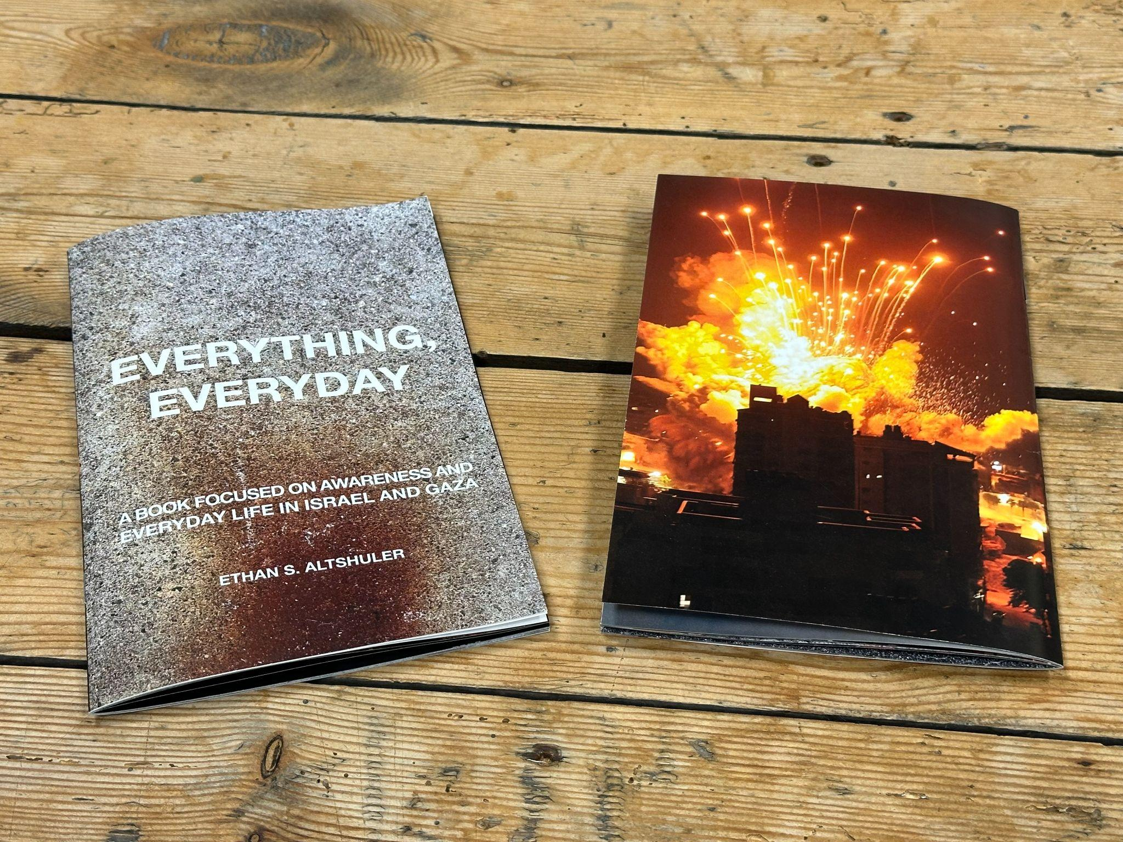
Notes:
I chose a book for my deliverable that was designed using InDesign.
I’m going to showcase two pages before I hand out the book.
It was an intentional medium choice as there’s a permanence to this medium that seems appropriate as opposed to viewing this electronically.
My audience is adults who have the maturity to grasp this content, and I definitely wanted the imagery to have a lasting and powerful impact on their psyche.

Slide 29
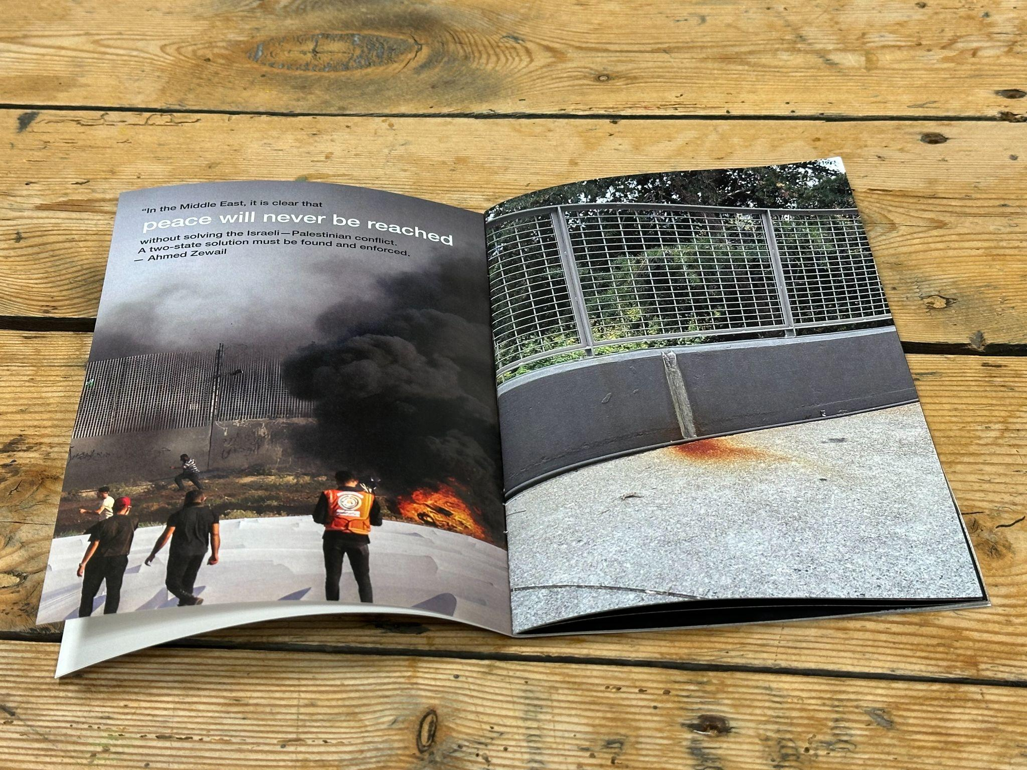
Notes:
Part of why this book in particular is really personal is because I have extended relatives living half a world away in Israel, which still feels very close to me, given that I’ve been there myself.
The intention behind this book was to compare and contrast my life here vs. life in Israel and Gaza and the parallels/associations between certain photos taken on campus.
What was going to be challenging for me as a graphic designer was figuring out how to convey a sense of perspective that would allow people living in peace to appreciate, so that the next time they would step outside and take in a deep breath of fresh air, they wouldn’t take it for granted.

Slide 30
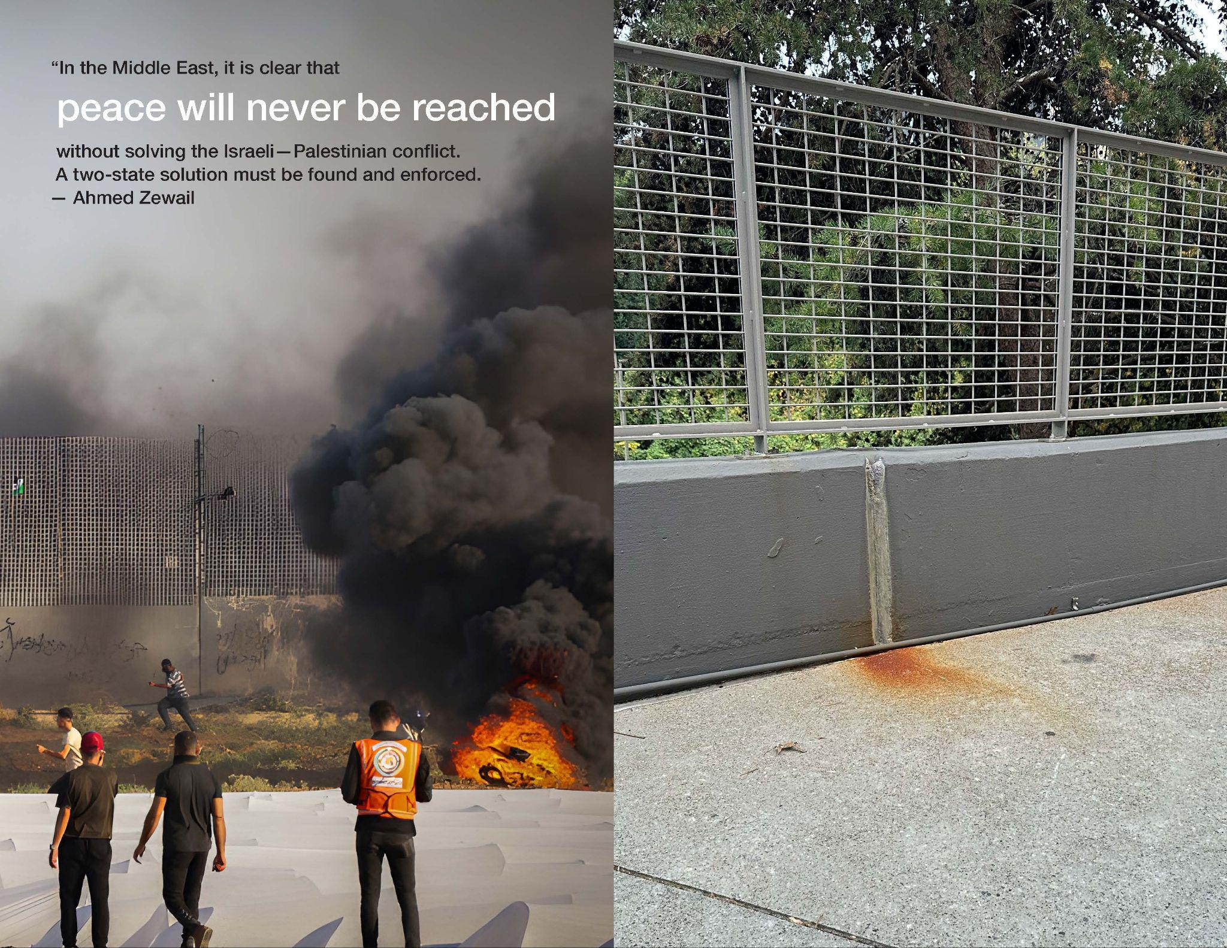
Notes:
I incorporated powerful quotes to captivate the reader, where certain words are enlarged and colored white for emphasis.
Logistically, the colors are monochromatic along with a sans serif typeface, which reflects a serious tone that’s appropriate for the subject matter.
I’m letting the images speak for themselves. i.e., the idea of living life on the other side of the wall where the grass might be greener.
In other words, I utilize visual metaphors through showcasing images of war and images of peace and tranquility through my life here.

Slide 31
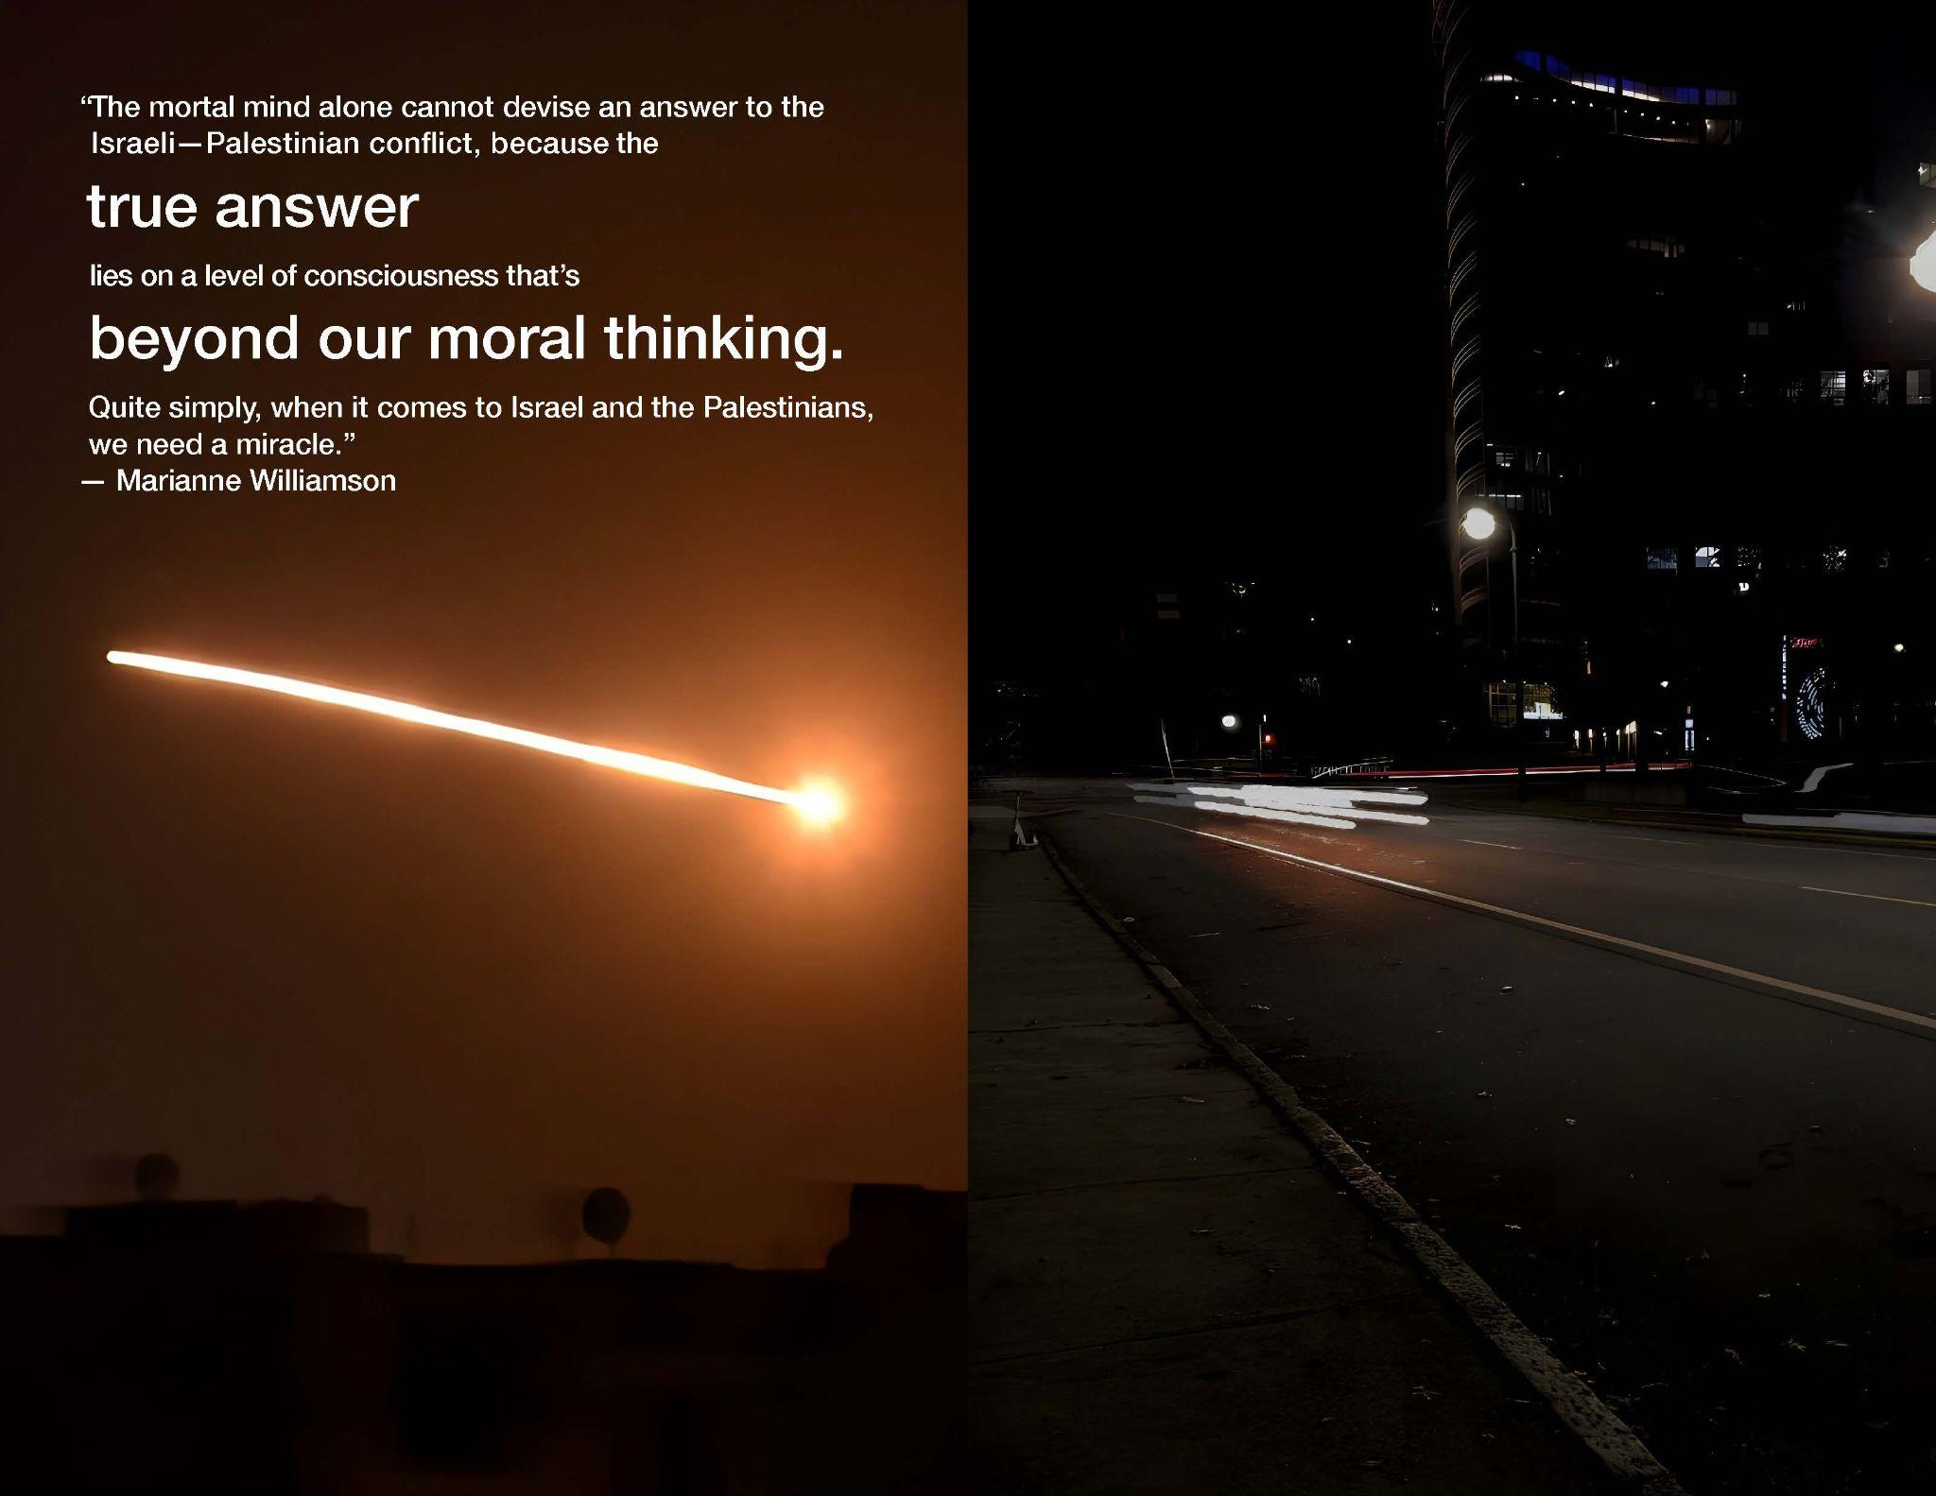
Notes:
What really stood out to me about these images was the idea of how quickly life can literally flash before your eyes.
Here is the book. Let me give you a little bit of time to glance through the book and feel the impact before we move onto my recap. (take about 15-20 seconds)

Slide 32
Everything, Everyday — What I Learned
What did I learn?
What went well?
What could I have done differently?
Notes:
*SLOW DOWN*
What did I learn?
The power of bridging and pairing images between my life here and life half a world away in Israel and Gaza, and how thought-provoking and self-reflecting these memoirs could have on the reader.
The power of imagery ties to expressing the difficulty of reality elsewhere
The importance of choosing the right medium in terms of having it be private vs. public like an actual exhibit
What went well?
Using captivating imagery to convey clear parallels and contrasts between life here in the States vs. life overseas in Israel & Gaza
Choosing the right stock imagery to complement my existing photos
Really paying close attention to my environment, which was definitely a mind stretcher
Choosing correlating quotes and the emotional impact of the paired quotes and images
What could I have done differently?
Spend more time sketching when ideating my initial process and emphasizing type & color studies in my process
More sketching would’ve allowed me to explore a wider range of compositions for how I would go about designing each page in my book in terms of image selection and type arrangement

Slide 33
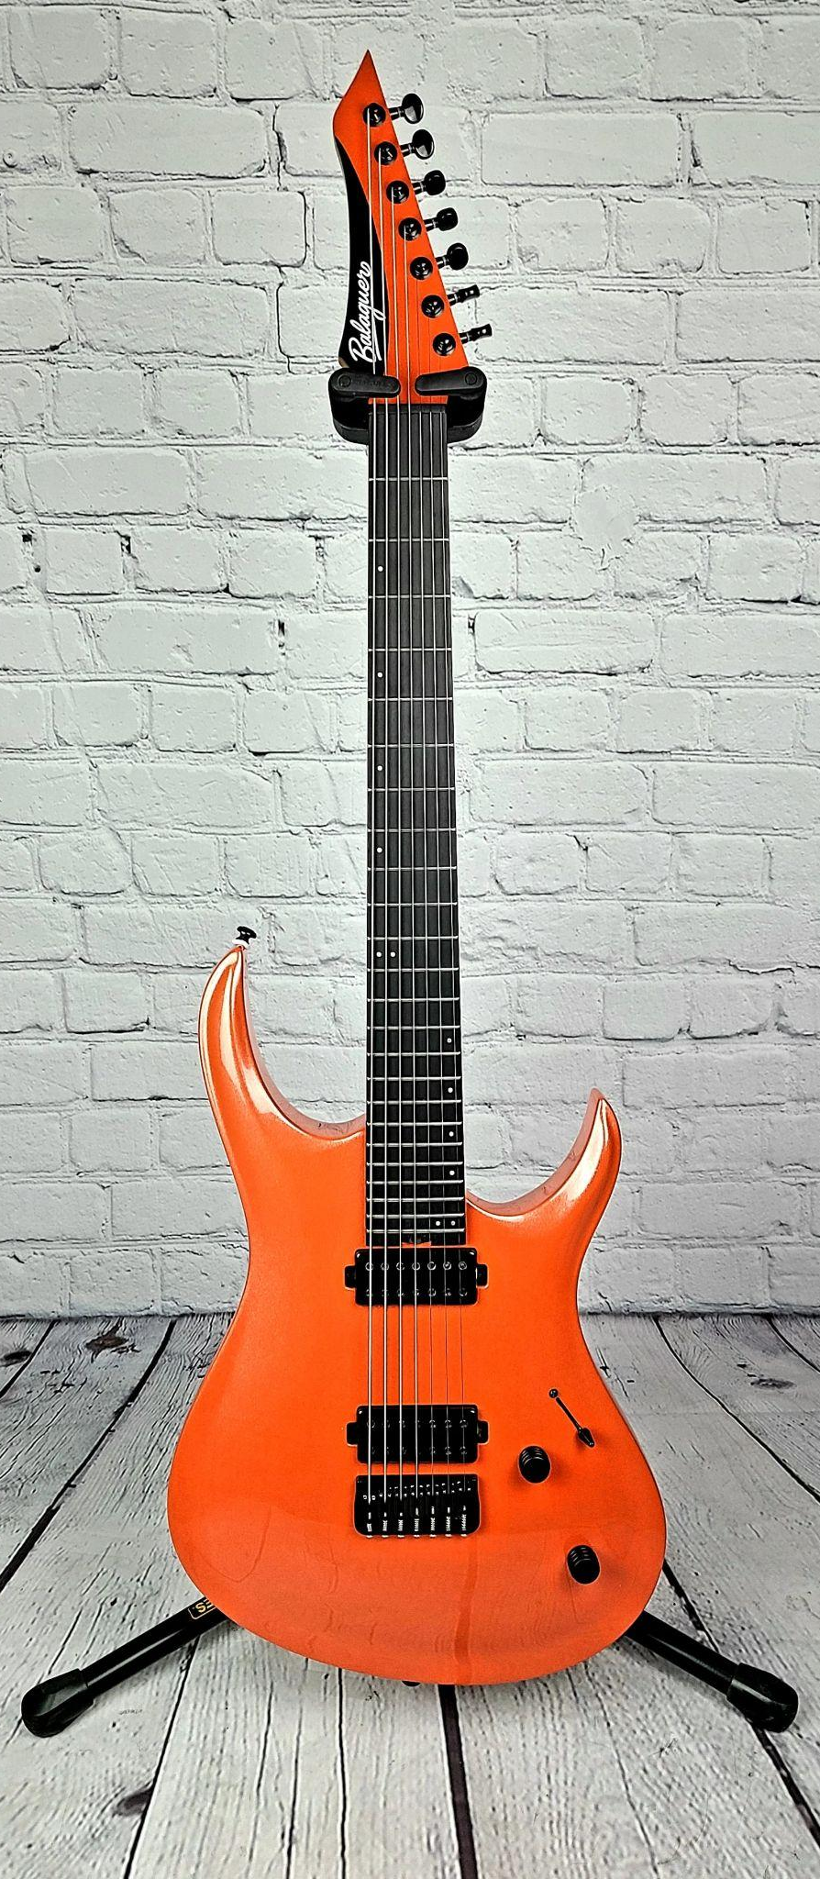
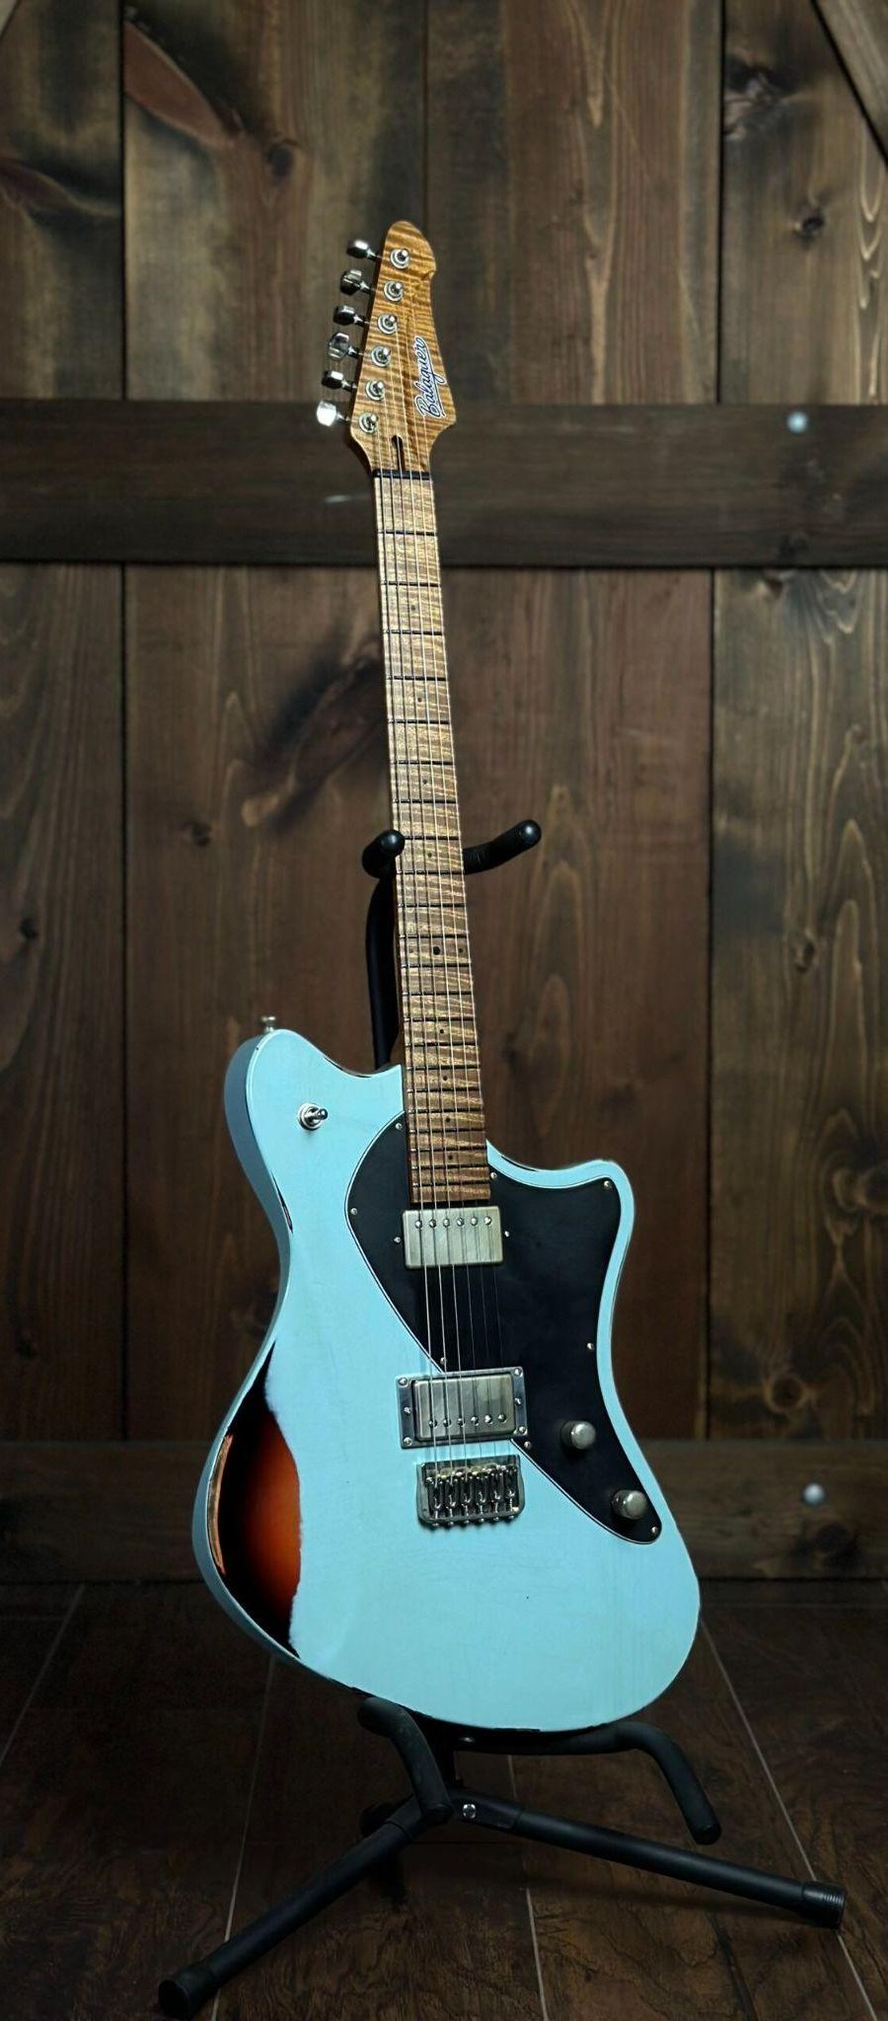

Balaguer Guitars
Notes:
Now… the time has finally come for me to share my passion project with you all, which is Balaguer Guitars.

Slide 34
Balaguer Guitars Hero’s Journey Overview
Research Results
Project Description
Final Deliverable — the Balaguer Hero’s Journey Exhibit
Notes:
Methodology —
I chose the music industry as my main area of focus because I’m a passionate musician who wants to enter this industry.
I started looking at larger well-known brands like Fender and Gibson but was advised by Assoc. Chair Eckersley to look for a smaller, lesser known company that would be less bureaucratic and more accessible, and boy was he right!
I ended up choosing Balaguer because of the uniqueness of their value proposition which I’m going to explain momentarily

Slide 35
Joe Balaguer Interview Response
Notes:
One of the delightful results of this process was interviewing the founder and CEO of Balaguer Guitars himself, Joe Balaguer, who allowed me to post my survey on his private Facebook Group timeline, which was very essential for my research!

Slide 36
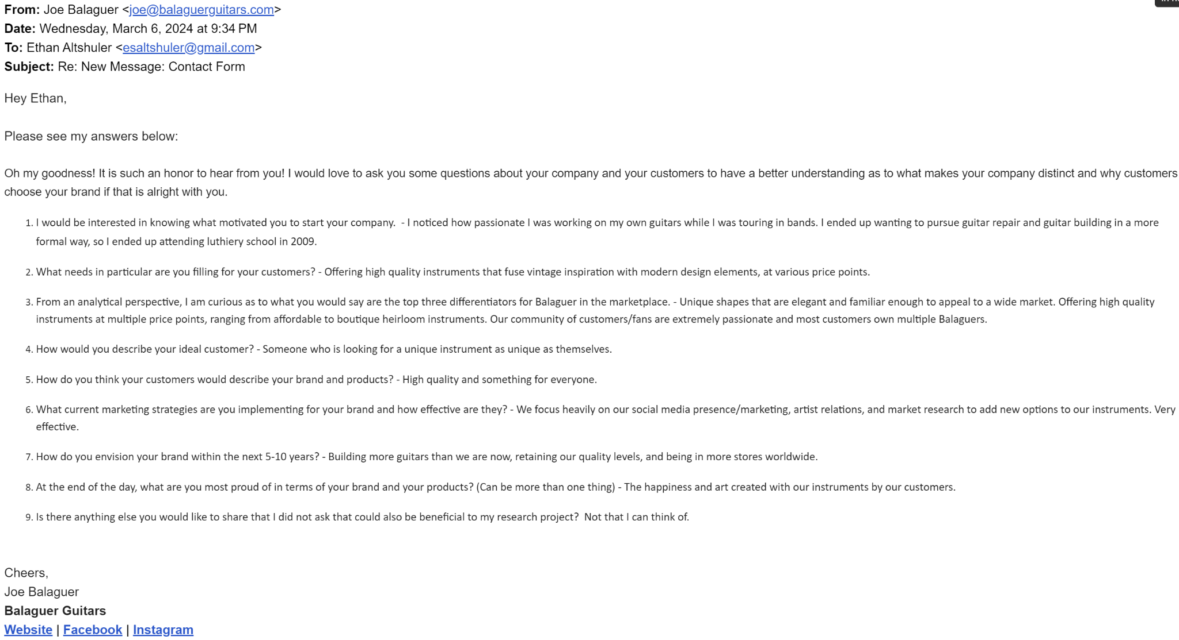
Notes:
Here is my interview with Joe.
His response to question 4, which was how he would describe his ideal customer, stood out the most. [click the clicker]

Slide 37
Someone who is looking for a unique instrument as unique as themselves
Notes:
This quote is quite impactful for me, given my diagnosis and life journey

Slide 38
Balaguer Guitars’ Main Objective
Customers center staged
Uniqueness to custom builds
Deepening existing client relationships
Attracting new customers
Notes:
What I took away from my interview with Joe is that:
Balaguer Guitars’ main objective is to put customers center stage with an instrument of their own that is unique and affordable.
The uniqueness that comes with these custom builds is reflective of the artists as both a person and a player.
Lastly, solidifying the company’s relationship with existing customers and attract new ones.

Slide 39
Demographic Analysis
Balaguer appeals to:
Mostly between 25-50 yr. olds
Wide income range
Predominantly male gender demographics
Serious guitar players interested in honing their craft
Notes:
Here is a summary of my demographic analysis. Read the slide.

Slide 40
Why One Chooses Balaguer Summary
What makes Balaguer unique:
Materials & Aesthetics
Product Customization
Company Culture/Community
Value
Quality
Notes:
Here is what makes Balaguer unique.
Materials & aesthetics are key.
Customization is their unique value proposition.
They have a huge sense of community driven by Joe from the very top who is very connected to satisfying his customers with value and quality.

Slide 41
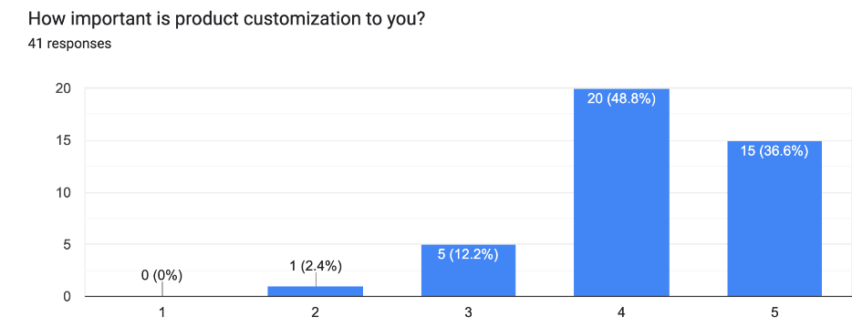
Product Customization
Not important
Very important
“Someone who is looking for a unique instrument as unique as themselves.” — Joe Balaguer
Notes:
My survey also revealed an astounding statistic — 86% of respondents value product customization to satisfy their unique desires
To quote my interview with Joe, “How would you describe your ideal customer?” his answer was “Someone who is looking for a unique instrument as unique as themselves.”

Slide 42
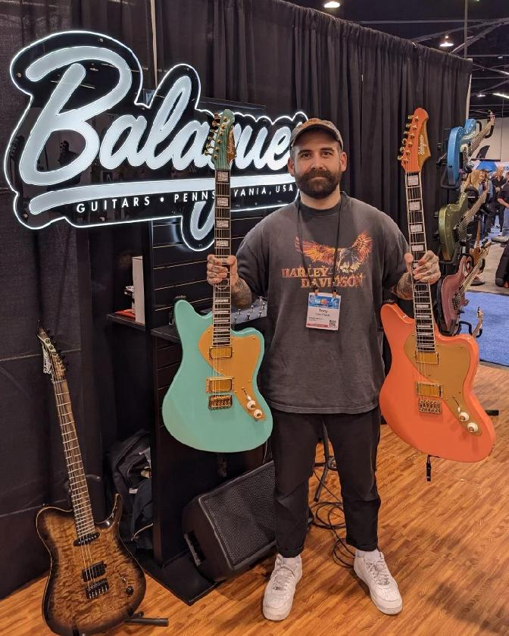
Research to Reaction
The Path From Survey Results to Balaguer Guitars Hero’s Journey Exhibit
Notes:
Let me explain how I went from research to deliverable:
I wanted to attract new customers and deepen the sense of community from existing customers by creating an exhibit to be shown at music conventions like NAMM (National Association of Music Merchants) and other trade associations.
I learned from Psychology Today that visualization helps influence decision making.
Here I am elevating Balaguer’s current exhibit to the next level

Slide 43
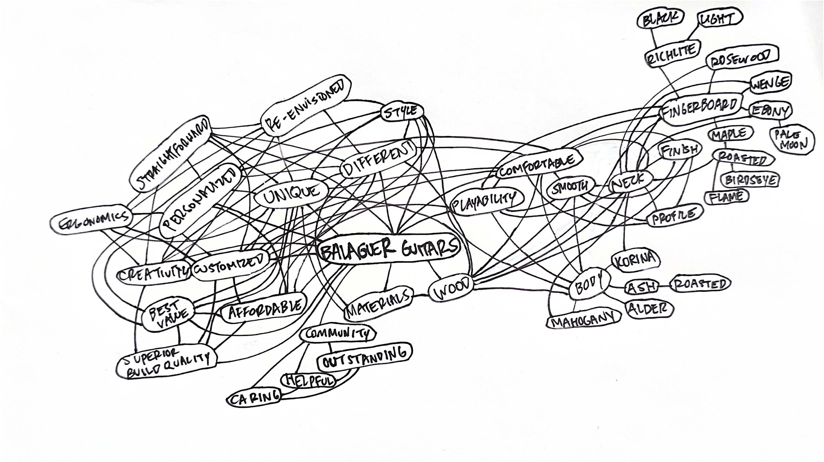
Notes:
So I started at the beginning with a mind map of Balaguer and the concept of an exhibit wall came to mind.

Slide 44
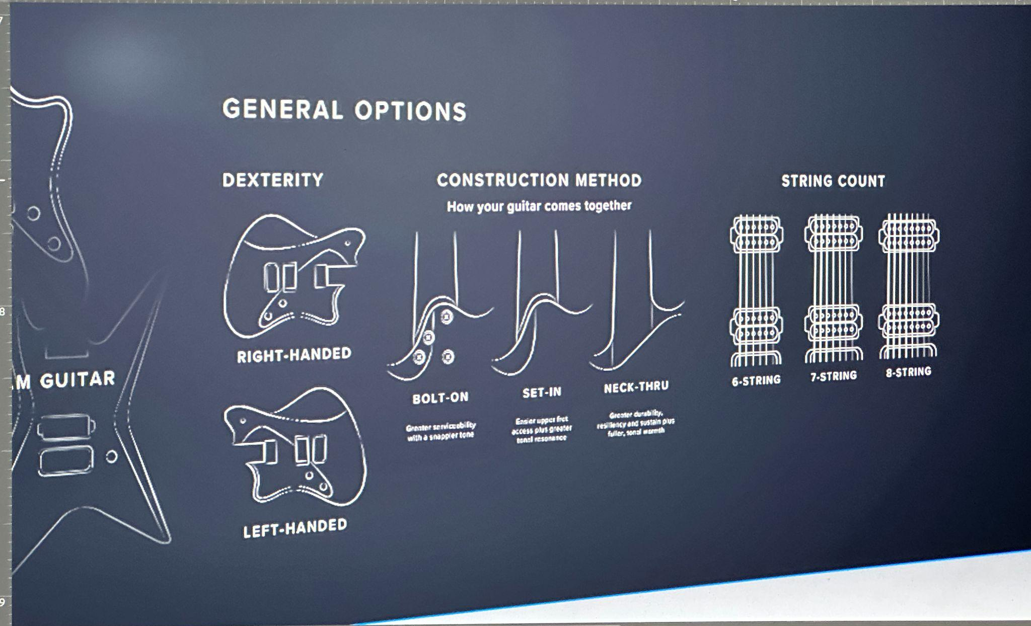
Balaguer Guitars Hero’s Journey
Ideation
Notes:
Given Balaguer’s competitive advantage of guitar customization, my first instinct was to create an exhibit that would walk the viewer through the process, providing all the options for customizing their own guitar.

Slide 45
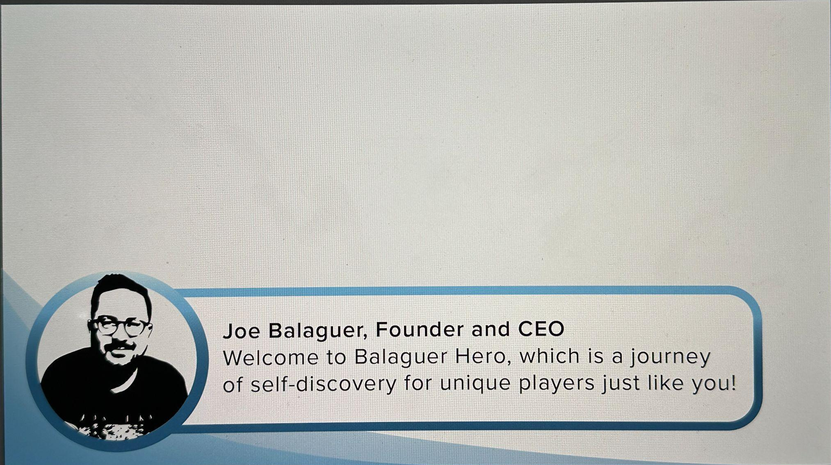
Balaguer Guitars Hero’s Journey
Ideation
Notes:
With feedback that this was too technical and more brochure-like, I pivoted to the concept of an interactive video game with Joe, the CEO, who serves as an avatar providing guidance and helping people choose their own custom guitar, and the player would earn tokens as they advance through each level growing their fanbase with a customized Balaguer guitar along the way.

Slide 46
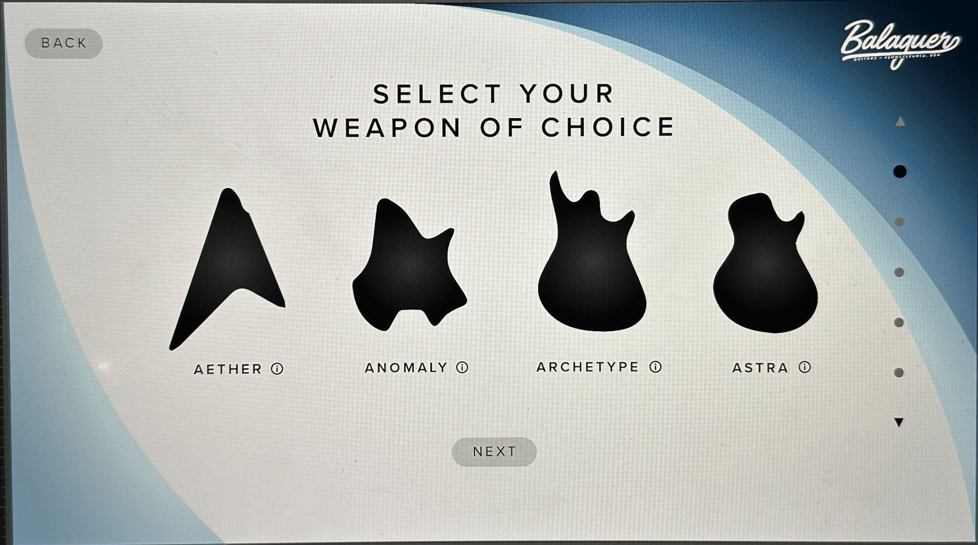
Balaguer Guitars Hero’s Journey
Ideation
Notes:
For the game, this is where the player would choose their own weapon of choice before proceeding.

Slide 47
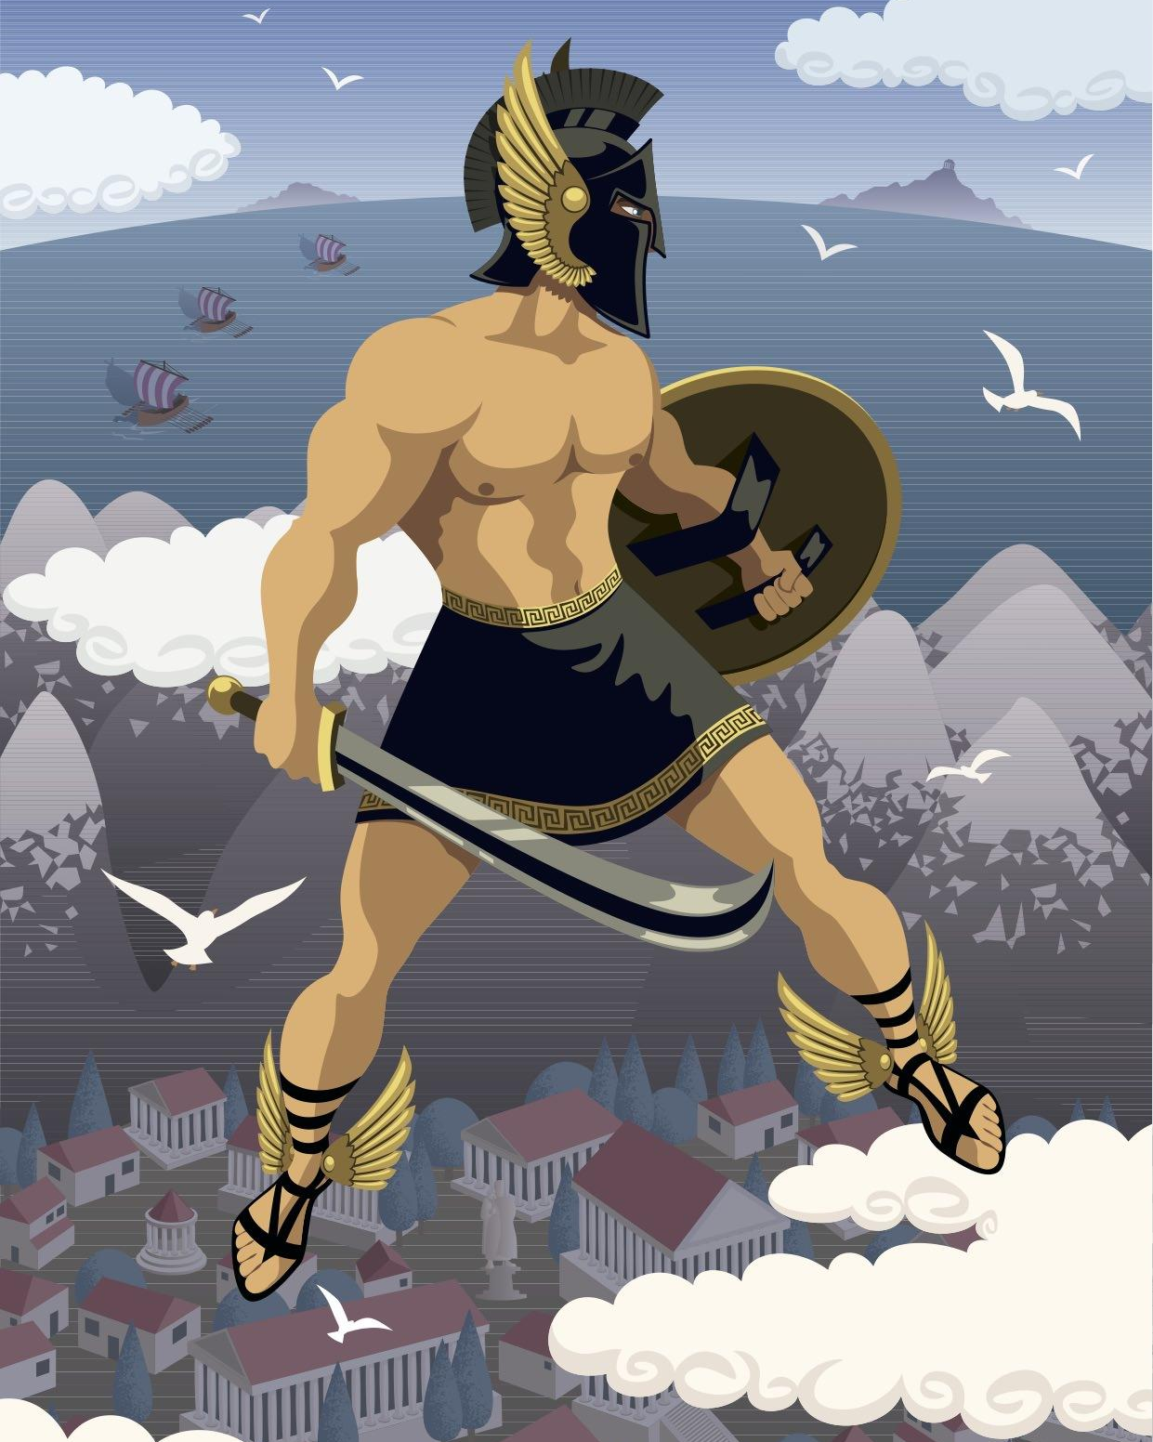
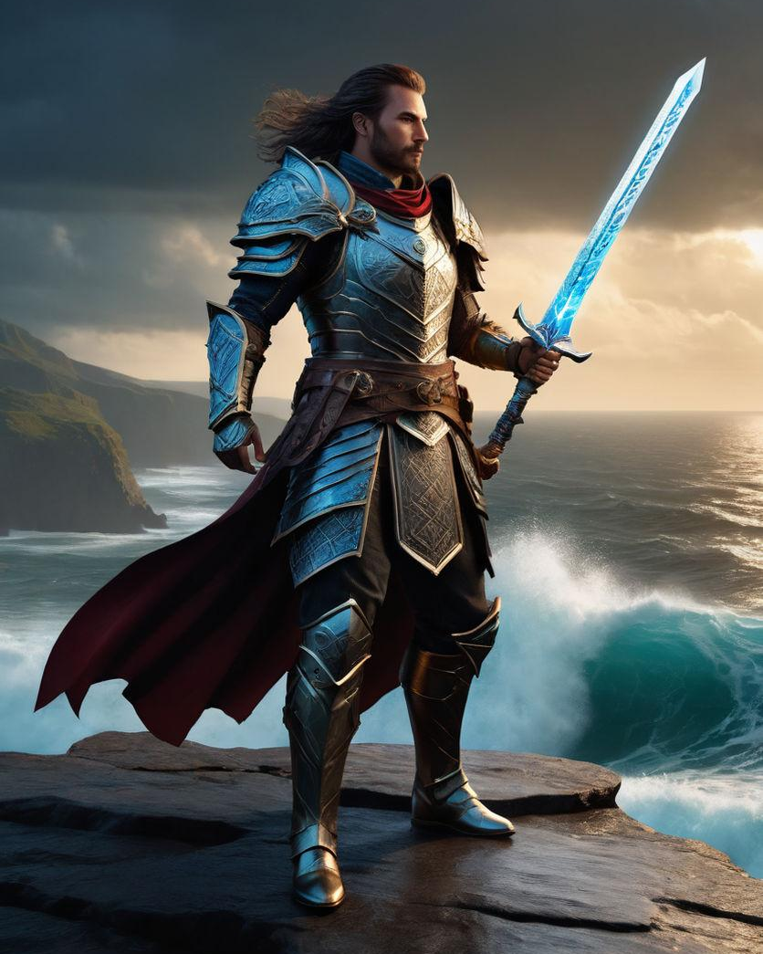

Mood Board to Hero’s Journey
Notes:
After scrapping the idea of a video game, I was stuck on the thought of somehow incorporating a Hero’s Journey.
You’ll see the direct correlation here between these heroes with actual weapons and rockstars with their weapons of choice, aka their customized guitars.

Slide 48
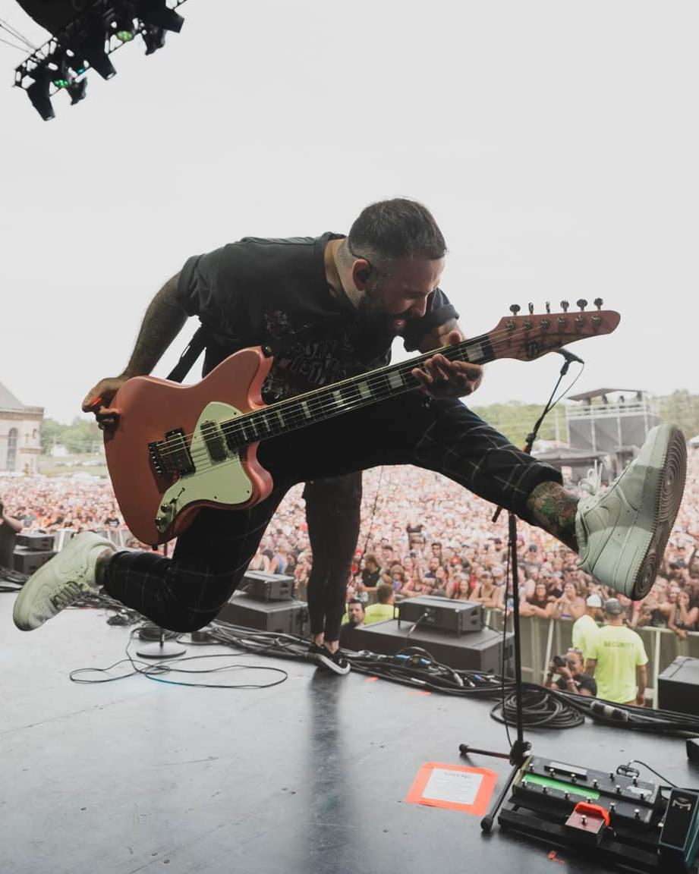
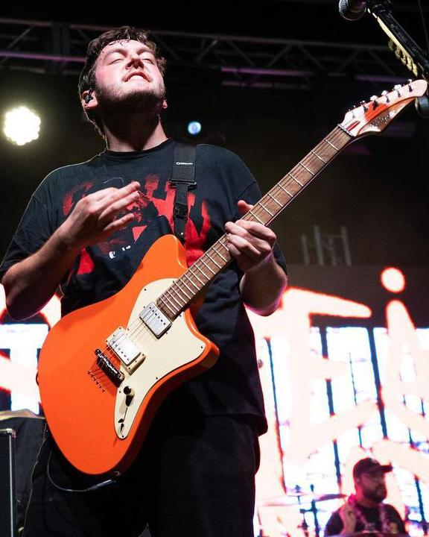
Mood Board to Hero’s Journey
Dan O’Connor, Four Year Strong
Tony Pizzuti, Sleeping With Sirens, ex-The Word Alive
Tyler Szalkowski, State Champs
Notes:
Here are examples of Balaguer heroes who chose Balaguer as their go-to brand of guitar for utilizing their customized products.

Slide 49
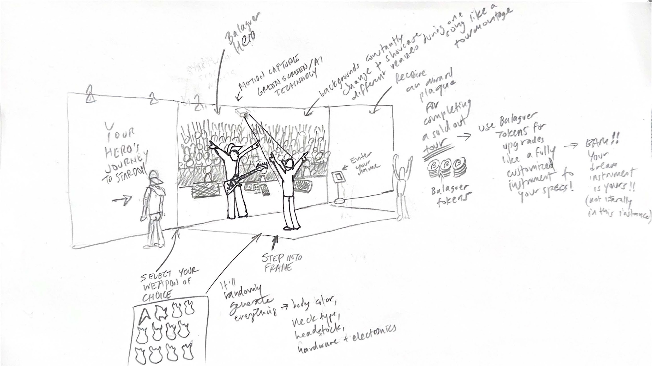
Notes:
I had many visual experiments and spent quite a bit of time sketching ideas.
Until Monday morning, this was the sketch of my final deliverable… you’ll see the simplified 3 phases of the hero’s journey: Departure, Initiation, and Return.

Slide 50
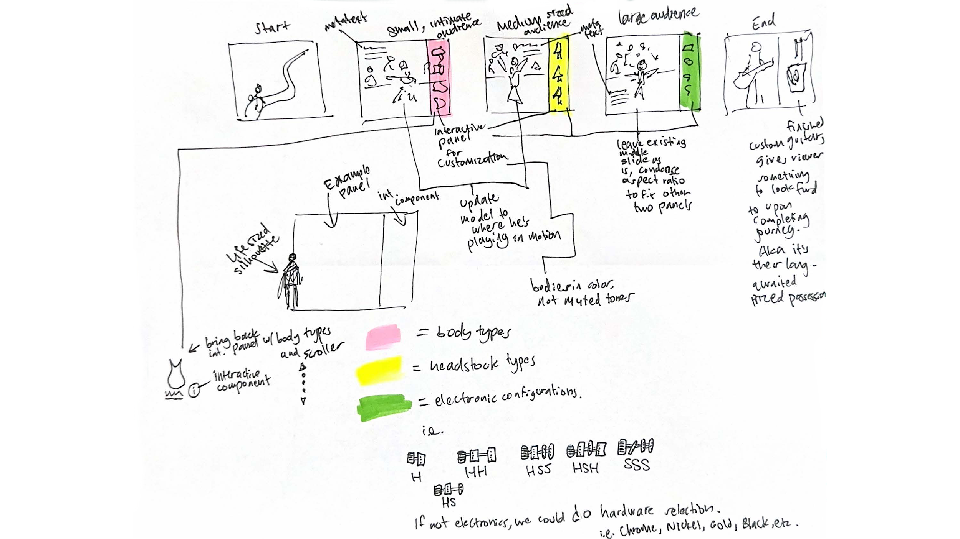
Notes:
It wasn’t long before THIS became my final sketch thanks to Eckersley encouraging me to take my ideal deliverable to the next level

Slide 51
Balaguer Guitars Hero’s Journey — Full Exhibit Overview
Notes:
And now…
Dum dum dum…
I would like to share what I finally settled on for my project deliverable, which is an interactive exhibit wall

Slide 52
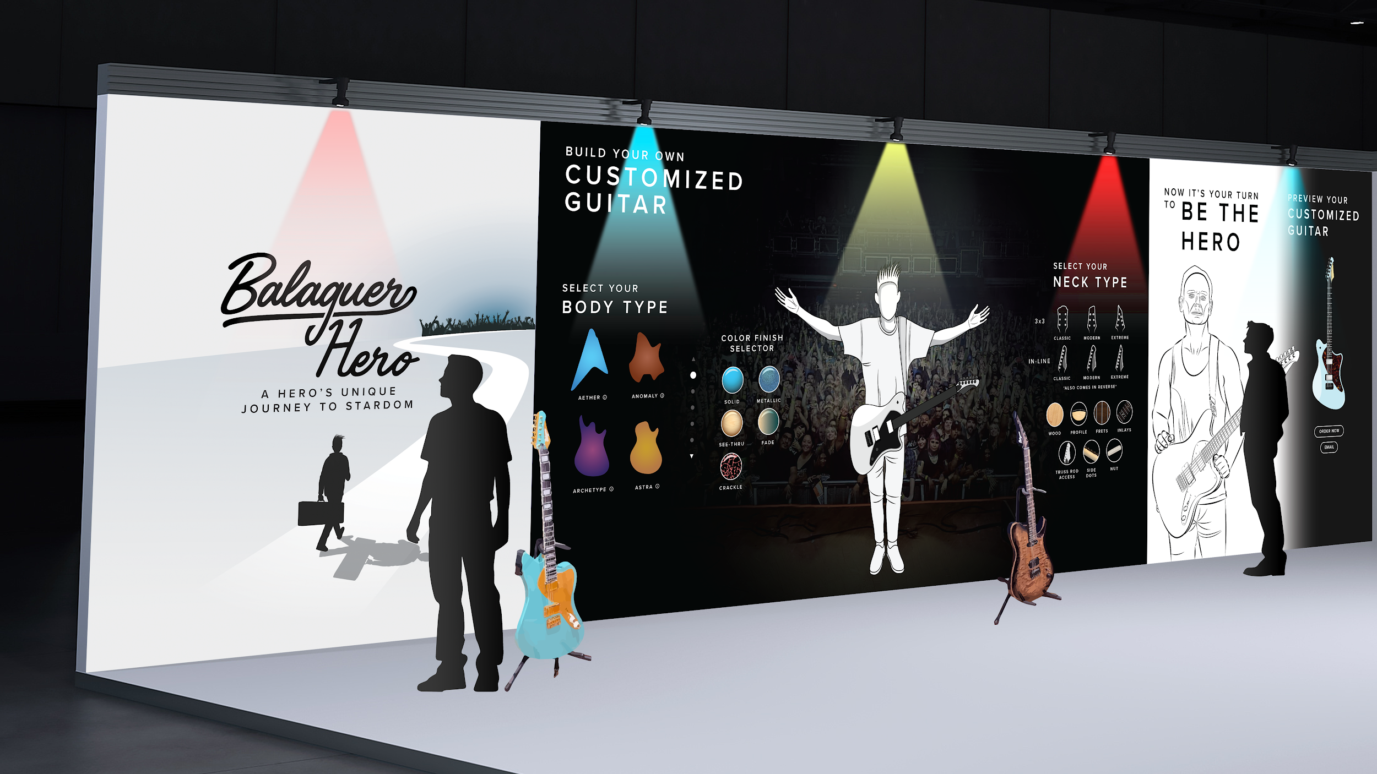
Notes:
This is the full exhibit overview.
The goal of the exhibit is to reinforce Joe’s vision of uniqueness and customization using the hero’s journey of departure, initiation and return, along with creating the incentive for those daring to embark on this journey to earn their own customized guitar from Balaguer.
DESIGN DECISIONS
I used Illustrator for designing the artboards and Photoshop for applying the artboards onto an actual perspective wall using a mockup from Adobe Stock.
I thought an exhibit wall was most efficient, given the objective of attracting new customers and inspiring existing customers.
I wanted the colors to provide a sense of empowerment as well as the same sense of being on stage.
Proxima Nova is one of my favorite sans serif typefaces, and I wanted to increase the kerning so that the messages would resonate a whole lot more to the viewer.

Slide 53
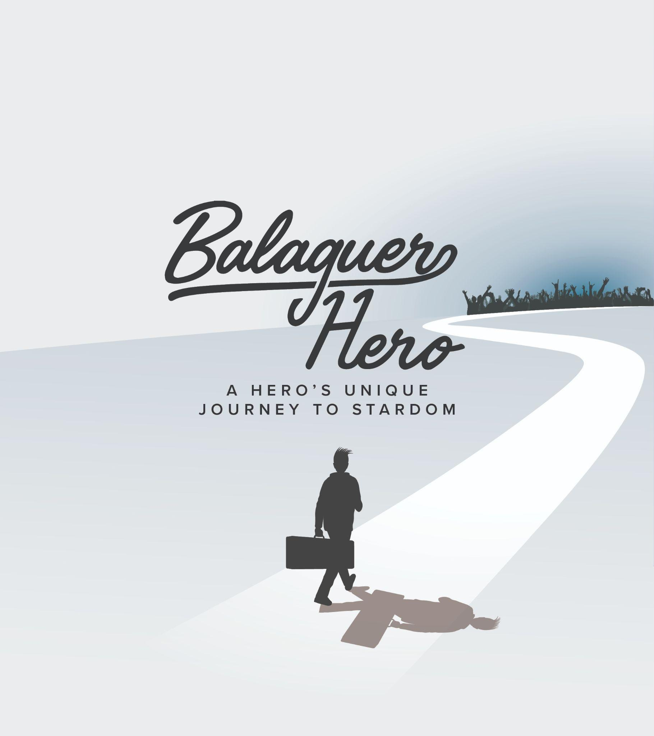
Departure
Notes:
Here is Phase 1 of the Hero’s Journey: Departure. This is where the journey begins with a soon-to-be rockstar with nothing but a guitar in hand ready to step forward and embark on a life-changing journey toward the horizon with a cheering crowd in the distance.

Slide 54
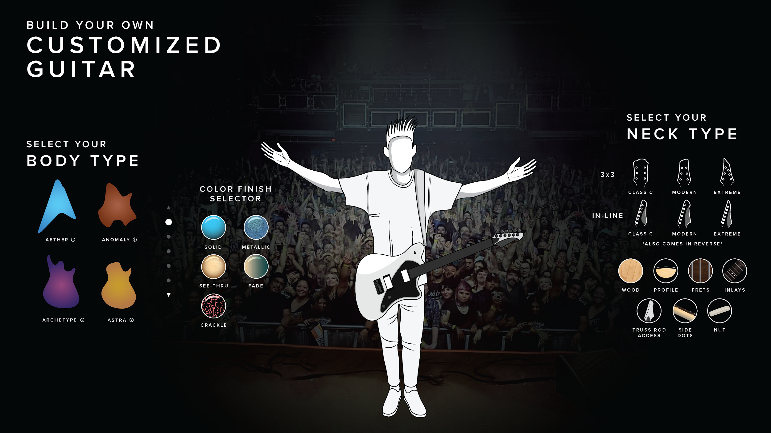
Initiation
Notes:
Here is Phase 2 — Initiation.
This is the interactive part with numerous panels overlaid on a dark background that showcase the customization process at the discretion of the customer, aka you!
Here the hero is seen playing his customized guitar in front of a cheering crowd and feeling that same sense of accomplishment just like those Greek heroes pictured earlier.
The options you select for customization, whether it’s body type, color finish, neck type or whatever, it will be reflected onto the middle panel

Slide 55
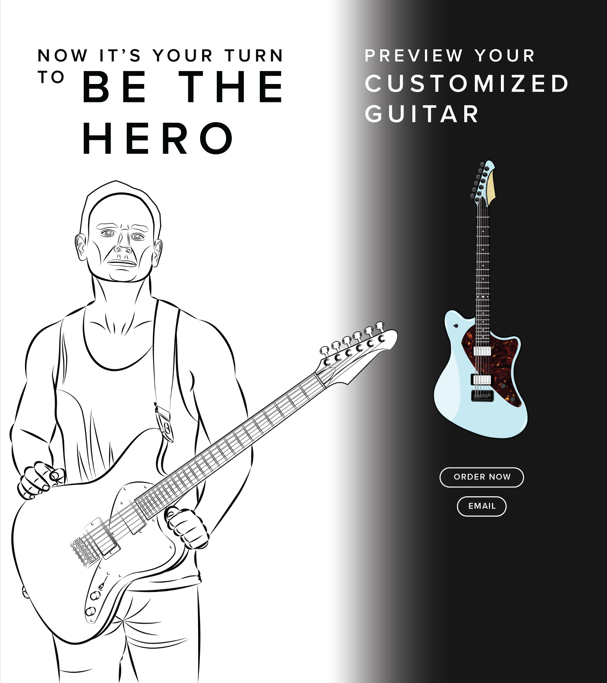
Return + Reward
Notes:
And now, Phase 3 — Return + Reward. This is where hero returns to their regular life, but as an inspired and evolved character after having completed their journey with a new guitar in their hand, only to await a new journey to begin!
Additionally, panelists will have the choice of fulfilling their order on the spot or emailing them a copy of their template design for them to decide on fulfilling later on
[add email & order now buttons]

Slide 56
Balaguer Guitars Hero’s Journey — What I Learned
Explorimenting
Research
Resolution
Persistence
Notes:
*SLOW DOWN*
What did I learn?
“Explorimenting”
I explorimented. I did a lot of trial and error.
An exhibit of building a customized guitar while embarking on the hero’s journey.
Then I got the idea of “hero’s journey” and spent time thinking about developing an ideal game with avatars and tokens, which was not feasible given the timeframe
Then I thought about an interactive exhibit with elements of VR/AR which was also not feasible given my limited timeframe
I landed on the idea of an exhibit that would simply showcase the three stages of the hero’s journey while incorporating some interactive elements
Using research as a way to really understand the brand and the customer from none other than the founder himself allowed me to showcase my graphic design skills and understand the connection of my project to the customer, given my understanding of Balaguer’s main objectives
My file size for my exhibit was 32x9” at 300dpi, at 135.3 MB. I had many challenges resizing the background image in order to retain the original image quality for my panel.
Pushing myself to limits I had no idea I was capable of. This Balaguer project, which started in January and is culminating today, was draining and psychologically challenging, but I am pleased to share that I am that man standing on the mountaintop with that sword and shield in my hands ready to slay my next journey!!
On a personal note, I see a direct correlation between the hero’s journey and my life: I overcame the challenges of my diagnosis to set my sights on the goal of higher education and now taking what I’ve learned here at SCAD to return to my life a changed man.

Slide 57
Closing Thoughts
Notes:
As I reflect on my first day of graduate school where I took IDUS-711 and learned about customer research and fast-forwarding to the creation of this project where I created a survey and connected with customers and synthesized their information, I was able to reach a point to where I could create a completely unique deliverable in the marketplace!

Slide 58


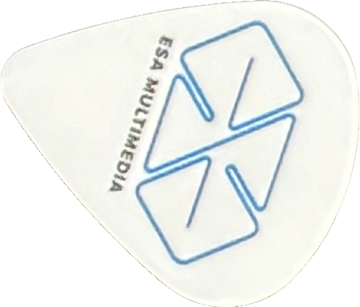

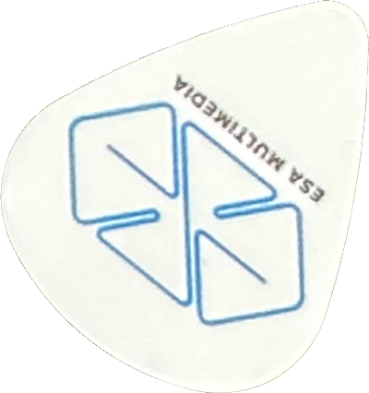
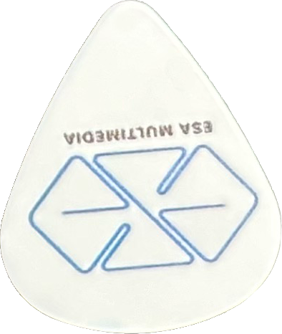
Major thanks to:
Prof. Chunshik Kim
Prof. Margaret Wilkerson
Prof. Stuart Fano
Prof. Peter Wong
Prof. Astha Thakkar
Prof. Holly Quarzo
Prof. Jason Butcher
Assoc. Chair Sam Eckersley
Dr. Latoya Moss
Michelle Garrigan-Durant
Notes:
Although my time here at SCAD will be coming to a close very soon, what I’ve learned from my experiences attending all my classes, as well as the creative input I’ve received from some of the most astounding and thought-provoking professors who have encouraged me to take things to the next level, is something that will always be a part of me throughout the rest of my life. Thank you!

Slide 59
Thank you!
Notes:
Thank you!
[hand out guitar picks]

Slide 60
Bibliography
Balaguer, J., (2024, March 6). Interview email response. https://drive.google.com/file/d/1GRPGOzeqmvz9SYS9eppHk40F3Jqd9lZC/view?usp=sharing
Balaguer Guitars. (n.d.). Retrieved March 21, 2024, from https://www.balaguerguitars.com/
ethanAart. (n.d.). Retrieved March 21, 2024, from https://ethanaart.com/
EventBrite All Access. (2023, August 29). Guide to Experiential Marketing (+ Examples). https://tinyurl.com/2u355hj9
EventBrite. The Complete Guide to Experiential Marketing. Retrieved May 9, 2024, from https://shorturl.at/dioFY
EventBrite All Access. (n.d.). Inside Experiential Marketing: Big-Name Brands Share Secrets to Success. Retrieved May 9, 2024, from https://rb.gy/jjzh7a
Facebook Group Survey results. (2024, March 7). Ethan Candidacy Review Project — Balaguer Guitars. Private post.
Notes:
Here are my sources.

Slide 61
Bibliography
NAMM. (2023, November 28). The NAMM show welcomes pro audio’s biggest brands. https://www.namm.org/news/press-releases/namm-show-welcomes-pro-audios-biggest-brands-full-force-packed-halls-and
Psychology Today. (2023, November 20). How Visualization Can Benefit Your Well-Being. https://www.psychologytoday.com/us/blog/click-here-for-happiness/202308/how-visualization-can-benefit-your-well-being
Sherman Altshuler Family Website. (n.d.). Retrieved March 21, 2024, from https://shermanaltshuler.com/
The Hero's Journey according to Joseph Campbell - video by Matthew Winkler and Kirill Yeretsky, https://www.youtube.com/watch?app=desktop&v=d1Zxt28ff-E
Notes:
Here are my sources.
[add source for Hero’s Journey articles or YouTube video]

